Slide 1
Warm Up #10- Legal Systems
1) What is one thing that you would change about the American legal system?
2) What is an example of a good law? (either an existing one or one that you make up)

Slide 2
Development of Law & Philosophical Foundations
Essential Questions: What are the major types of law in the USA and how has the legal system developed over time? Why is it important for laws to be written down?

Slide 3
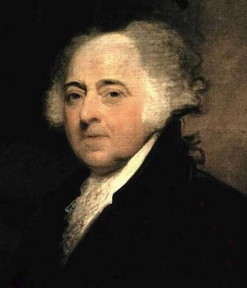
What is Law?
John Adams – “In the United States, we will have a government of laws, not of men.”
Law: a set of rules that allow peaceful living in a society.
- These rules are binding on all people (everyone must follow them).
- They are also intended to discourage people from doing bad things.
All people are equal under the law.

Slide 4
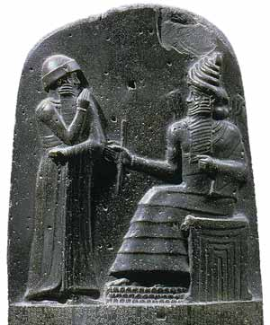
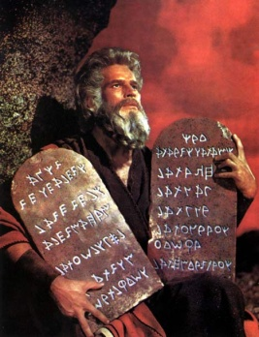
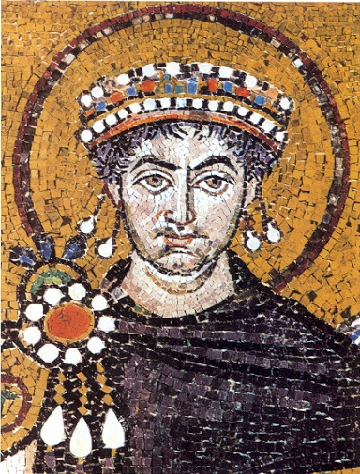
Historical Development of Law
Hammurabi’s Code (1750BC):
first written set of laws.
If laws are written and posted for all to see, then everyone has to follow the same laws.
Ten Commandments- (1446 BC)
A list of moral and religious principles
Many principles still used today
Roman Law:
- Jurisprudence: the study of law. Roman judges studied and interpreted the laws of Rome the same way our judges do today.
- Code of Justinian (528 AD): Emperor Justinian of Eastern Roman Empire has all existing laws and decrees written down in a single document.

Slide 5
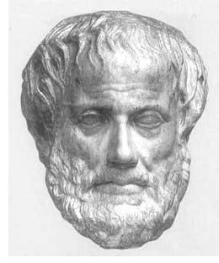
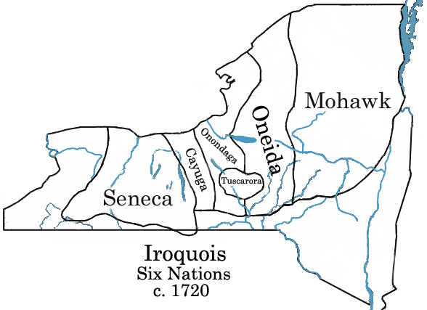
Historical Development of Law
Draconian Law- 621 BC
Written by the first lawgiver of ancient Greece
Laws were harsh and included death penalty for minor offenses
Magna Carta- 1215
England’s first document to check the power of the king
Declared people could not be deprived or lives, liberty, or property except by judgment of their peers
This is shown in the 5th Amendment of the US Constitution
Iroquois Nation Constitution- 1500
Established a confederacy of nations & participatory government
Influenced the U.S. Constitution

Slide 6
Law In Our Society Today
Why we need laws
To settle disputes between people. In modern American Law these are known as civil cases. An example is a person being bit by a dog on your property.
To discourage wrongdoers—and to set standards that are accepted by the community.
To provide order, organization, and protection. An example is a copyright law.
To protect civil liberties. These involve our basic freedoms and equality found in the Bill of Rights. It also protects us against discrimination.

Slide 7
Characteristics of Good Laws
Laws should be fair, and applied equally to all
Laws should be reasonable. The punishment should fit the crime
Laws should be enforceable. Citizens must agree to follow. An example of a law that people did not follow was the 18th Amendment.
Laws should be understandable. They should be clear and not confusing

Slide 8
Civil Liberties found in the Constitution
Due Process- These are procedures that must be followed by the government. EX. Search warrants.
Habeas Corpus- If you are arrested, you must be charged within 48 hours or be released.
Bill of Attainder- You cannot be punished without a trial.
Ex Post Facto- No law written can be retroactive, or made after the fact.
Equal Protection Under The law- The 14th Amendment guarantees equality. There will be no discrimination on the basis of race, creed, gender, age, or religion

Slide 9
Rights of the Accused
The basic principle of the American legal system is that you are innocent until proven guilty.
You will face a Grand Jury. If there is enough evidence for a trail then you are formally Indicted, or charged with that crime.
You have the right against self-incrimination. This right is given to you by the 5th Amendment. You cannot testify against yourself.
You have the right to an attorney. This right was made possible for all people by the Supreme Court case of Gideon v. Wainwright. You also have the right to call witnesses. If you are called as a witness you will be served with a subpoena.

Slide 10
You have the right to a speedy trial. Your case must be heard in a timely fashion. In federal cases a case must begin within 100 days.
You have the right to a trial by a jury of your peers. A petit jury consists of 6-12 members. A change in venue may be granted if it is impossible for the defendant to receive a fair trail because of too much pre-trial publicity.
You have the right to double jeopardy. That means that you cannot be tried twice for the same crime. Exceptions are cases on appeal, and mistrials or a hung jury.
You have the right to appeal the verdict (decision) of the jury.

Slide 11
Punishment and Fines
Bail- is the sum of money that allows the accused to stay out of jail until the end of the trial. A judge sets the bail at the arraignment.
No Cruel or Unusual Punishments- this is guaranteed by the 8th Amendment. No whippings, or any type of torture is allowed.
Capital Punishment- this is the death penalty. It is legal for states to have the death penalty if they follow the guidelines set forth by the Supreme Court.

Slide 12
Legal Duties of all US Citizens
To serve on a jury if called. Locally a summons will be issued by the Sheriff’s Department ordering you to appear on a certain time and date at the County Courthouse. This will usually last about one week. Most jobs will pay you for jury duty.
To testify in court as a witness
To appear in court as a witness

Slide 13
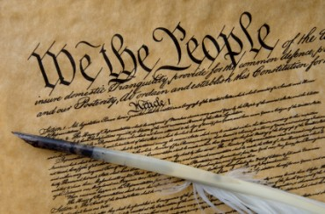
Types of Law
English Law:
- Common Law: based on traditions and precedent. Not all laws written down.
- Trial by jury.
- Innocent until proven guilty.
US Constitution (Constitutional Law):
- Titles of nobility outlawed.
- Specific powers granted to the government.
- Specific rights guaranteed to citizens.

Slide 14
Types of Law
Criminal Law: Prevent people from deliberately or recklessly harming others or other’s property.
Civil Law: disputes between people or groups when no law has been broken. Disputes get settled in a court case called a lawsuit.
- Tort: a civil case where injury occurs because of negligence.
- Family Law: Divorce, custody, child support, adoption.
Administrative Law: describes how executive agencies of the Federal government function.
Statutory Law: laws for states. Ex: speed limits, alcohol laws, food inspection.
International Law: deal with geographic areas outside of a single country (oceans) and agreements between two or more countries.
- The World Court: settles disputes between two or more nations. Also prosecutes war criminals.

