Slide 1
Types of Government
Why do we have governments and what are the different forms they take throughout human history?

Slide 2
Need For Government
Government: The ruling authority for a community or society. Any organization with the power to make and enforce laws for its members.
Functions of Government:
1. Keep order: prevent conflicts; settle them when they occur
2. Provide security: military and police
3. Provide public services: keep public healthy and safe. Ex: fire departments, driver’s licenses, test water

Slide 3
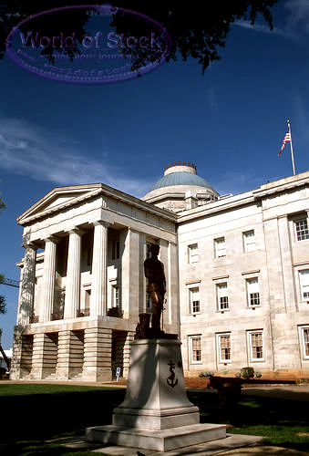
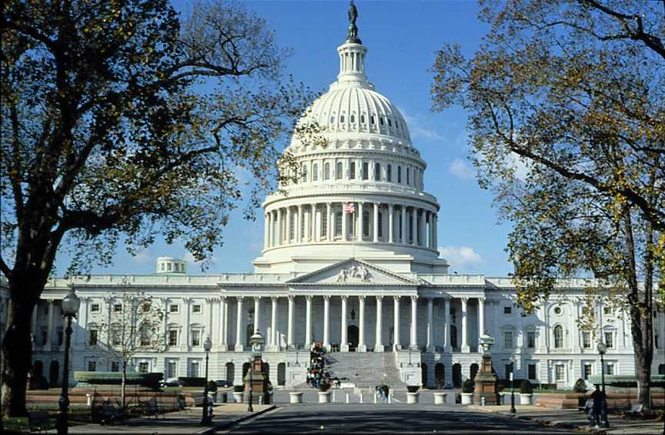
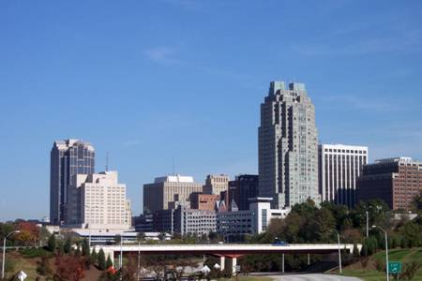
Levels of Government
National: The government of an entire country. In the USA, the national government is also called the Federal Government.
State: The government of a specific region or area of a country; in the USA we call these states. Other countries call them provinces, prefects, regions, etc.
Local: The government of a small area, usually a county, city, or town.

Slide 4
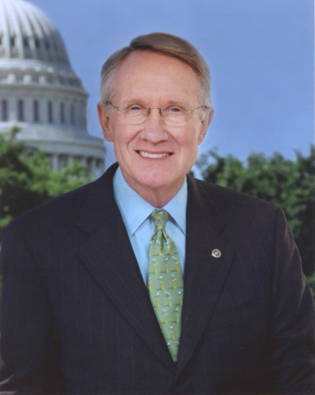
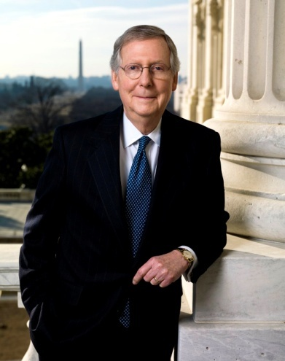
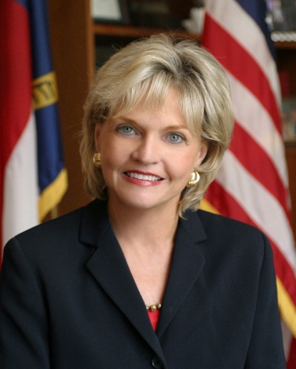
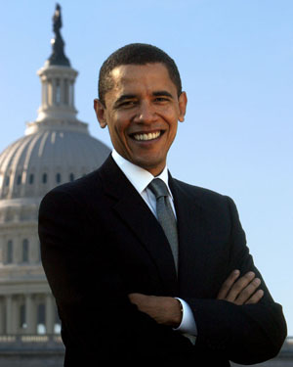
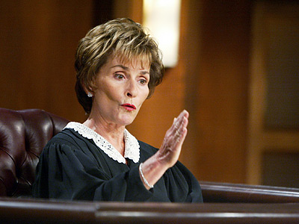
Branches of Government
Legislative: Makes laws
-Ex: US Congress, NC General Assembly
Executive: Enforces laws
- President Barack Obama, Governor Pat McCrory
Judicial: Interprets laws
- Courts

Slide 5
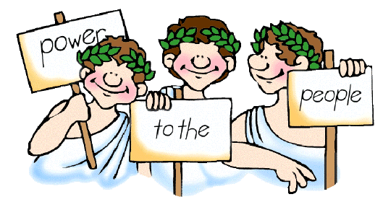
Types of Government
Democracy: Government by the citizens/people
-Direct Democracy: All citizens have the chance to vote for any law or action.
- Representative Democracy: citizens elect people to represent them in making government decisions.

Slide 6
Other Types of Government
Monarchy: a King or Queen controls the entire government and makes all decisions
Constitutional monarchy: the King or Queen shares power with a legislative body, often called Parliament
Dictatorship/Autocracy/Totalitarian State: A single ruler completely controls the government and all decision-making. This person usually came to power by military force.
Theocracy: Government is controlled by religious leaders
Oligarchy: Government of the few; often a small group of wealthy nobles/aristocrats

Slide 7
Types of Government cont…
Anarchy- When there is no government and chaos reigns---usually a stepping stone until another form of government takes over

Slide 8
English Political Traditions
What aspects of the English government do we use in the US today?

Slide 9
The Magna Carta
England’s government has historically been a monarchy
The Magna Carta: In 1215, King John I was forced to sign a document called the Magna Carta which guaranteed certain rights to the citizens of England. Important rights established by the document and adopted by the US government include:
1. Accused people are guaranteed a trial with a jury. They are presumed innocent until proven guilty.
2. All citizens are guaranteed justice
3. All citizens, regardless of class, must follow the same laws and will be punished in the same way if they break a law.

Slide 10
The Parliament
The Parliament: Originally a group of advisors to the monarch, the Parliament slowly took on more and more power. Today the Parliament has all powers of government in England.
“The Glorious Revolution”: In 1688, Parliament forced the King out of power and installed his daughter and her husband (William and Mary) as the rulers of England. This event established the Parliament as stronger than the monarch.
Following the Glorious Revolution, the Parliament passed the English Bill of Rights. Important parts of the English Bill of Rights are 1) members of Parliament elected 2) no cruel and unusual punishment

Slide 11
Common Law
England’s laws have not always been written down in the way that we have today. This type of system is called Common Law.
Common Law: A system of law based on customs and precedents.
Precedent: a decision or ruling in a court case which is used as a basis for similar cases.

Slide 12
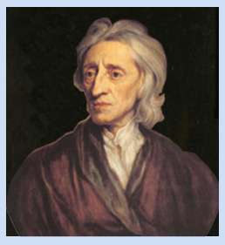
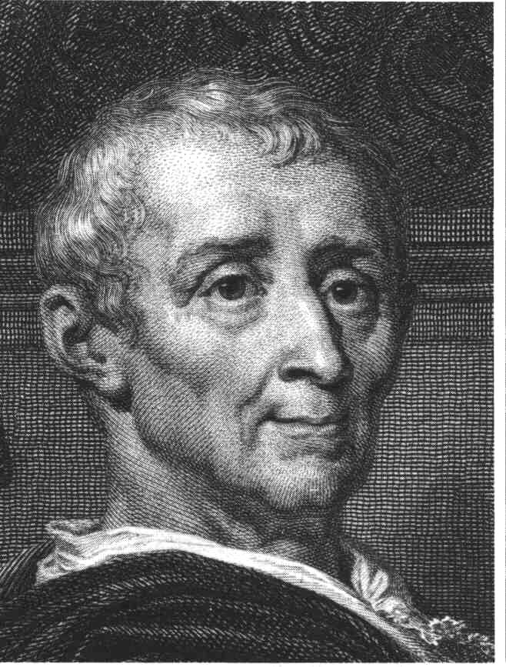
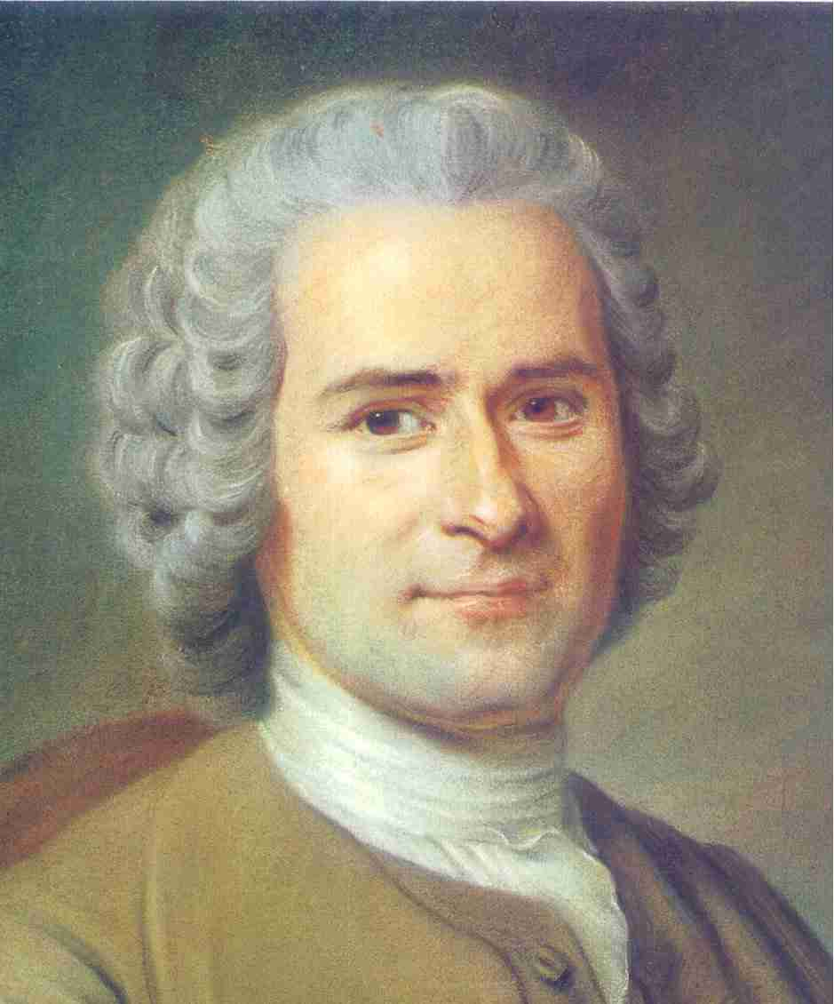
Enlightenment Philosophy
The Enlightenment was a time when people in Europe began to question the traditional ideas about government and power, and came up with new ideas about who should be involved in government.
Several important writers of the 1700s helped pave the way for the American Revolution.

Slide 13
John Locke
The most important Enlightenment philosopher in the design of the government of the United States.
Natural Rights: purpose of government is to protect the natural rights of citizens; these rights are “life, liberty, and property”
Social Contract: people in a society agree to give up some of their freedom in exchange for protection of their natural rights by a government—Thomas Hobbes

Slide 14
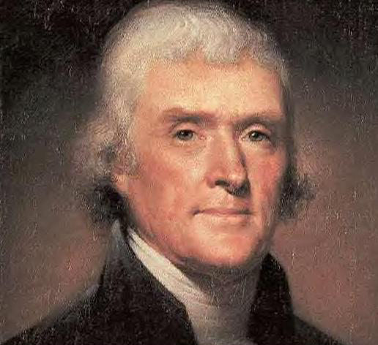
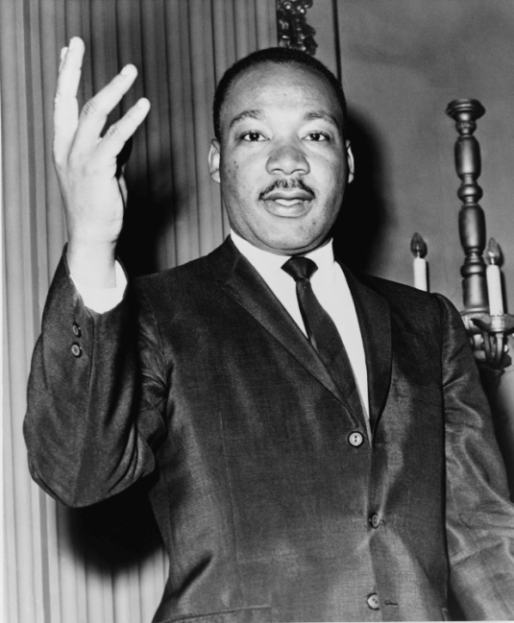
Montesquieu and Rousseau
Baron de Montesquieu: Separation of Power → powers of government should be divided into branches (Legislative Branch: Makes Laws; Executive Branch: Enforces Laws; Judicial Branch: Interprets Laws)
Jean-Jacques Rousseau: “All Men Are Created Equal”

