Slide 1
The Articles of Confederation
Essential Question: In what ways did the Articles of Confederation attempt to correct the problems of the colonial period?

Slide 2
We’re Independent! …Now what?
After the colonies declared independence in 1776, they had to go to war against Great Britain.
Ultimately, the colonies won the war so now we were free from British control to establish our own, new government.

Slide 3
Wanted: Weak Central Government
The former colonies were now called “states”. Each state wrote their own Constitution, but there were still some things that individual states could not provide on their own – like a military.
So, the founding fathers realized that we need to create a central government.
We were fearful of a strong central government because we had just fought a war to break away from a controlling government.

Slide 4
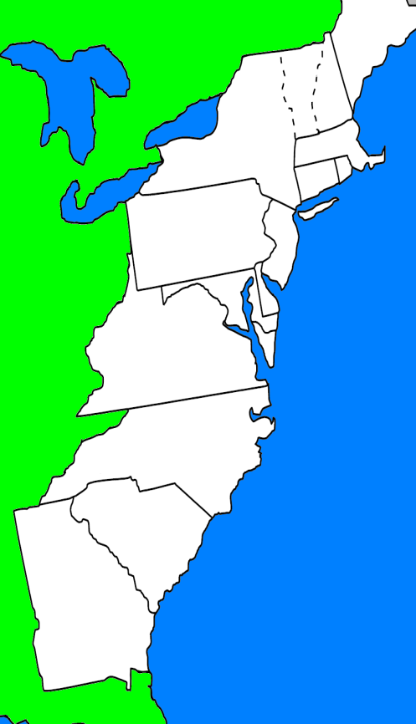
A “Confederation”
“League of Friendship” - Cooperation between states
The new states decided that they should form a weak central government to provide an army and to deal with foreign countries.

Slide 5
The Articles of Confederation
Structure of the new government:
Most powers were left up to the individual states
No Executive Branch
No Court System
One branch called Congress
Congress could not: collect taxes, regulate trade, or enforce laws
In order to pass laws, Congress had to get approval from 9 of the 13 states, which was very difficult. Any changes to the Articles had to be approved by all 13 states – nearly impossible!
Had to rely on the states to create military and because they couldn’t control the states, the military was almost non-existent.

