Slide 1
The Constitutional Convention
How did the American colonists attempt to fix the problems of the Articles of Confederation?

Slide 2
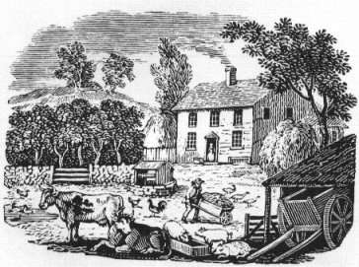
Problems Facing the Young Nation
Just like the British in the French & Indian War, the USA faced a very high debt after the Revolutionary War
The national government could not impose taxes, so the individual states placed high taxes on their citizens. This caused many businesses to fail, and many people lost their property because they could not pay back their loans.

Slide 3
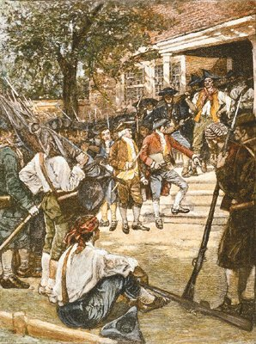
Shays’ Rebellion
Daniel Shays lost his farm in Massachusetts and then raised an army that marched through the countryside. They tried to prevent farms from being seized by the courts.
The national government had a very difficult time stopping the rebellion, and people began to think that the government was too weak to protect them.

Slide 4
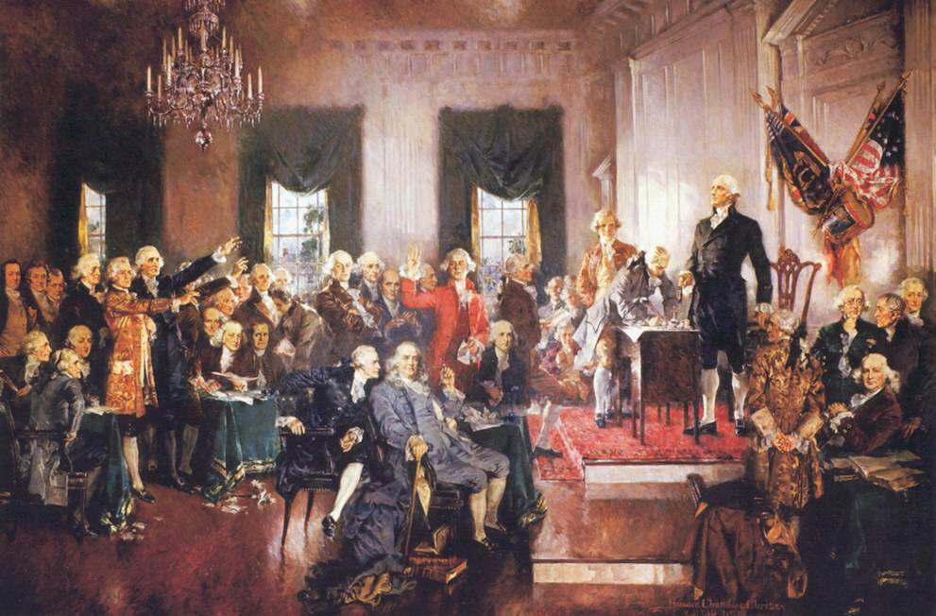
Constitutional Convention 1787
Delegates from 12 states meet in Philadelphia to revise the Articles of Confederation. They quickly decide to throw out the Articles and start over.
They made George Washington the head of the convention and decided to keep everything they were doing secret during the convention.

Slide 5
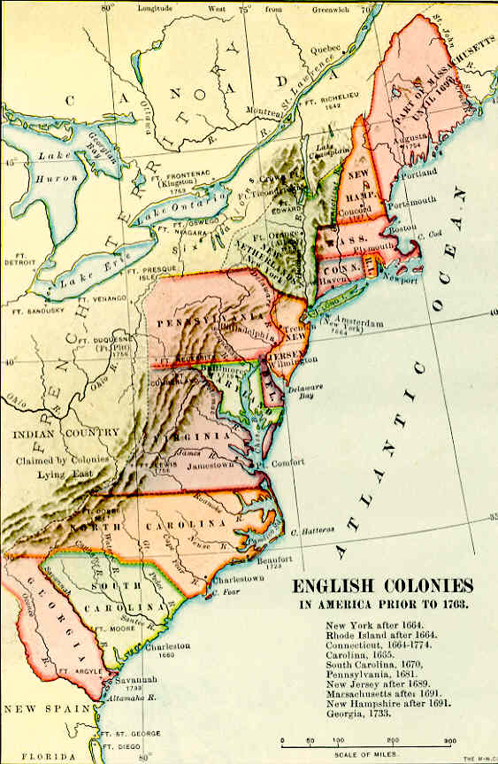
Two Competing Plans
Virginia Plan: supported by states with a large population
1. Bicameral legislature
2. Representation based on population: large states have more representatives and more power.
New Jersey Plan: supported by states with a small population
1. Unicameral Legislature
2. Equal Representation: 1 state, 1 vote

Slide 6
Compromises
Delegates from the small states threaten to leave the convention
Great Compromise/Connecticut Compromise
1. Bicameral Legislature
2. Senate with equal representation→ 2 per state
3. House of Representatives with representation based on population
Three-fifths Compromise
1. Southern states want slaves to be counted as part of their population. Northern states opposed to this because it makes slave states more powerful
2. Decide that three out of every five slaves will count in a state’s population

Slide 7
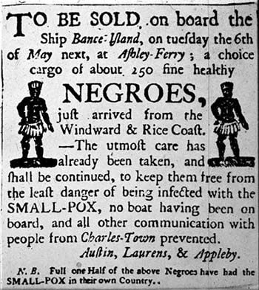
Trade/Commerce Compromise
1. Northern states want the national government to be able to regulate trade. Southern states concerned that this regulation will include taxes on exports and laws against the slave trade
2. National government given the power to regulate trade, but cannot put a tax on exports. Also cannot pass new laws about the slave trade for 20 years.

Slide 8
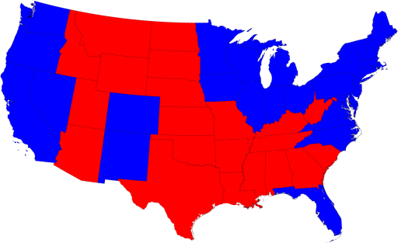
Presidential Compromise
Who will choose the President?
1. Constitution writers do not trust regular people to make a good choice about the Presidency
2. Answer the question with the Electoral College → State legislatures choose electors who meet together to decide the President.

Slide 9
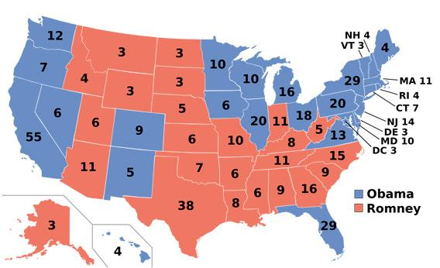

Slide 10
Ratification of the New Constitution
Ratify = Approve
¾ of states (9 out of 13) must ratify the Constitution before it will take effect
Federalists: Group that supports ratification. Named for the concept of Federalism → a system of government where the national a state governments share power
Anti-Federalists: Group that opposes the Constitution. Anti-Federalists believe the Constitution makes the national government too powerful and does not adequately protect citizens.

Slide 11
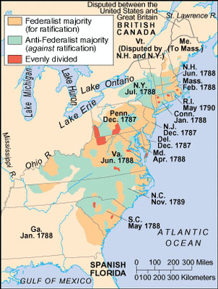
Finally Ratified…
After a year of arguing, the Federalists agree to add a Bill of Rights to the Constitution if the Anti-Federalists will support ratification
July 21, 1788: New Hampshire becomes the 9th state to ratify the Constitution and it becomes the official plan of government for the USA.
NC did not ratify until over a year later. We were the next to last of the original states to ratify.

Slide 12
Federalist/Anti-Federalist Practice
Supported new Constitution
Only small, local govt. can ensure rights/freedoms
National gov. should be strong
There should be no national army during peacetime
A Bill of Rights is needed to protect freedoms
Alexander Hamilton, James Madison, John Jay
Feared the Const. created too powerful a fed gov.
US should be able to provide for common defense at all times

Slide 13
Federalist Papers (#10/#71)
What Anti-Federalist concern is Madison addressing in Federalist #10?
How does Madison refute that concern?
What Anti-Federalist concern is addressed by Alexander Hamilton in Federalist #71?
What relationship does he place between one’s time in office and effectiveness at their job?
How does a four-year term impact the President’s relationship with the legislature?
What does Hamilton think would happen if a term was longer than four years?

