Slide 1
Warm Up
What type of government did Athens have? Sparta? How did these governments work?
Which of the early river valley civilizations does the first written code of laws come from? Which ERV civilization does the first alphabet come from? Which ERV had the first type of writing? Which ERV is famous for its great system of roads and communication?
What influenced where the early civilizations settled?
Who fought against each other in the Persian War?
What two sides fought against each other in the Peloponnesian War? Who won the war?

Slide 2
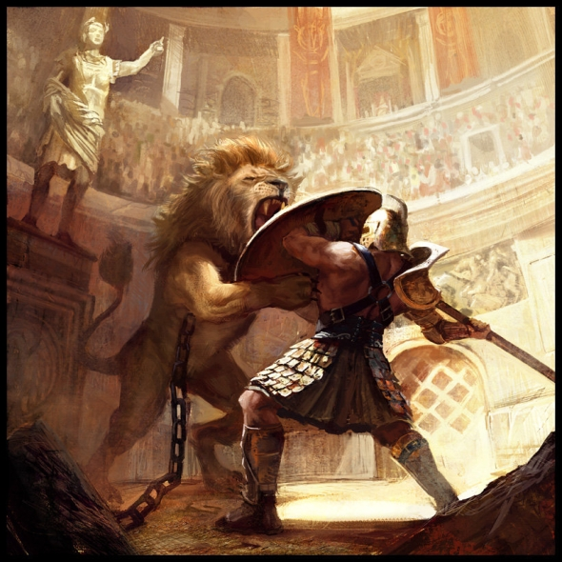
Rome
Notes:
Romulus and Remus twin brothers desendants of aeneas of the Trojan war
Put into a basket set on the Tiber rescued by a wolf and cared for until a shepherd
When they grew up they decided to build a city and fought about where to locate it
Romulus killed his bro and built the city where he wanted named it after himself and ruled for 40 years

Slide 3
The Republic
Set up a republic system of government
Patricians ran the state
Plebeians not happy
Forced patricians to write all laws down
Eventually created an unwritten constitution
Notes:
When invaders

Slide 5
Three parts of the Republic
The Senate
Controlled public finance, handled foreign affairs
Assembly
Location where citizens could vote
Magistrates
Put laws into practice

Slide 7
The Republic Expands
Rome generally treated defeated enemies with justice
Acknowledge Roman leadership
Pay taxes
Supply troops for Roman armies
Rome let them keep many of their customs and become full citizens
Led to many defeated empires remaining loyal
United their kingdom through a system of roads

Slide 8
The Republic Expands
Two Brothers
Many tensions emerged between different classes in Roman society
Tiberius and Gracchus tried to help Rome’s poor by proposing to:
Give land to the poor
Limit the size of estates (latifundias)
The senators felt threatened and the two brothers were murdered

Slide 9
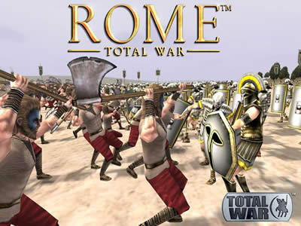
3
Rich Romans became corrupt with money and luxury and tensions between the rich and the poor caused a civil war!

Slide 10
Julius Caesar
Patrician who used politics and charm to gain position as governor of Spanish province; gained wealth, influence, and power

Slide 11
First Triumvirate
In 60 B.C. Julius Caesar joined forces with Pompey (military general) & Crassus (rich patrician who helped get Caesar started) to form the First Triumvirate (three leaders)
With help of the Triumvirate, Caesar was elected Consul; for 10 years this triumvirate controlled the Senate
Notes:
Consul is highest elected office chief executives and commanders of the army

Slide 12
Julius Caesar
Caesar only served 1 year as Consul, became Governor of Gaul where he spent 8 years defeating Gauls & attacking Brittania
Gained devotion of poor citizens & his army; Pompey & the Senate became afraid of his power & ordered Caesar to disband his army

Slide 13
Caesar refused to disband his army & instead returned to occupy Rome; defeated & assassinated his former ally Pompey
Caesar won the support of the people; In 44 B.C. named 10-year dictator:
Granted citizenship to more people, created more jobs, founded 20 more colonies (gave poor people a place to live), created a 365-day calendar, paid soldiers more, added senators

Slide 14
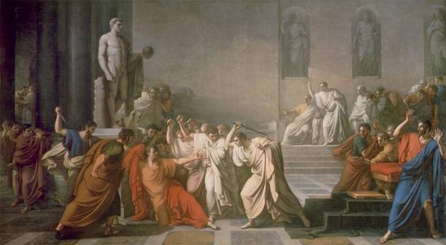

Slide 15
Second Triumivrate
Octavian (Caesar’s adopted son), Mark Antony (Caesar’s closest friend), & Lepidus (a politician) formed the Second Triumvirate to destroy Caesar’s enemies
They murdered 100 Senators & others who helped kill Caesar (or talked badly about him)
The Triumvirate ruled Rome for 5 years

Slide 16
Love and War
Rivalry ended 2nd Triumvirate; Antony had married Octavian’s sister, but fell in love with Cleopatra in Alexandria while trying to extend empire; Octavian was upset & civil war began
Octavian defeated Antony’s army; Antony & Cleopatra committed suicide

Slide 17
Beginning of the Pax Romana
Octavian created the first empire but called himself princeps
Senate gave Octavian the title of Augustus (the exalted one)
Augustus ruled Rome for 41 years

Slide 18
Pax Romana
A 207 year period of peace that started with Augustus’ reign
Rome continued to expand the empire & reached its height under Emperor Hadrian (included England, Spain, France, Holland, Greece, Egypt, Turkey, Iraq)
Roman leaders used gladiator events & chariot races to keep poor people happy

Slide 19
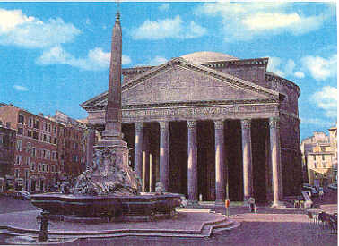
Concrete was used to make strong buildings

Slide 20
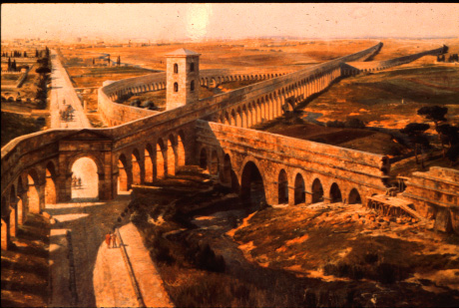
Roman Aqueduct
Roman Highway “All roads lead to Rome”

Slide 21
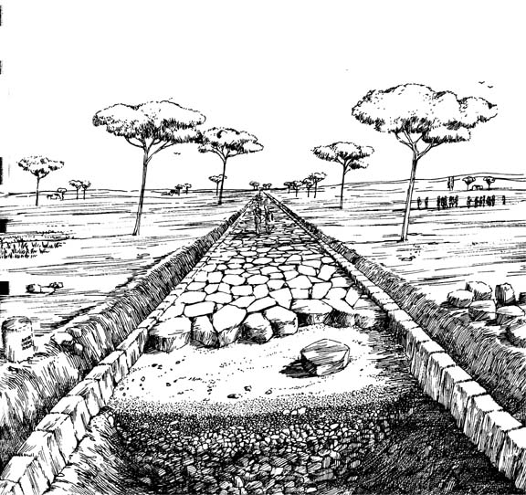
Agger: layer of small stones for drainage

Slide 22
Rudus: Middle layer of sand for stability

Slide 23
Metalling: layer of large, smooth stones for pavement; Roads were angled to allow for drainage & were of various widths

Slide 24
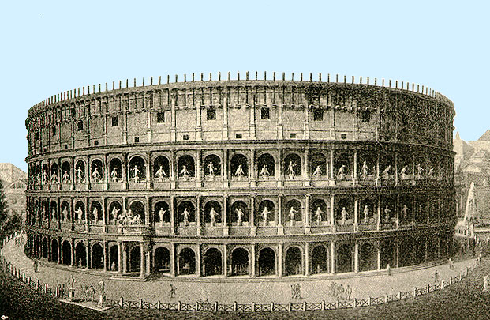
The Roman Coliseum

Slide 25
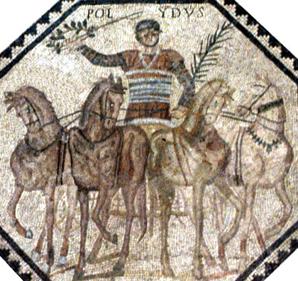
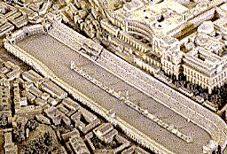

Slide 26
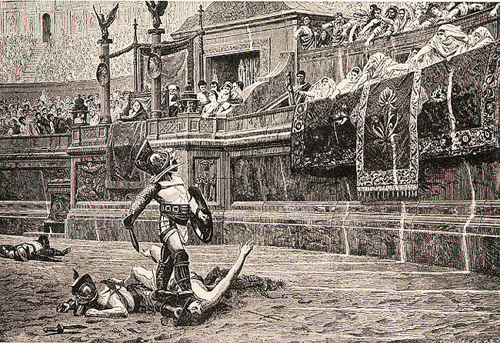

Slide 27
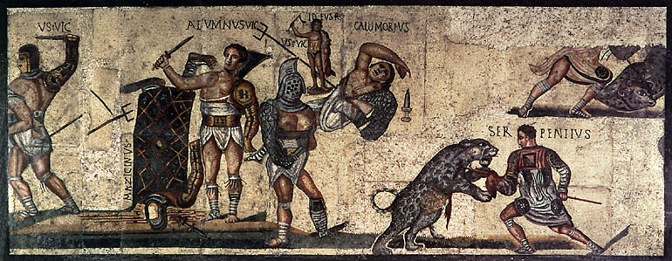
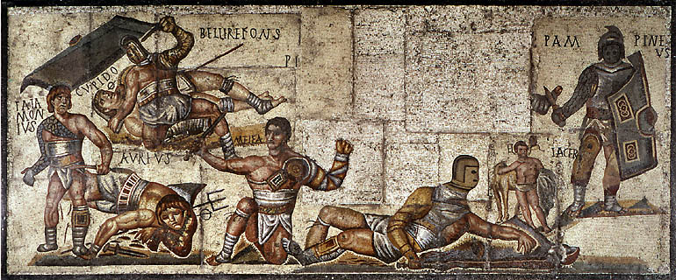

Slide 28
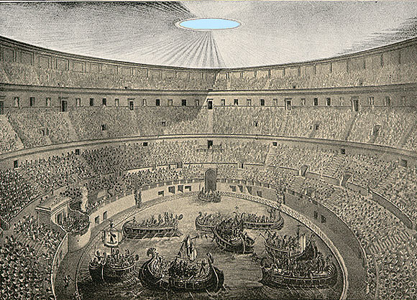

Slide 29
Christianity in Rome
Rome conquered Judea (where the Jews lived) and allowed them to keep their religion
At 30, Jesus began preaching to bring salvation and eternal life to his followers
Called self the Son of God
Jesus was condemned to be crucified by the Romans who thought him too revolutionary
After his death, Christianity began to spread
Christians still persecuted throughout Rome

Slide 30
Fall of the Roman Empire
Decline begins after the pax romana in 3rd Century

Slide 31
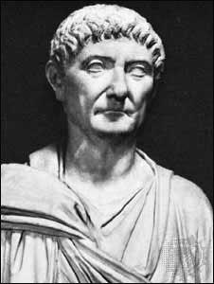
Temporary Help
Diocletian in A.D. 284 became a strong leader
He doubled the Roman armies and hired German mercenaries
Persecuted Christians
He divided the Roman empire into 2 sides
East: Greek speaking
West: Latin speaking
He took over the East, but Civil war broke out after his death

Slide 32
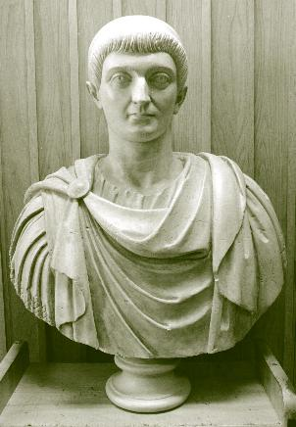
Constantine
Took over the West part of the empire in A.D. 312
Moved the capital to a strategic location in Greece in the East in Byzantium and renamed it Constantinople
He accepted Christianity

Slide 33
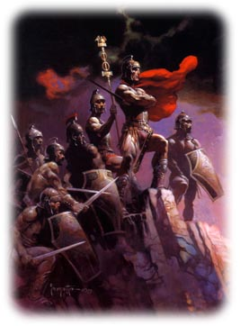
Military Troubles
Germanic tribes were invading Rome
Soldiers no longer had discipline or loyalty to Rome.
Soldiers had loyalty only to their commanders, who fought not for Rome, but to try to become the emperor.
To defend Rome, mercenaries were recruited – foreign soldiers who fought for money.
Notes:
b

Slide 34
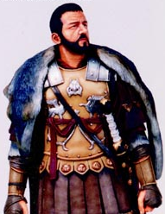
Political Troubles
Troubles in the empire made citizens lose patriotism for Rome
Being a political official was no longer thought to be an honor
Few people wanted to serve in the government
Out of 26 generals who became emperors, 25 met violent deaths.

Slide 35
Economic Troubles
Poor harvests
No more “war plunder”
Rome began making coins with less silver which caused massive Inflation
Massive gap between rich and poor—heavy taxes on small farmers
Notes:
b

Slide 36
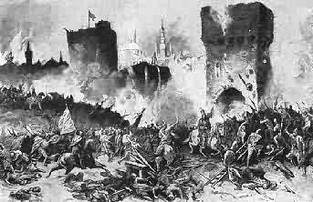
The West Falls
The west faced worse problems than the east that was further from invaders
From A.D. 376 to 476, huge numbers of Germanic tribes poured into Rome to get away from the fierce Huns
Attila the Hun was a powerful chieftain who swept through the west

Slide 37
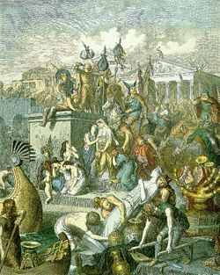
The West Falls
Germanic tribes continued to invade and finally the west was no longer Rome
But the Eastern Roman empire will continue as the Byzantine Empire that will preserve Greek and Roman heritage.

