Slide 1
Criminal Cases, Civil Cases, and Juvenile Justice
What are the steps of a trial, and how are the rights of citizens maintained through the legal process?

Slide 2
Criminal Cases
Crime: any act that breaks a law
Penal Code: the list of crimes and their punishments

Slide 3
Crimes Against People
Homicide: any time a person kills another person
1st degree murder: planned, premeditated, intentional murder
2nd degree murder: unplanned, intentional murder
Voluntary manslaughter: intentional murder in the “heat of the moment”; often in a moment which causes the person to temporarily lose control
Involuntary manslaughter: unintended death caused by negligence (such as a car accident)
Justifiable Homicide: self defense or when a police officer kills someone in the line of duty
Assault: threatening to injure someone
Battery: actually causing bodily harm

Slide 4
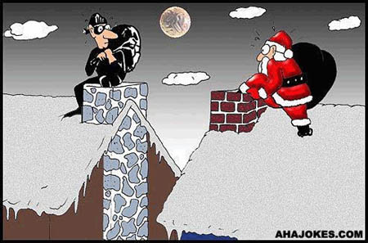
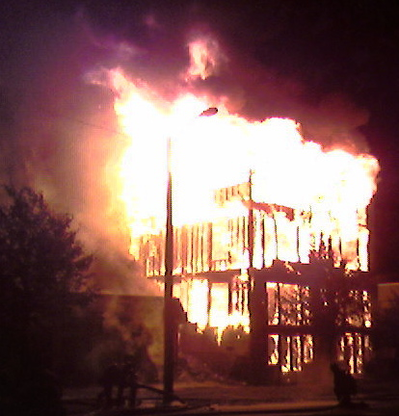
Crimes Against Property
Robbery: take someone’s property by threat of force
Burglary: take someone’s property without a threat of force
Arson: intentionally and unlawfully burning something
Vandalism: deliberate destruction of property

Slide 5
Steps in a Criminal Trial
1. Arrest
2. Preliminary Hearing: accused informed of charges and bail set
3. Grand Jury: probable cause presented and a formal charge is made in an indictment
4. Arraignment: accused is formally charged and enters a plea.
- Possible pleas: guilty, not-guilty, not-guilty by reason of insanity, no contest: don’t admit guilt but choose not to fight the charges because there is so much evidence that a jury will definitely find the defendant guilty

Slide 6
5) The Trial
Both sides gather evidence and question witnesses.
Witnesses receive a subpoena to appear in court
A jury is selected.
Prosecution makes opening statement. Defense makes opening statement.
Prosecution calls witnesses for testimony. Defense will cross-examine. Prosecution will then rest.
Defense calls witnesses for testimony. Prosecution will cross-examine. Defense will then rest.
Both sides make closing statements.

Slide 7
6) Verdict
Standard of evidence is “beyond a reasonable doubt” – jury must be sure
Acquittal: The jury decides not guilty. Defendant is released.
Convicted: If the jury decides a person is guilty, the judge will then set a date for sentencing.
Hung jury: A jury cannot make a decision. This is a mistrial.

Slide 8
7) Sentencing
Four Functions of Sentencing
1) Punishment- Punish criminals
2) Social Protection- Protect society by keeping criminals in prison
3. Deterrence- Discourage people from committing crimes in the first place
4. Rehabilitation- Prepare lawbreakers to re-enter society

Slide 9
Sentencing cont…
Some prisoners are eligible for parole after serving part of their sentence.
Parole- Early release from prison. Felons on parole must meet regularly with their parole officer until the end of their original sentence
Indeterminate sentence: Judge sets a minimum and maximum sentence.
Determinate sentence: Judge sets a specific sentence.
Mandatory sentence: Judge sets a sentence in accordance with state laws.

Slide 10
Civil Law

Slide 11
Civil Law
In civil law, a harmed individual (plaintiff) seeks to win a judgment against the accused wrongdoer (defendant).
A summons is sent to the defendant requiring them to appear in court, and they enter a plea.
Often times these cases are settled outside of court
*** The same illegal activity can be a crime & tort! ***

Slide 12
Civil Law
Civil law includes tort law.
A tort occurs when one person causes injury to another person or to another persons property or reputation.
Civil law may also include divorces and child custody cases

Slide 13
Civil Law
The question to be answered is over liability – who is responsible for the harm?
May be decided by a lone judge, or the plaintiff my request a jury if the amount involved is over $20 (7th Amendment!)
Standard of evidence here is “preponderance of evidence” – judge/jury only needs to be 51% sure

Slide 14
Civil Law
Punishment is not jail time, but rather restitution, or monetary payment
Damages may be awarded by the jury, including:
Compensatory Damages - recover damages to make up for the harm caused.
Nominal Damages – small amount of money awarded by the courts to show that the claim was justified.
Punitive Damages – amounts of money awarded to the plaintiff to punish the defendants for malicious, willful, or outrageous acts.

Slide 15
What Happens in a Civil Case?
- Plaintiff: person who was wronged and files lawsuit
- Defendant: person who is being sued
1. Complaint: plaintiff notifies court of the dispute and identifies the defendant
2. Summons: defendant notified of lawsuit
- subpoena: legal document requiring someone to appear in court (used in both civil and criminal cases)
3. Answer: defendant admits responsibility or notifies court of intention to fight the lawsuit
4. Discovery: both sides collect information, interview witnesses, and prepare case

Slide 16
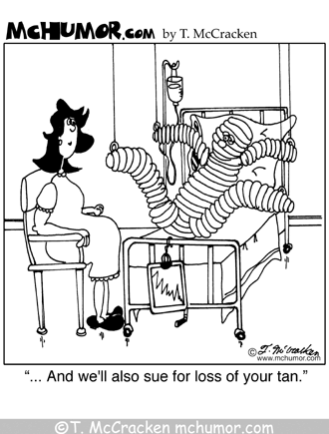
Civil Case continued…
5. Pretrial discussion: both sides meet with judge to discuss case before trial
- mediation: both sides meet with impartial mediator who suggests a solution. If either side disagrees they can go to trial
- arbitration: same as mediation but both sides agree to do whatever the arbitrator decides before the meeting
6. Trial: right to a jury if more than $20, but often just a judge because it is cheaper. Plaintiff must present a “preponderance of evidence” to win
7. Decision: if plaintiff wins, defendant pays damages; if defendant wins, plaintiff pays court costs. If there is a jury, they only need a majority decision.

Slide 17
Juvenile Courts

Slide 18
Juvenile Courts
A juvenile is anyone under the set age for an adult in a specific state.
A juvenile DELINQUENT is a juvenile who has committed a crime
You are an adult in NC at 18 HOWEVER……
The “age of consent” in NC is 16.

Slide 19
Juvenile Courts
The goal is rehabilitation, not punishment
Neglect cases: Children who are neglected or abused by caregivers.
Delinquent cases: Children who commit crimes.
At a delinquent court appearance, the child, parents, arresting officer, probation officer, lawyer, and judge meet.
No jury trial. The judge decides delinquent or non-delinquent.

Slide 20
Juvenile Rights and Protections
Parents must be notified of arrest. Charges must be written down.
Juveniles are not fingerprinted or photographed.
Right to confront witnesses.
Identity is kept secret. Records can be erased as adults.
Right to remain silent and have an attorney.
Most of these protections were established by the Supreme Court (In re Gault case).

Slide 21
Punishment for Juveniles
Lectured, placed in special schools, or probation.
Ward of the court: Court may become guardian.
Sometimes tried as adults.

Slide 22
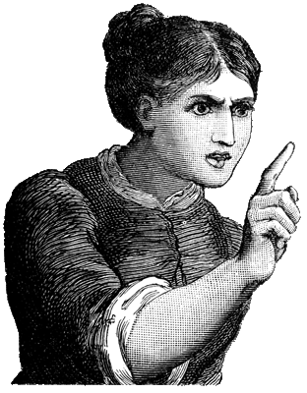
Juveniles continued…
Punishments for juvenile offenders:
- Stern lecture
- reform school
- treatment center
- probation
- juvenile detention center (prison for juveniles)
Rights of accused juveniles: right to confront accusers, be silent, have attorney, and must be notified of charges.

