Slide 1
Personal Finance Literacy
And other life skills

Slide 2
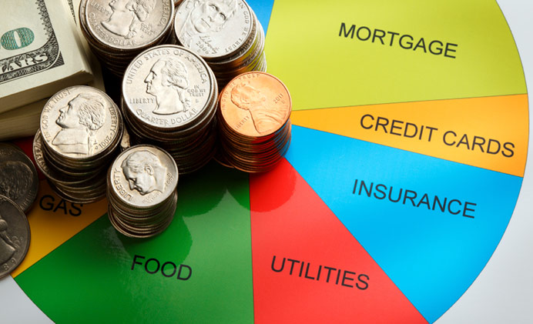
Banking and budgeting
Credit v Debit, IRA’s, CD’s

Slide 3
Interest
A percentage paid for borrowing money.
You can either owe interest if you have a credit card, or you are paid interest by the bank for keeping your money there.
On credit cards, you want low interest rates, while you would look for high interest rates when leaving your money with a bank.

Slide 4
Types of Accounts
Checking Account
No interest
Write checks, use a debit card, or withdraw cash from an ATM.
Some banks charge fees to open or require a minimum balance
Savings Account
Offer a slight amount of interest (more than a checking account)
Some banks charge fees to open or require a minimum balance

Slide 5
Types of Accounts
Certificate of Deposit (CD’s)
Similar to a savings account, except the customer agrees not to withdraw any money for a set period of time, often 6 months or one year
Individual Retirement Accounts (IRA’s)
Allows you to save money for retirement
Usually invested in the stock market in hopes that the money will grow faster than at normal interest rates.
However, does involve some risk.

Slide 6
Budgeting
Budget: A plan for how a person, family, or organization will raise and spend money.
Fixed Costs: Charges/costs that will be the same every month, no matter how often something is used.
Rent/Mortgage payments
Car payments
Variable Costs: Charges/costs that will change depending on how much of something is used.
- Food
-Travel
-Entertainment

Slide 7
Creating a Family Budget
List all of your fixed costs for each month.
Estimate your variable costs based on previous experience. (This can be difficult at first, but you will learn more as you become a more experienced consumer).
Set an amount you want to save each month and put it into your savings account as soon as you get paid.
List large purchases you may want to make this year (vacations, home improvements, etc.) and determine additional money to save to achieve these goals.

Slide 8
Debt vs. Wealth Building

Slide 9
Debt
Your debt is the money you owe to creditors. People build debt by taking loans for homes, cars, education, starting a new business, etc.
People also build debt when making purchases with credit cards. Buying on credit is like taking a small loan.
Principle: Actual cost of the good or service.
Credit limit: Maximum amount a person can buy with the promise of payment at a later time.

Slide 10
Debt
Building debt is not always bad.
Most people will need to take a loan of some kind during their lives.
Banks are more willing to offer loans, or low interest rates, to people with a good credit history/credit score.
You can build a good history/score by paying back your debts on time or early.
- Credit cards only help your score if you pay back the money quickly.
- You can also build credit by having bills and utilities in your name and paying them on time every time.

Slide 11
Building Wealth
1. Put money in savings accounts and CDs: The money will grow at a slow rate of interest, but it is guaranteed to grow.
2. Buy US Government Bonds and Treasury Bills: Similar to a CD, when you buy a US govt. bond, you can sell it back to the government years later at a much higher price.

Slide 12
Building Wealth
3. Buy a home: In most economic situations, house prices rise over time. When you buy a house, you should be able to sell it several years later for more money.
4. Invest in the Stock Market: When you buy shares of stock you are buying pieces of ownership in a corporation.
- You can make money from stocks in two ways: 1) Dividends: You get a piece of the company’s profits for owning some of the company. 2) Capital Gains: Selling your shares of stock at a higher price than when you bought it.

Slide 13
Insurance

Slide 14
Insurance
Insurance: A practice by which a company provides a guarantee of compensation for specified loss, damage, illness, or death in return for payment.
Insurance Agent: Person who sells and manages insurance policies
Claim: A demand made by the insured, or the insured's beneficiary, for payment of the benefits as provided by the policy.
Deductible: Amount of money that the insured pays before the insurance kicks in.

Slide 15
Insurance
Health Insurance: Provides money for medical care; including doctor and hospital visits, prescription drugs, rehabilitation, etc.
Life Insurance: Pays money to a beneficiary (often a family member) upon the death of the insured.
- Life Insurance is designed to help families pay for death expenses (funerals, etc.) and other expenses after the loss of income previously provided by the deceased.

Slide 16
Insurance
Automotive Insurance: Provides money in the event of a car accident. Pays for medical expenses of anyone injured in a crash, and may pay for repairs.
In NC, all licensed drivers must have insurance that covers at least $30,000 for a single person’s injuries, $60,000 for multiple persons’ injuries, and $25,000 for property damage.
Homeowner/Renter Insurance: Provides money for personal property and structural damage in the event of damage or theft.

Slide 17
Consumer Protection

Slide 18
Consumer Protection
Technology has played a major role in the issue of ID theft and has forced consumers to remain more aware of protecting themselves.
The Federal Trade Commission (FTC) is responsible for stopping unfair, deceptive, and fraudulent practices and are able to investigate and sue companies that break the law.
Don’t’ fall victim to:
Phishing Scams
Money Laundering Scams
“Guaranteed” Bank Loan or Credit Card Scam
“Robocalls”
Suspicious phone calls

Slide 19
Ways to Protect Yourself
Clear logins and passwords
Monitor your credit report
Monitor your bank and credit card statements
Shred documents with personal information
Pay for online purchases with a credit card – they typically have better guarantees under federal law than using your banking card

Slide 20
Warm Up #16
What is interest?
Rank which offers the best interest: checking, savings, CD’s
What is the difference between debit and credit?
What is an IRA used for?
Why does an IRA grow faster than a savings account or CD?
Name an example of a fixed cost.
Name an example of a variable cost.
How can debt be a good thing?
What are the two ways to make money off of a stock?
What are two ways you can build up your credit?

Slide 21
Taxes

Slide 22
W-2 Wage and Tax Statement

Slide 23
Taxes – The Basic Info
Taxes are used primarily to pay for services for citizens and all citizens must pay them.
Understanding how your income tax works and how or where to file is very important.
Filling out a W-4:
Fill this out when you get a job
Allowances and Withholdings
This is what your employer uses to determine how much you will probably pay in taxes and is to be ‘withheld’ from your check.
You must choose the number of ‘allowances’ to determine the amount of money taken from your paycheck
The more allowances, the less money that will be withheld from your paycheck

Slide 24
Taxes
Claiming Zero Allowances
The maximum amount of taxes is withheld. Meaning, when it comes time to file your tax return you will most likely receive a refund.
If you are claimed as a dependent on someone else’s tax return, you should claim zero allowances.
Claiming One Allowance (best option if you are single with one job)
If you are single and have one job, by claiming one allowance will most likely result in a refund when you file your taxes.
Claiming Two Allowances
If you are single, claiming two allowances will get you close to your tax liability but may result in tax due when filing your taxes.
If you are single and work more than one job, you can claim one allowance at each job or two allowances at one job and zero at the other.
If you are married, you should claim two allowances
Claiming Three Allowances
If you are married and have one child, you should claim three allowances.

Slide 25
Filing Your Income Tax
You will file your income tax at the end of each year based on your earned income. Your employer will provide a W2 with information needed for your tax forms.
The amount you owe is based on the current tax brackets, found on the next slide.
Lowering Your Tax Bill
You may use deductions, that are various things that can be subtracted from your taxable income.
Interest paid on your home
Property taxes
Medical expenses
Charitable contributions
Education/work-related expenses

Slide 27
Filing Your Income Tax
You have 2 options when considering deductions:
Take the standard deduction (which varies based on your income, age and filing status)
Itemize your deductions (for those with large medical bills, large charitable donations, or high state and local taxes)
Tax Credits are also another way to lower your tax bill. Examples include:
Child Tax Credit
Earned Income Credit
Elderly and Disabled Credit

Slide 28
Buying a Home

Slide 29
Buying a Home
Start with your credit score – a strong credit score will help in getting a better interest rate for your house.
Determine how much you can afford – you can easily find an online calculator or ask to be pre-approved by a lender.
You’ll probably need a good chunk of cash for a down payment and closing costs.
Use a real estate agent and search for a home!
Make an offer, sign the contract, and secure your loan.
Have the home inspected and secure the deal!
Mortgage – monthly house payment
Escrow Account – a bundled account that includes your mortgage, property taxes, and home insurance.
Typical loans include 15 or 30 years.

Slide 30
Buying a Car

Slide 31
Buying a Car
Similar to a house, your credit score will impact your ability to purchase a car.
Co-signing with a trustworthy person will improve your chance of getting a loan with a low interest rate.
Things to keep in minds:
Research the car you want before you go shopping. Websites like KBB usually help.
It usually is a better idea to purchase a used car rather than a new one.
You can often negotiate prices, so don’t get bullied!
Leasing is an option but may not be the best choice
A car lease is allows you to “rent” a car without having to take out a loan. However, after the lease is over you must return the car.

Slide 32
Financing a Car
Car loans typically range from 3-5 years. The shorter the loan time, the more your monthly payments will be.
Some car dealerships offer 0% financing, meaning you will pay no interest, but will be left with a large monthly payment.
This typically requires a large down payment.
APR – Annual Percentage Rate – is a yearly charge (rather than monthly) that is applied to your loan.

Slide 33
Resume Building and job interview skills

Slide 34
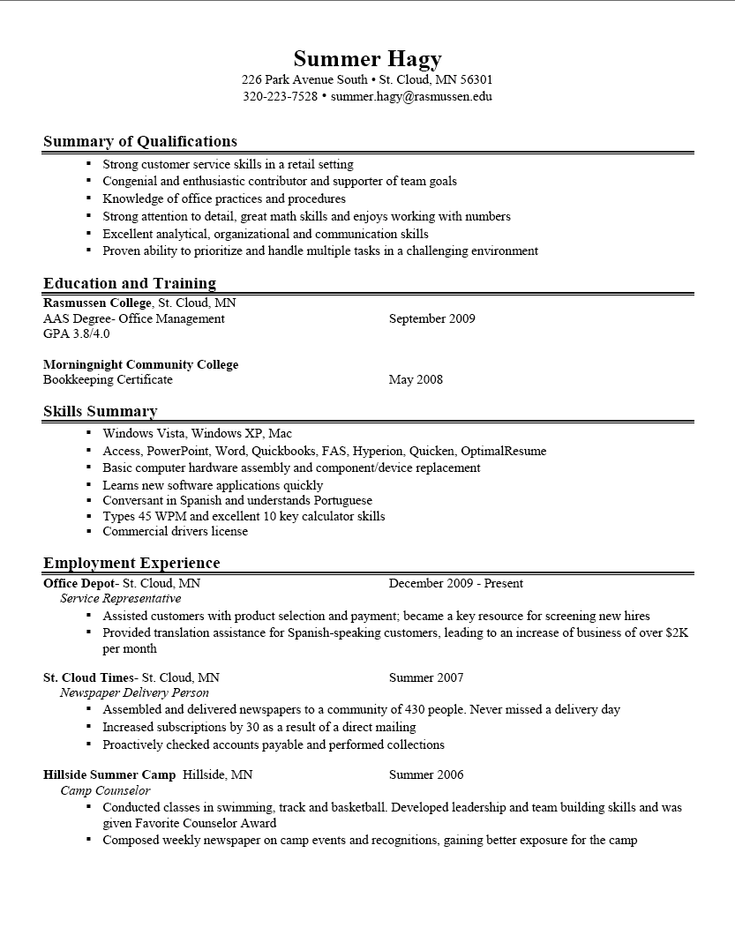
Resume Building

Slide 35
Resume Tips
To Do’s
Make yourself sound as good as possible
Include your objective, education, past jobs, other relevant skills
Use specific details if possible
BAD- I help the manager
GOOD- I assist the manager with tasks such as interacting with clients, helping make the schedule, etc…
Do Not Do
Include a picture of yourself
Make something incredibly complicated that cannot be viewed in easily in Word
Include unnecessary personal information
Using vague language (Good communication skills, creative, people person, etc…)

Slide 36
Social Media
If you are applying for a job, clean up your social media accounts/make them private!
It really is the first place employers/decision makers will look before scheduling an interview
It’s not a good look if you are on twitter talking about how much you hate your current job or doing illegal things

Slide 37
Interview Tips
Dress professionally and show up early
Be polite to everyone—including secretaries and other assistants, if you are a jerk they will tell their bosses
Conduct research on your employer ahead of time
What is the name of the company?
Who are you interviewing with?
What does the company do?
What is their mission statement/who is the CEO?
Sell yourself—blunt honestly can hurt you
Ask insightful questions at the end to show interest
Follow up by thanking the interviewer via Email/Postal Mail/other appropriate correspondence

Slide 38
Common Interview Questions
What are your three biggest strengths?
What are your three biggest weaknesses? How are you working to overcome them?
Tell me about a time you overcame a tough situation.
Why should we hire you?
Tell me about a time you learned from one of your mistakes.
What are three adjectives you’d use to describe you?
What is your greatest accomplishment?
Where do you see yourself in five years?
What is most important to you about your workplace?
Do you have any questions for me?

