Slide 1
Elections
What is the easiest way for citizens to influence the government?

Slide 2
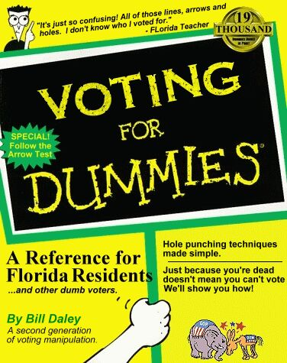
Who Can Vote?
In order to vote, you must be a US citizen, 18 years old, not in prison, and registered to vote.
Some convicted felons lose the right to vote forever. In NC, felons can vote when they have completed their sentences.
You can get registration materials many places including libraries, schools, and county election offices.
You can also register at the DMV when you renew your driver’s license.

Slide 3
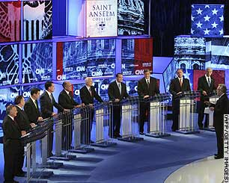
Presidential Election Process
1. Debates/Campaign
2. Primary elections: Registered voters choose the candidate.
Caucus: Meeting of party members to decide candidates (sometimes done instead of a primary election)
Open: Party membership not required to vote.
Closed: Only registered party members may vote.

Slide 4
Presidential Election Process
3. The candidate for each party is announced at the National Convention.
States choose delegates to attend the convention according to population.
Each state has a different method for allocating delegates
Proportional, winner take all, must get at least 15% in a district to get any delegates, etc…
The chosen candidate chooses a running mate for VP. (Ticket)
3 ½. More campaigning and debates!
4. General Election – people vote
5. Electoral College vote

Slide 5
Political Campaigns and Propaganda

Slide 6
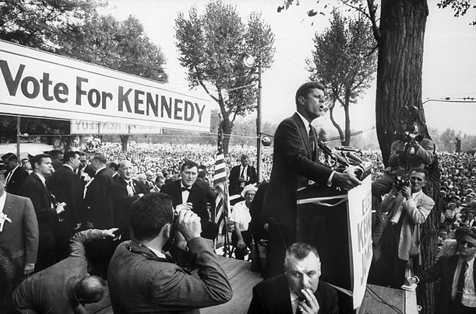
Campaigns
Over $4 billion are spent every four years on political campaigns.
Canvassing: people go door to door to promote a candidate
Endorsements: celebrities and public officials publicly support a candidate.
Advertising and Image Molding: candidates use many techniques to convince potential voters of what type of person they are.

Slide 7
Financing Campaigns
Political Action Committees (PACs): Fund raising organizations.
Presidential Election Campaign Fund: Tax payers check a box on tax forms.
Political parties hold elaborate dinners to raise money.
Individual donors contribute money.

Slide 8
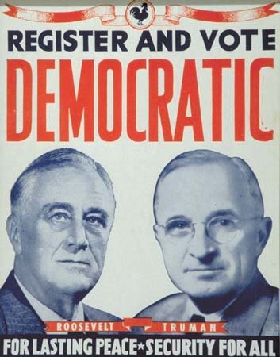
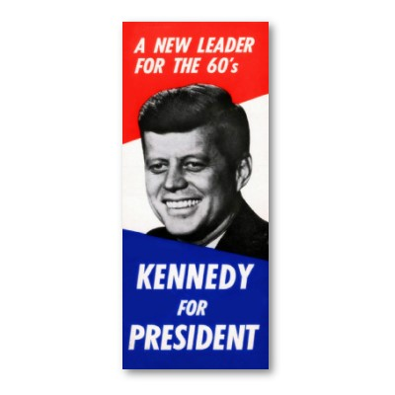
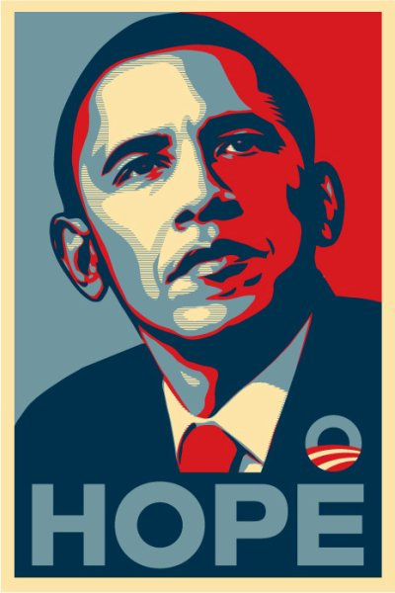
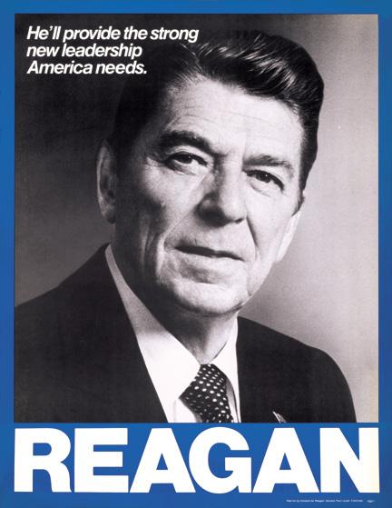
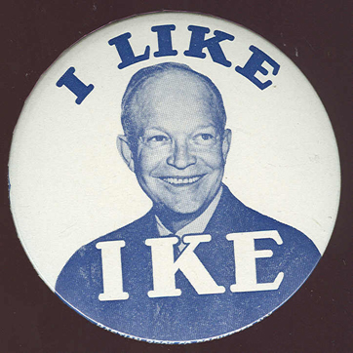
Presidential Campaign Posters

Slide 9
Propaganda
Information and ideas deliberately spread in order to affect people’s opinion of a person, group, or issue.
Types:
- Print: Posters, magazines, mailings, etc.
- Radio: Audio only ads played on the radio.
- Video: commercials and other informational programs played on TV or the Internet.

Slide 10
Propaganda Techniques
Glittering Generality: Use attractive, but vague words that make speeches and other communications sound good, but in practice say nothing in particular.
Plain Folks: Make the leaders look just like mom'n'pop-style ‘plain folks’.
Bandwagon: Make it appear that many people have joined the cause already, and that they are having lots of fun or getting significant advantage.

Slide 11
More Techniques
Card-Stacking: Candidate lists accomplishments and statistics showing their capabilities.
Name-Calling: Information is presented to intentionally discredit the opponent or the ideas of an opponent.
Transfer/Symbol: Candidate is shown with common symbols of America (flags, eagles, Statue of Liberty, etc.). Designed to make candidate look patriotic.
Endorsements: Candidate is given support by well known people

Slide 12
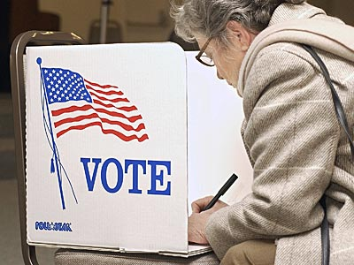
Voting Process
Each county is divided into pieces of equal population called precincts. Registered voters are assigned a precinct with a polling place based on where they live.
After proving their identities, voters complete their ballot by choosing one candidate for each open office.
Straight ticket: vote for the same party in each race.
Split ticket: vote for different parties on same ballot.

Slide 13
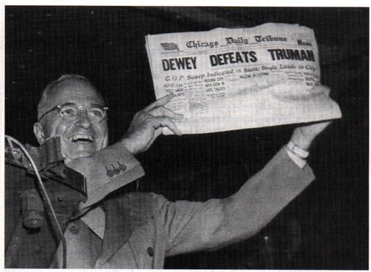
Process continued…
If unable to reach the polling place on election day, a voter can complete an absentee ballot and mail it in.
Winners of races are determined by counting all ballots, but many media outlets guess (called making a projection) on who has won a race based on a percentage of the votes called exit polls.
This can sometimes cause people not to vote. Also, these projections can be wrong.

Slide 14
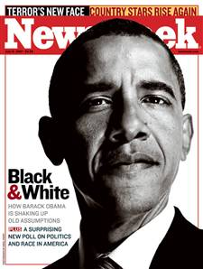
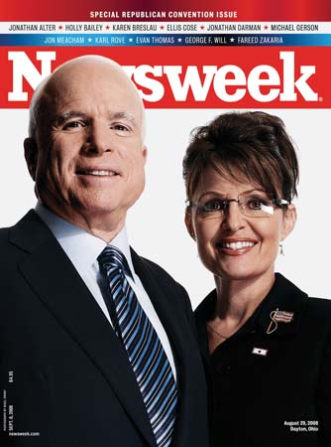
Who to Vote For?
Stay informed with TV, magazines, newspapers, and the Internet.
Questions to consider:
1. Does the candidate share your same views?
2. Is the candidate reliable?
3. Is the candidate experienced?
4. Will the candidate be effective?
5. Does the candidate have a chance to win?

Slide 15
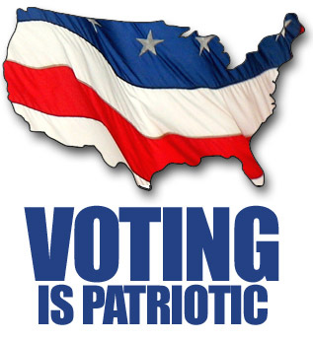
Types of Elections
General elections: decide people who will fill positions in government. Always takes place on the first Tuesday after the first Monday of November in even years.
- Who elected?: President every four years; all members of House and 1/3 of Senators every two years; several members of State and Local government.
Issue Elections: decide government issues other than who will take part. Can take place any time of year.
- Initiative: voters decide to support or reject a new law.
- Referendum: voters can decide to overturn an existing law.

Slide 16
Voter Apathy
Voter Apathy- A perceived lack of caring among voters in an election
-Can lead to low turnout
-Turnout is MUCH higher in Presidential election years than in other elections when in actuality local elections have a bigger impact on your life
-Tends to be highest among younger voters
-Voter turnout had decreased steadily from the
1960’s before returning above 60% in 2008

Slide 17
Interest Groups
Interest group: People who share a similar point of view.
Strength in numbers – they use this to influence lawmakers
Bring issues to the public and lawmakers.
Support candidates who favor their goals..
Often biased (one-sided point of view)

Slide 18
Types of Interest Groups
The most common type are economic groups—which seek some sort of monetary advantage for their members
Business Organizations: Interested in trade relationships (Chambers of Commerce, American Petroleum Institute)
Industrial and trade: Represent certain types of businesses.
Labor unions: Interested in the rights of workers (AFL-CIO)
Professional associations: for different jobs
There are groups for ethnic (NAACP), age (AARP) and gender (NOW).
There are groups that focus on specific causes (NARAL- National Abortion Rights Action League).

Slide 19
Lobbyists
Lobby: Try to get government officials to support a groups goals.
Lobbyists are people that try and gain support and influence lawmakers.
Usually hired by different interest groups
Spend a lot of time researching issues in order to persuade lawmakers. They are frequently invited to speak in congressional committees.
They try and arouse public opinion encouraging the public to communicate with elected leaders.

