Slide 1
Warm Up
Define and give an example of the following terms:
-Command Economy
-Market Economy
-Mixed Economy
What are similarities and differences between socialism and communism? How do these two differ from capitalism?

Slide 2
Demand, Supply and Market Equilibrium
What are “demand” and “supply” and how do they work together to determine the prices of goods and services?

Slide 3
Demand
Market: An arrangement through which potential buyers and sellers come together to exchange goods and services. Supply and demand together make a market
Demand - The desire, willingness, and ability on the part of people to buy certain quantities of a product at different price levels.
Individual demand is how many goods a single person is willing to buy at any price.
Market demand is how many goods all people are willing to buy.

Slide 4
Demand Schedule
Price per Frosty | Quantity Demanded per day
2 | 4
1.50 | 8
1 | 13
.50 | 19
.25 | 25
A demand schedule is a table that lists the various quantities of a product or service that someone is willing to buy over a range of possible prices.
Demand Schedule for Wendy’s Frosties

Slide 5
Demand Graph
A demand schedule can be shown as points on a graph.
The graph lists prices on the vertical axis and quantities on the horizontal axis.
Each point on the graph shows how many units of the product or service an individual will buy at a particular price.
The demand curve is the line that connects these points.

Slide 6
The Mighty Demand Curve

Slide 7
Market Demand Schedule and Curve
Price (monthly bill)
120
Cell phone service price (monthly bill)
Cell phone subscribers (millions)
100
$ 124 3.5
$ 92 7.6
$ 73 16.0
80
$ 58 33.7
$ 46 55.3
60
$ 41 69.2
Demand
40
0
10
20
30
40
50
60
70
Quantity (millions of subscribers)

Slide 8
Market Demand Schedule and Curve
Price (monthly bill)
The height of the demand curve at any quantity shows the maximum price that consumers are willing to pay for that additional unit.
120
100
For example, when 16 million units are consumed, the value of the last unit is $73.
80
60
Demand
40
Quantity (millions of subscribers)
0
10
20
30
40
50
60
70

Slide 9
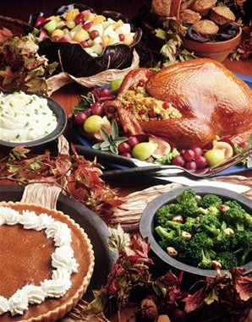
Law of Demand
The Law of Demand: A law stating that as the price of an item rises and other factors remain unchanged, the quantity demanded by buyers will fall; as the price of an item falls and other factors remain the same, the quantity demanded by buyers will rise.
For this reason, the demand curve always slopes downward
Utility: the pleasure, usefulness, or enjoyment we get from using a product.
Principle of Diminishing Marginal Utility: Each additional unit of a product is less valuable than the one that came before it

Slide 10
Changes in Demand
When consumers decide to buy more or less of an item at all possible prices we experience a change in demand. If demand increases, the demand curve shifts right. If demand decreases, the demand curve shifts left.
6 things can cause demand to change:
1. Change in income of consumers
2. Change in population
3. Change in attitudes and tastes of consumers
4. Change in consumer’s expectations
5. Change in availability and prices of substitute goods.
- Substitute Good: A good that can be used in the place of/instead of another good.
6. Change in availability and prices of complementary items.
- Complimentary Good: A good that is used with another good.
How changes in demand affect price: Use the graph of the demand curve to show how demand shifts change the price. If demand shifts to the right, consumers are willing to buy goods at higher prices. If the demand curve shifts left, consumers are only willing to buy at lower prices.

Slide 11
An Increase in
Demand
If DVDs cost $30 each, the demand curve for DVDs, D₁, indicates that Q₁ units will be demanded.
Price (dollars)
If the price of DVDs falls to $10, the quantity demanded of DVDs will increase to Q₂ units (where Q₂ > Q₁).
30
Several factors will change the demand for the good : shift the entire demand curve).
20
As an example, suppose consumer income increases. The demand for DVDs at all prices will increase.
10
After the shift of demand, Q₃ units are demanded at $10 instead of Q₂ (Q₃ > Q₂ > Q₁).
D₁
D₂
Quantity (DVDs per year)
Q₁
Q₂
Q₃

Slide 12
Decrease in Demand
The Demand Curve shifts inward
Price
$30
D₁
D₃
Q₂
Q₁
Quantity Demanded (per day)

Slide 13
Elasticity of Demand
Elasticity of demand: A measure of the responsiveness of quantity demanded to a change in price.
If a change in the price of an item has a very big effect on the quantity demanded, then the demand is elastic.
- Most goods that are not considered essential are demand elastic. People will buy a lot of candy if it is 10 cents per candy bar, but they will buy almost no candy if it is $2 per bar.
- Other examples: cars, goods with substitutes, expensive items, purchases that can be postponed
If a change in the price of an item has little effect on the quantity demanded, then the demand is inelastic.
- Goods that are considered essential tend to be inelastic Examples: salt, sugar, turkey in late November or Frasier Firs in late December;
- Oil has traditionally been inelastic but that fact appears to be changing recently.

Slide 14
Elastic and Inelastic Demand Curves
Price
Gasoline market
When the market price for gasoline rises from $1.25 to $2.00 a gallon, the quantity demanded in the market
falls insignificantly from 8 to 7 million units per week.
$2.00
$1.25
$1.00
In contrast, when the market price for tacos rises from $1.25 to $2.00, quantity demanded in the market falls significantly from 8 to 4 million units per week.
D
Quantity (gasoline)
1
2
3
4
5
6
7
8
9
Price
Taco market
$2.00
Because taco demand is highly sensitive to price changes, taco demand is described as elastic; because the demand for gas is largely insensitive to price changes, gasoline demand is described as inelastic.
$1.25
D
$1.00
Quantity (tacos)
1
2
3
4
5
6
7
8
9

Slide 15
Supply
Supply: The ability and willingness of suppliers to make things available for sale at set prices
Opposite of Demand: Buyers buy a certain number based on the price being charged. Producers produce a certain number based on the price consumers will pay.
Law of Supply - as the price of an item rises the quantity supplied will rise; as the price of an item falls quantity supplied will fall. The higher the price of a good, the more incentive they have to sell more, so they produce more.
Supply Schedule - chart showing amounts of an item sellers are willing to sell at various possible prices.
Supply Curve - Graphical representation of a supply schedule. It generally slopes upward and to the right. This shows that at higher prices, suppliers are willing to produce more product.
Supply of Labor: Consider selling your own labor. How many hours do you want to work if you are being paid $6 per hour? What if you were being paid $20 per hour?

Slide 16
Supply Schedule/ Curve
Price (monthly bill)
Cell phone service supplied to market (millions)
Supply
Cell phone service price (monthly bill)
120
$ 60 5.0
100
$ 73 11.0
$ 80 15.1
$ 91 18.2
80
$ 107 21.0
$ 120 22.5
60
40
Quantity (millions of subscribers)
0
10
20
30
40
50
60
70

Slide 17
Changes in Supply
Supply can change just like demand can. Like demand, the curve shifts right if supply goes up and shifts left if supply goes down.
Based on Cost: changes in supply are mostly based on the costs of production because businesses want to make as much money as possible. If they can reduce costs, they supply more. Supply always moves in the opposite direction of cost.
1. Changes in costs of resources
2. Changes in productivity
3. New technology
4. Change in govt. policy: More govt. regulation (minimum wage, safety/environmental standards) increases costs, which lowers supply. Less regulation does the opposite.
5. Changes in taxes and subsidies: Taxes increase costs, subsidies lower them
- Subsidy: payment to an individual or business for a specific action Ex: corn farming
6. Changes in producer expectations

Slide 18
Changes in Supply
Increase in Supply (Outward Shift)
P
S₁
S₂
$3
13
18
Q

Slide 19
Changes in Supply
Decrease in Supply (Inward Shift)
P
S₃
S₁
$3
9
13
Q

Slide 20
A Change in Supply
If the market price for gasoline is $2.00 a gallon, the supply curve for gasoline S₁ indicates Q₁ units would be supplied.
Price (dollars)
S₂
S₁
$2.00
If the price fell to $1.50, the quantity supplied would fall to Q₂ units (where Q₂ < Q₁).
$1.50
If, somehow, the opportunity costs for gas manufacturers changed then the supply of gas would change.
$1.00
Consider the case where the cost of crude oil (an input in gasoline production) increases.
Q₃
Q₂
Q₁
Quantity (units of gasoline per year)
The supply of gasoline at all potential market prices would fall. Now at $1.50, Q₃ units are supplied (where Q₃ < Q₂ < Q₁).

Slide 21
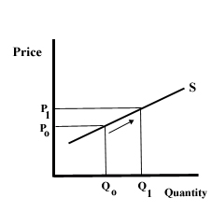
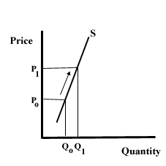
Elasticity of Supply
How much does a change in price affect the amount supplied?
Supply Elastic: Producers offer many more goods as prices rise. Ex: goods that require little investment/money to increase production like candy.
Supply Inelastic: Producers don’t change amounts offered very much as price changes. Ex: goods that need a lot of money to increase production like oil.

Slide 22
Supply and Demand at Work
Markets bring buyers and sellers together.
The forces of supply and demand work together in markets to establish prices.
In our economy, prices form the basis of economic decisions.

Slide 23
Corn Market
Price Per Bushel (in $) | Quantity Demanded per Week (thousands) | Quantity Supplied per Week (thousands)
5 | 2 | 12
4 | 4 | 10
3 | 7 | 7
2 | 11 | 4
1 | 16 | 1

Slide 25
Market Equilibrium
A surplus is the amount by which the quantity supplied is higher than the quantity demanded.
1. A surplus signals that the price is too high.
2. At that price, consumers will not buy all of the product that suppliers are willing to supply.
3. In a competitive market, a surplus will not last. Sellers will lower their price to sell their goods.

Slide 26
Surplus
4

Slide 27
Market Equilibrium
A shortage is the amount by which the quantity demanded is higher than the quantity supplied
1. A shortage signals that the price is too low.
2. At that price, suppliers will not supply all of the product that consumers are willing to buy.
3. In a competitive market, a shortage will not last. Sellers will raise their price.

Slide 28
4
Shortage

Slide 29
Market Equilibrium
When operating without restriction, our market economy eliminates shortages and surpluses.
1. Over time, a surplus forces the price down and a shortage forces the price up until supply and demand are balanced.
2.The point where they achieve balance is the equilibrium price. At this price, neither a surplus nor a shortage exists.
Once the market price reaches equilibrium, it tends to stay there until either supply or demand changes.
1. When that happens, a temporary surplus or shortage occurs until the price adjusts to reach a new equilibrium price.

Slide 30
Market Equilibrium
7

Slide 31
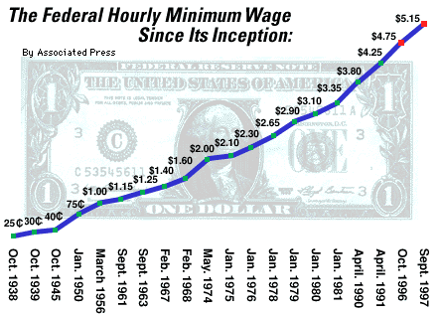
Price Controls
The government sometimes regulates prices if they think the market will result in unfair prices.
- Price Ceiling: maximum price that can be charged Ex: rent
- Price Floor: Minimum price than can be paid Ex: minimum wage

Slide 32
Prices as Signals
Prices are signals that help businesses and consumers make decisions.
1. WHAT → Producers focus on goods and services that consumers are willing to buy at prices that yield a profit.
2. HOW → To stay in business, a supplier must find a way to provide a good or service at a price consumers will pay.
3. FOR WHOM → Some businesses aim their products at a small # of consumers that will pay high prices, others at a large # of consumers that will pay a low price.
Characteristics of Price system
1. Prices are a compromise
2. Prices are flexible.
3. The price system provides for freedom of choice.
4. Prices are familiar.

