Slide 1
Foundations & Types of Laws
Essential Questions: What are the major types of law in the USA and how has the legal system developed over time? Why is it important for laws to be written down?

Slide 2
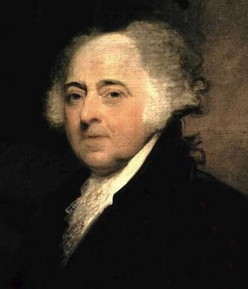
What is Law?
John Adams – “In the United States, we will have a government of laws, not of men.”
Law: a set of rules that allow peaceful living in a society.
- These rules are binding on all people (everyone must follow them).
- They are also intended to discourage people from doing bad things.
All people are equal under the law.

Slide 3
Law In Our Society Today
Why we need laws
To settle disputes between people. In modern American Law these are known as civil cases. An example is a person being bit by a dog on your property.
To discourage wrongdoers—and to set standards that are accepted by the community.
To provide order, organization, and protection. An example is a copyright law.
To protect civil liberties. These involve our basic freedoms and equality found in the Bill of Rights. It also protects us against discrimination.

Slide 4
Characteristics of Good Laws
Laws should be fair, and applied equally to all
Laws should be reasonable. The punishment should fit the crime
Laws should be enforceable. Citizens must agree to follow. An example of a law that people did not follow was the 18th Amendment.
Laws should be understandable. They should be clear and not confusing

Slide 5
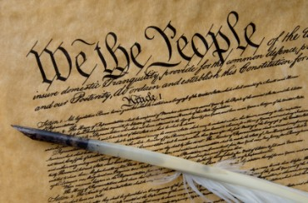
Types of Law
English Law:
- Common Law: based on traditions and precedent. Not all laws written down.
- Trial by jury.
- Innocent until proven guilty.
US Constitution (Constitutional Law):
- Titles of nobility outlawed.
- Specific powers granted to the government.
- Specific rights guaranteed to citizens.

Slide 6
Types of Law
Criminal Law: Prevent people from deliberately or recklessly harming others or other’s property.
Civil Law: disputes between people or groups when no law has been broken. Disputes get settled in a court case called a lawsuit.
- Tort: a civil case where injury occurs because of negligence.
- Family Law: Divorce, custody, child support, adoption.
Administrative Law: describes how executive agencies of the Federal government function.
Statutory Law: laws for states. Ex: speed limits, alcohol laws, food inspection.
International Law: deal with geographic areas outside of a single country (oceans) and agreements between two or more countries.
- The World Court: settles disputes between two or more nations. Also prosecutes war criminals.

Slide 7
Criminal Cases, Civil Cases, and Juvenile Justice
What are the steps of a trial, and how are the rights of citizens maintained through the legal process?

Slide 8
Criminal Cases
Crime: any act that breaks a law
Penal Code: the list of crimes and their punishments

Slide 9
Crimes Against People
Homicide: any time a person kills another person
1st degree murder: planned, premeditated, intentional murder
2nd degree murder: unplanned, intentional murder
Voluntary manslaughter: intentional murder in the “heat of the moment”; often in a moment which causes the person to temporarily lose control
Involuntary manslaughter: unintended death caused by negligence (such as a car accident)
Justifiable Homicide: self defense or when a police officer kills someone in the line of duty
Assault: threatening to injure someone
Battery: actually causing bodily harm

Slide 10
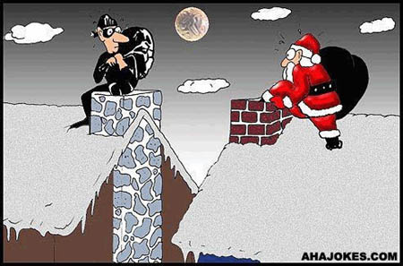
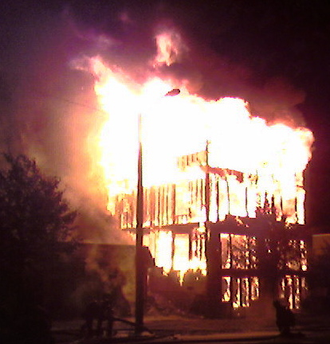
Crimes Against Property
Robbery: take someone’s property by threat of force
Burglary: take someone’s property without a threat of force
Arson: intentionally and unlawfully burning something
Vandalism: deliberate destruction of property

Slide 11
Steps in a Criminal Trial
1) Arrest
2) Preliminary Hearing: accused informed of charges and bail set
TYPES OF BAIL
Citation Release: You never really even get arrested. Simply issued an order to appear before a judge on a certain date (like with a traffic ticket).
Recognizance Release: No money needed (except to pay a lawyer). Not for high risk cases.
Cash Bond: You pay the amount and you get out of jail. Can be set high for major cases if judges don’t want you out on the street.
Surety Bond: ”Bail bond”. Accused cannot afford the cash bond so gets help through a bail bondsman. You generally pay a 10% premium to bail bondsman.

Slide 12
Steps in a Criminal Case cont…
3) Grand Jury: probable cause presented and a formal charge is made in an indictment
4) Arraignment: accused is formally charged and enters a plea.
Guilty- by far and away the most popular plea, 90%+ of cases end in plea bargains
Not Guilty
No Contest- You admit no guilt, but accept the punishment of the court. Cannot be used against you in a civil tria

Slide 13
5) The Trial
Both sides gather evidence and question witnesses.
Witnesses receive a subpoena- an order to appear in court
A jury is selected.
Prosecution makes opening statement. Defense makes opening statement.
Both sides call witnesses and cross examine the opposing witnesses (prosecution presents case first)
Both sides make closing statements.
Burden of proof is on the prosecution

Slide 14
6) Verdict
Standard of evidence is “beyond a reasonable doubt” – jury must be sure
Acquittal: The jury decides not guilty. Defendant is released.
Convicted: If the jury decides a person is guilty, the judge will then set a date for sentencing.
Hung jury: A jury cannot make a decision. This is a mistrial.

Slide 15
7) Sentencing
Four Functions of Sentencing
1) Punishment- Punish criminals
2) Social Protection- Protect society by keeping criminals in prison
3. Deterrence- Discourage people from committing crimes in the first place
4. Rehabilitation- Prepare lawbreakers to re-enter society
Recidivism- The tendency of a criminal to reoffend (how likely is a former prisoner to go back to prison)

Slide 16
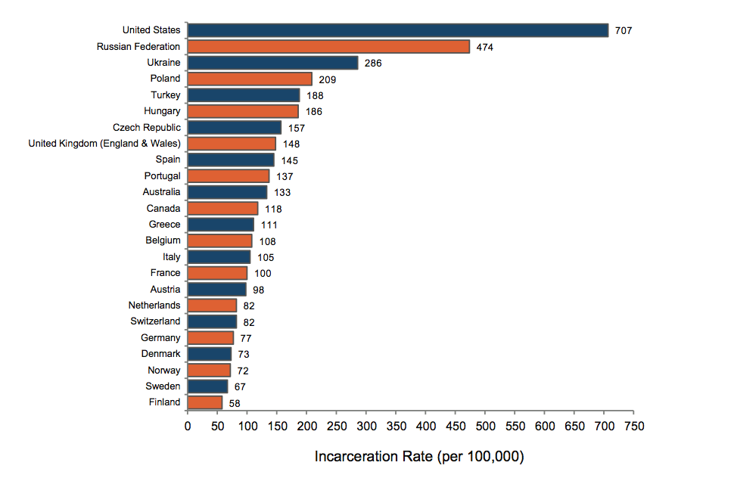

Slide 17
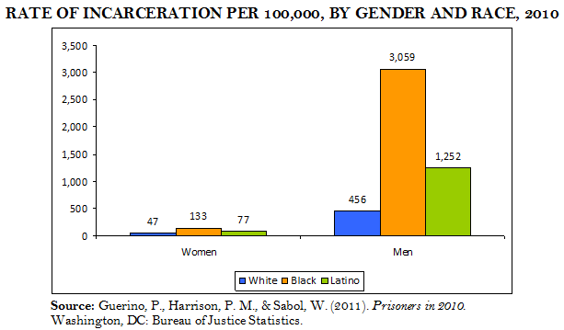

Slide 18
Sentencing cont…
Some prisoners are eligible for parole after serving part of their sentence.
Parole- Early release from prison. Felons on parole must meet regularly with their parole officer until the end of their original sentence
Indeterminate sentence: Judge sets a minimum and maximum sentence.
Determinate sentence: Judge sets a specific sentence.
Mandatory sentence: Judge sets a sentence in accordance with state laws.

Slide 19
Civil Law

Slide 20
Civil Law
In civil law, a harmed individual (plaintiff) seeks to win a judgment against the accused wrongdoer (defendant).
A summons is sent to the defendant requiring them to appear in court, and they enter a plea.
Often times these cases are settled outside of court
*** The same illegal activity can be a crime & tort! ***

Slide 21
Civil Law
Civil law includes tort law.
A tort occurs when one person causes injury to another person or to another persons property or reputation.
Civil law may also include divorces and child custody cases

Slide 22
Civil Law
The question to be answered is over liability – who is responsible for the harm?
May be decided by a lone judge, or the plaintiff my request a jury if the amount involved is over $20 (7th Amendment!)
Standard of evidence here is “preponderance of evidence” – judge/jury only needs to be 51% sure

Slide 23
Civil Law
Punishment is not jail time, but rather restitution, or monetary payment
Damages may be awarded by the jury, including:
Compensatory Damages - recover damages to make up for the harm caused.
Nominal Damages – small amount of money awarded by the courts to show that the claim was justified.
Punitive Damages – amounts of money awarded to the plaintiff to punish the defendants for malicious, willful, or outrageous acts.

Slide 24
What Happens in a Civil Case?
- Plaintiff: person who was wronged and files lawsuit
- Defendant: person who is being sued
1. Complaint: plaintiff notifies court of the dispute and identifies the defendant
2. Summons: defendant notified of lawsuit
- subpoena: legal document requiring someone to appear in court (used in both civil and criminal cases)
3. Answer: defendant admits responsibility or notifies court of intention to fight the lawsuit
4. Discovery: both sides collect information, interview witnesses, and prepare case

Slide 25
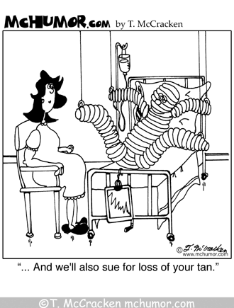
Civil Case continued…
5. Pretrial discussion: both sides meet with judge to discuss case before trial
- mediation: both sides meet with impartial mediator who suggests a solution. If either side disagrees they can go to trial
- arbitration: same as mediation but both sides agree to do whatever the arbitrator decides before the meeting
6. Trial: right to a jury if more than $20, but often just a judge because it is cheaper. Plaintiff must present a “preponderance of evidence” to win
7. Decision: if plaintiff wins, defendant pays damages; if defendant wins, plaintiff pays court costs. If there is a jury, they only need a majority decision.

Slide 26
Juvenile Courts

Slide 27
Juvenile Courts
A juvenile is anyone under the set age for an adult in a specific state.
You are an adult in NC at 18 HOWEVER……
The “age of consent” in NC is 16.

Slide 28
Juvenile Courts
The goal is rehabilitation, not punishment
Neglect cases: Children who are neglected or abused by caregivers.
Delinquent cases: Children who commit crimes.
At a delinquent court appearance, the child, parents, arresting officer, probation officer, lawyer, and judge meet.
No jury trial. The judge decides delinquent or non-delinquent.

Slide 29
Juvenile Rights and Protections
Parents must be notified of arrest. Charges must be written down.
Juveniles are not fingerprinted or photographed.
Right to confront witnesses.
Identity is kept secret. Records can be erased as adults.
Right to remain silent and have an attorney.
Most of these protections were established by the Supreme Court (In re Gault case).

Slide 30
Punishment for Juveniles
Lectured, placed in special schools, or probation.
Ward of the court: Court may become guardian.
Sometimes tried as adults.

Slide 31
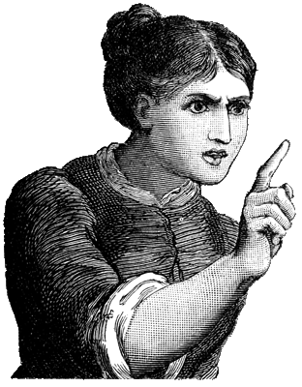
Juveniles continued…
Punishments for juvenile offenders:
- Stern lecture
- reform school
- treatment center
- probation
- juvenile detention center (prison for juveniles)
Rights of accused juveniles: right to confront accusers, be silent, have attorney, and must be notified of charges.

