Slide 1
Part III: Judicial branch- The United States Court System
Essential Questions: What are the similarities and differences between the US and NC courts in terms of structure, power, and organization? What relationship exists between citizens and the government? What relationship exists between the federal, state, and local governments?

Slide 2
US Courts
Most directly influenced by English common law.
Common law is a system of of unwritten rules or laws based on customs and traditions.
Many decisions are based on precedents.
Precedents are decisions made from a previous ruling.
Courts use the idea of judicial review
Reviewing decisions or actions made by the other 2 branches

Slide 3
Marbury v. Madison
Midnight judges: John Adams appointed several judges on his last night as President.
James Madison became Jefferson’s Secretary of State and was instructed to withhold the commissions.
William Marbury took the case to the Supreme Court as a provision of the Judiciary Act of 1789.

Slide 4
Marbury v. Madison Principles
1. Constitution is the Supreme law of the land.
2. In cases of conflict between the Constitution and any other document, the Constitution must be followed.
3. Judicial branch must uphold the Constitution and nullify all unconstitutional laws.
4. This case established judicial review.

Slide 5
Types of jurisdiction
Jurisdiction - the ability to hear a case
Original jurisdiction – the first court to hear a case
Appellate jurisdiction – the court can review a case heard at a lower court to check for errors
Concurring jurisdiction – when more than one court has the authority to hear a case
Exclusive jurisdiction – when only one court can hear a case

Slide 6
US Court hierarchy
The lowest court in the Unites States District Court.
Above the District Courts are the US Court of Appeals
The highest court in the United States is the US Supreme Court.
US Supreme Court
US Court of Appeals
US District Court

Slide 7
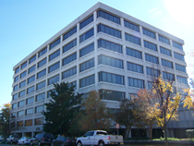
US District Courts
There are 94 US District Courts across the US.
Each District Court hears cases from that happen in their district.
DCs have Original Jurisdiction in most cases – meaning, most cases start here.
Only US court where actual “trials” are held.
Created by the Judiciary Act of 1789.

Slide 8
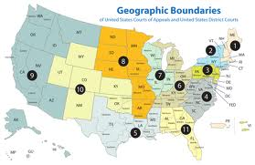
US Court of Appeals
If a case is appealed – or if one of the parties ask for the case to be reviewed, it will be heard at the US Court of Appeals.
This is called Appellate Jurisdiction.
There are 12 US Court of Appeals around the United States known as circuits.
Created by the Judiciary Act of 1789.

Slide 9
Us court of appeals
Each appeals court has from 6-27 judges. They earn $167,600 a year.
A panel of at least three judges will hear each case.
The court may:
1. Uphold the earlier ruling.
2. Overturn the decision.
3. Remand the case to a lower court for a new ruling.
Some cases will be appealed to the Supreme Court.

Slide 10
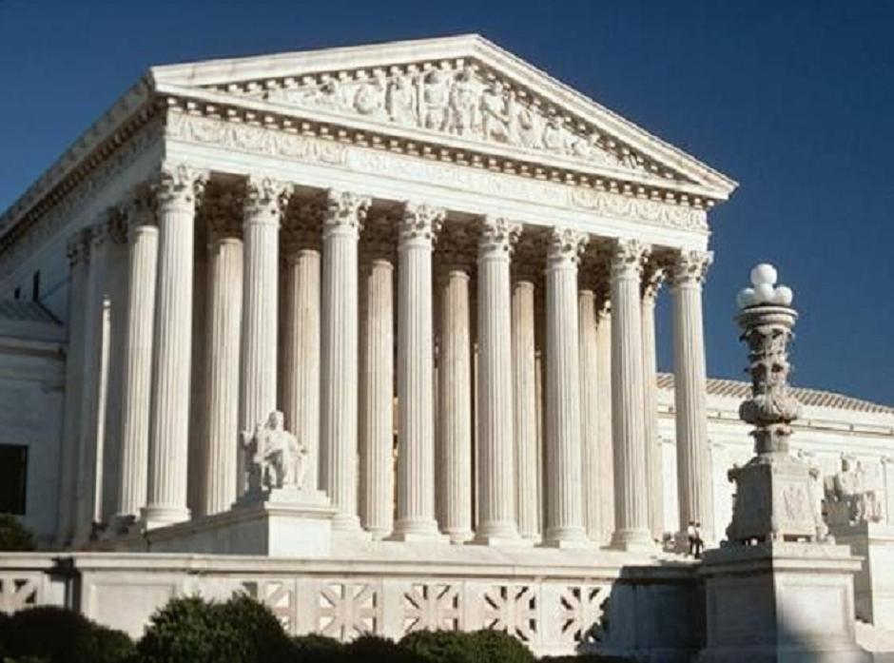
US Supreme Court
The highest court in the United States
Established by Article 3 of the US Constitution.
Any case appealed from the US Court of Appeals is heard here (Appellate Jurisdiction).
Exclusive Jurisdiction in: cases where one state sues another state, cases involving foreign diplomats
Located in Washington, D.C.

Slide 11
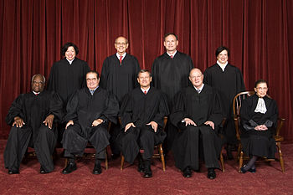
US Supreme Court
Structure of the SC
There are 9 SC Justices – 1 Chief Justice and 8 Associate Justices
Judges are appointed by the President and approved by the Senate
No listed qualifications for judges
Appointed for life – only way to “quit” is to be impeached, die, or resign
Should not be “partisan”

Slide 12
Supreme Court Schedule
First two weeks of the month, they hear arguments, discuss cases, and vote. They have a two week recess where they decide what cases to hear and write opinions on other cases. They read briefs, or arguments written by attorneys.
Four out of nine justices must vote to hear a case. It is then placed on the docket, calendar.
The case must have two adversaries, opposing sides.

Slide 13
When making a decision…
When the US Supreme Court rules in a case, we call it the court’s “opinion”.
The “winning” decision comes from the “majority” of justices agreeing, so it is called the majority opinion.
If a justice does NOT agree with the majority of the court, then they would write a different opinion called a dissenting opinion.
If a justice agrees with the majority, but for different reasons, they would write a concurring opinion explaining their reasoning.
If all of the justices agree – it’s called a “unanimous” decision.

Slide 14
The nc court system

Slide 15
Nc court hierarchy
The lowest court in NC is the NC District Court.
NC has a second trial court called the NC Superior Court.
Appeals cases from the trial courts are heard at the NC Court of Appeals.
The highest court in the state is the NC Supreme Court.
NC Supreme Court
NC Court of Appeals
NC Superior Court
NC District Court

Slide 16
Nc district court
NC’s District Court has original jurisdiction in cases involving misdemeanors, juveniles, and civil cases dealing with less than $10,000.
Cases appealed from the NC District Court go to the NC Court of Appeals.
All judges in NC are elected by the people to 8 year terms.

Slide 17
NC superior court
NC’s Superior Court has original jurisdiction in felony cases and civil cases dealing with more than $10,000.
Cases appealed from the NC District Court go to the NC Court of Appeals, except for First Degree Murder cases resulting in the Death Penalty – they go straight to the NC Supreme Court.

Slide 18
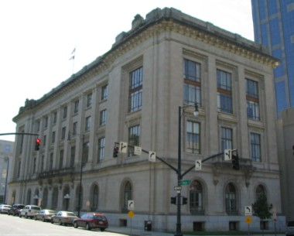
NC court of Appeals
NC’s Court of Appeals hears all reviews of cases from the District and Superior Courts. (Appellate jurisdiction)
Made up of a panel of 15 judges state wide.
Only 3 judges sit in on each case.

Slide 19
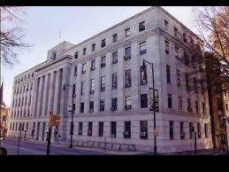
NC supreme Court
Highest court in the state
Made up of 7 SC Justices
Hear all cases appealed from the lower courts in NC

Slide 20
Important Supreme Court Cases
You will be responsible for learning several Supreme Court cases and decisions in this unit….
Take your time reviewing this information!!!!

Slide 21
Each slide includes background information about the court case to help you understand why this case was brought before the Supreme Court. However, you MUST understand the significance or conclusion of each case for your mastery assignments.

Slide 22
Marbury v. Madison
This was the first major important court case in the history of our nation because this court case………

Slide 23
ESTABLISHED JUDICIAL REVIEW!!!!!!!!
Judicial Review is the power of the Supreme Court to determine whether laws or acts of Congress are Constitutional!!!!
This court case expanded the power of the Supreme Court and defined how they were to “interpret” laws and the Constitution!

Slide 24
Plessy v. Ferguson
Facts of the Case
The state of Louisiana enacted a law that required separate railway cars for blacks and whites.
In 1892, Homer Adolph Plessy--who was seven-eighths Caucasian--took a seat in a "whites only" car of a Louisiana train.
He refused to move to the car reserved for blacks and was arrested.

Slide 25
Plessy v. Ferguson
Question Presented
Was Louisiana's law mandating racial segregation on its trains unconstitutional and a violation of the equal protection clause of the Fourteenth Amendment? (which says that the government must treat all people equally)‏
Conclusion
No. State law did not violate the Constitution
The Supreme Court established the concept of separate-but-equal (segregation of public facilities is legal as long as the facilities are equal)‏

Slide 26
Brown v. Board of Education
Facts of the Case
Black children were denied admission to public schools attended by white children under laws requiring or permitting segregation according to race.
Often, black children had to travel far to get to their school. In Topeka, Kansas, a black student named Linda Brown had to walk through a dangerous railroad to get to her all-black school. Her family believed that segregated schools should be illegal .

Slide 27
Brown v. Board of Education
Question Presented
Does the segregation of children in public schools solely on the basis of race violate the equal protection clause of the 14th Amendment?
Conclusion
Yes. Segregation of schools is a violation of the Constitution and the segregated schools were not equal as Plessy v. Ferguson required.
This court case overturned Plessy v. Ferguson and established that separate was unequal.

Slide 28
Swann v. Charlotte Mecklenburg
Facts of the Case
The decision from the Brown v. Board of Ed. case made little or no progress in the desegregation of schools.
In the Charlotte-Mecklenburg School System in North Carolina there were approximately 14,000 black students attending schools that were either totally black or more than 99 percent black
The local Courts were trying to integrate the schools but were having problems with citizens agreeing to their decisions

Slide 29
Swann v. Charlotte Mecklenburg
Question Presented
Were federal courts constitutionally authorized to oversee desegregation of state schools? (remember the power to establish and regulate schools is a reserved power!!)
Conclusion
Yes. The Supreme Court ordered that CMS use bussing in order to integrate schools and comply with the decision of Brown v. Board of Education

Slide 30
Korematsu v. US
Facts of the Case
During World War II, the President and Congress ordered that many people living in the US who were of Japanese ancestry (especially those living on the west coast) be placed in internment camps.
The government questioned whether these people might be giving information about the US to Japan.
Fred Korematsu, one of the Japanese who was arrested and moved to an internment camp, sued the US claiming that he was being discriminated against and that what the government was doing was unconstitutional.

Slide 31
Korematsu v. US
Question Presented
Did the President and Congress go beyond their war powers by forcing Americans of Japanese descent into internment camps and taking away many of their rights?
Conclusion
Yes.The Court sided with the government and said that the need to protect the US against spies and additional attacks was greater than Korematsu's individual rights. The Court also said that during times of national emergency or extreme hardships, the government has the right to limit individual rights.

Slide 32
Schenck v. US
Facts of the Case
During WWI, Schenck sent out mailers to people that had been drafted into the military telling them not to submit to military intimidation.
Schenck was arrested for attempting to cause insubordination in the military and for obstructing recruitment.

Slide 33
Schenck v. US
Question Presented
Were Schenck's actions (words, expression) protected by the free speech clause of the First Amendment?
Conclusion
No. Free speech is limited during times of war and 1st Amendment rights are not absolute depending on the circumstances.

Slide 34
Reynolds v. Sims
Facts of the Case
Many states had a very unequal distribution of voters per seat in the state legislature.
Voters in Jefferson County, Alabama challenged that in some Alabama Senate districts there were 41 times as many people voting as in other districts
Some other states had as many as 1,000 times as many voters in one district as in others

Slide 35
Reynolds v. Sims
Question Presented
Are states free to determine the representatives in their state legislatures without regard for population?
Conclusion
No. The court struck down unequal state senate representation on the principle of “one person, one vote.”

Slide 36
Furman v. Georgia
Facts of the Case
Furman was burglarizing a private home when a family member discovered him.
He attempted to flee, and in doing so tripped and fell.
The gun that he was carrying went off and killed a resident of the home.
He was convicted of murder and sentenced to death

Slide 37
Furman v. Georgia
Question Presented
Does the carrying out of the death penalty in cases such as this, where the death was accidental, constitute cruel and unusual punishment in violation of the Eighth and Fourteenth Amendments?
Conclusion
Yes. The Court deemed the death penalty cruel and unusual in cases where the death was not intentional.
The Court's decision forced many states to change the way they use the death penalty.

Slide 38
Gregg v. Georgia
Facts of the Case
A jury found Gregg guilty of armed robbery and murder. He was sentenced to death.
Gregg challenged his death sentence for murder, claiming that capital punishment (the death penalty) was a "cruel and unusual" punishment that violated the 8th and 14th Amendments.

Slide 39
Gregg v. Georgia
Question Presented
Is the imposition of the death sentence prohibited under the Eighth and Fourteenth Amendments as "cruel and unusual" punishment?
Conclusion
No. The Court held that a punishment of death did not violate the 8th and 14th Amendments under ANY circumstances.
In extreme criminal cases, such as when a defendant has been convicted of deliberately killing another, the careful and judicious use of the death penalty may be appropriate.

Slide 40
Roe v. Wade
Facts of the Case
Jane Roe (not her real name) was a pregnant female in Texas who wanted an abortion, but Texas state law prohibited abortion unless the mother’s life was in danger.
Roe argued that she had a right to privacy and should be able to decide whether or not to have an abortion.

Slide 41
Roe v. Wade
Question Presented
Are laws prohibiting abortion unconstitutional?
Should women have the right to privacy and choice when it comes to abortion?
Conclusion
A state cannot prohibit a woman’s right to an abortion.
The Supreme Court ruled that during the first 3 months of a pregnancy, abortion is legal. During months 4-6, each state determines whether abortion should be legal. During months 7-9, abortion is illegal unless the mother’s life is in danger.

Slide 42
Regents of the University of California v. Bakke
Facts of the Case
Allan Bakke, a 35 year-old white man, had twice applied for admission to the University of California Medical School.
He was rejected both times.
The school reserved 16 places in each entering class of one hundred for "qualified" minorities.
This was done as part of the university's affirmative action program, in an effort to remedy longstanding, unfair minority exclusions from the medical profession.
Bakke's qualifications (college GPA and test scores) exceeded those of any of the minority students admitted in the two years Bakke's applications were rejected.

Slide 43
Regents of the University of California v. Bakke
Question Presented
Did the University of California violate the Fourteenth Amendment's equal protection clause, and the Civil Rights Act of 1964, by practicing an affirmative action policy that resulted in the repeated rejection of Bakke's application for admission to its medical school?
Conclusion
Yes. Schools cannot use admissions quotas and admit students solely based on race.

Slide 44
Texas v. Johnson
Facts of the case
In 1984, in front of the Dallas City Hall, Gregory Lee Johnson burned an American flag as a means of protest against the Reagan administration policies.
Johnson was tried and convicted under a Texas law outlawing flag desecration (destruction).
He was sentenced to one year in jail and assessed a $2,000 fine.

Slide 45
Texas v. Johnson
Question Presented
Is the desecration of an American flag, by burning or otherwise, a form of speech that is protected under the First Amendment?
Conclusion
Yes. The Court held that Johnson's burning of a flag was protected expression under the First Amendment.
The government cannot limit a citizen’s right to burn the US flag

Slide 46
Mapp v. Ohio
Facts of the Case
While searching Dolree Mapp’s home with a fake warrant for a fugitive, police found obscene materials. Mapp was arrested and tried for possession of these illegal obscene materials.

Slide 47
Mapp v. Ohio
Question Presented
Can evidence obtained illegally through a search violating the Fourth Amendment, be admitted in a state criminal court case?
Conclusion
No. The Court declared that "all evidence obtained by searches and seizures in violation of the Constitution is, by the Fourth Amendment, inadmissible in a state court."
Simply put…..Illegally obtained evidence cannot be used against a person in court.

Slide 48
Gideon v. Wainwright
Facts of the Case
Gideon was charged in a Florida state court with a felony for breaking and entering.
He lacked funds and was unable to hire a lawyer to prepare his defense.
The court refused to give him an attorney when he requested one.
Gideon defended himself in the trial; he was convicted by a jury and the court sentenced him to five years in a state prison.

Slide 49
Gideon v. Wainwright
Question Presented
Did the state court's failure to appoint counsel for Gideon violate his right to a fair trial and due process of law as protected by the Sixth and Fourteenth Amendments?
Conclusion
Yes. In a unanimous opinion, the Court ruled that Gideon had a right to be represented by a court-appointed attorney

Slide 50
Miranda v. Arizona
Facts of the Case
Ernesto Miranda was arrested but not told his right to not confess to the crime (5th amendment - the right to no self-incrimination). He signed a confession and was convicted.

Slide 51
Miranda v. Arizona
Question Presented
Does police interrogation of individuals without notifying them of their right to have an attorney and their protection against self-incrimination violate the Fifth Amendment?
Conclusion
Yes. The Court ruled that the police must read people their rights, including warnings of their right to remain silent and the right to have an attorney present during interrogations, before being arrested.

Slide 52
Bethel School District v. Fraser
Facts of the Case
At a school assembly of approximately 600 high school students, Matthew Fraser made a speech nominating a fellow student for elective office.
In his speech, Fraser used what some observers believed was a graphic sexual metaphor to promote the candidacy of his friend.
As part of its disciplinary code, “use of obscene, profane language or gestures." Fraser was suspended from school for two days.

Slide 53
Bethel School District v. Fraser
Question Presented
Does the First Amendment prevent a school district from disciplining a high school student for giving a lewd speech at a high school assembly?
Conclusion
No. The Court found that it was appropriate for the school to prohibit the use of vulgar and offensive language. (Students do not have complete freedom of speech in school!)‏

Slide 54
Tinker v. Des Moines
Facts of the Case
The Tinker children decided, along with their parents, to protest the Vietnam War by wearing black armbands to their Des Moines schools during the Christmas holiday season.
Upon learning of their intentions, and fearing that the armbands would provoke disturbances, the principals asked the students not to wear them or they would be suspended.
When the Tinker siblings wore their armbands to school, they were asked to remove them.
When they refused, they were suspended until after New Year's Day.

Slide 55
Tinker v. Des Moines
Question Presented
Does prohibiting students from wearing armbands in public school, as a form of symbolic protest, violate the First Amendment's freedom of speech?
Conclusion
Yes. The wearing of armbands was protected by the First Amendment.
Students do not lose their right to freedom of expression when they come to school; however, their choice of expression cannot be disruptive to the school environment.

Slide 56
Engel v. Vitale
Facts of the Case
A school system in the state of New York authorized a short, voluntary prayer for recitation at the start of each school day.
The prayer read as follows: "Almighty God, we acknowledge our dependence upon Thee, and beg Thy blessings upon us, our teachers, and our country."

Slide 57
Engel v. Vitale
Question Presented
Does the reading of a nondenominational prayer at the start of the school day violate the "establishment of religion" clause of the First Amendment?
Conclusion
Yes. A school cannot require students to pray. This court case upheld separation of church and state and ruled that forced prayer in school is a clear violation of the establishment clause.

Slide 58
Hazelwood v. Kuhlmeier
Facts of the Case
Students wrote an article the principal would not allow to be published in the school newspaper because it discussed divorce and teen pregnancy.

Slide 59
Hazelwood v. Kuhlmeier
Question Presented
Did the principal's deletion of the articles violate the students' right to freedom of the press under the First Amendment?
Conclusion
No. The court ruled that schools can filter or limit information that is placed into a school newspaper.

Slide 60
West Virginia v. Barnette
Facts of the Case
West Virginia had a statute mandating that all students stand and recite the pledge daily in school
Failure to do so was considered insubordination and was subject to expulsion
As a Jehovah’s Witness, Barnette was unwilling to salute or pledge to any symbols and was expelled

Slide 61
West Virginia v. Barnette
Question Presented
Was a previous decision on the issue stating that parents needed to try and change local laws on the issue invalid?
Does forcing students to salute the flag violate freedom of speech?
Conclusion
Yes. The Free Exercise Clause prohibits public schools from forcing students to salute the flag and/or say the pledge.

Slide 62
New Jersey v. TLO
Facts of the Case
T.L.O. was a fourteen-year-old girl accused of smoking in the girls' bathroom of her high school.
A principal at the school questioned her, searched her purse and found a bag of marijuana along with other drug paraphernalia.

Slide 63
New Jersey v. TLO
Question Presented
Did the search violate the Fourth and Fourteenth Amendments?
Conclusion
No. The Supreme Court ruled that schools only need “reasonable suspicion” to search students and do not require a search warrant to do so.

Slide 64
Vernonia Schools v. Acton
Facts of the Case
School district officials in Vernonia noticed a large rise in drug use in the district with student athletes as the “leaders of the drug culture”
The district required all student athletes to submit to a random drug testing plan with all athletes tested at the beginning of the season and 10% of athletes tested every week

Slide 65
Vernonia Schools v. Acton
Question Presented
Do random drug tests violate students’ Fourth Amendment rights that probable cause be necessary for any search?
Conclusion
No. The Fourth Amendment allows for random drug testing of high school students involved in athletic programs

