Slide 1
The Legislative Branch
How does the most powerful branch of government work to represent citizens at each level of government?

Slide 2
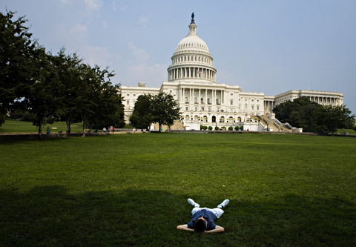
Terms of Congress
Every two years, new representatives join the Congress. They meet in sessions each year from January to November.
Usually, the two houses of Congress meet separately, but they occasionally meet together in a Joint Session.

Slide 3
The House of Representatives
435 members; must be 25 and a 7 year US citizen. Each representative serves for two years
Representation is based on population. The number of representatives of each state changes every ten years based on the census. This process is called apportionment.

Slide 4
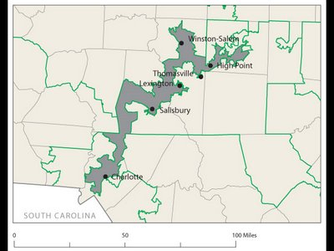
Congressional Districts
Each state is divided in parts of approximately equal population called districts. There is one representative per district. The people living in each district are called constituents.
Gerrymandering: drawing a district to favor one group over another. This is somewhat illegal.
Representatives focus on the concerns of their district rather than the whole state.

Slide 5
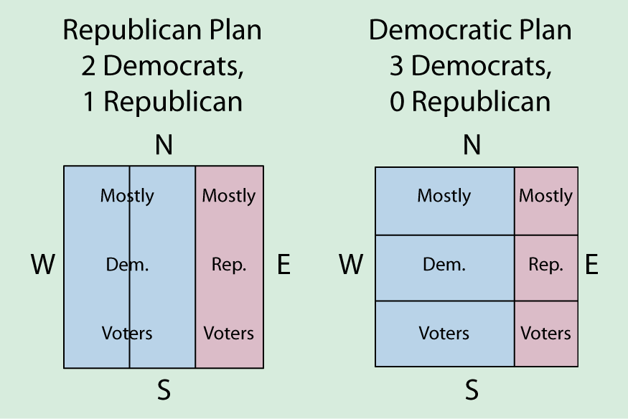
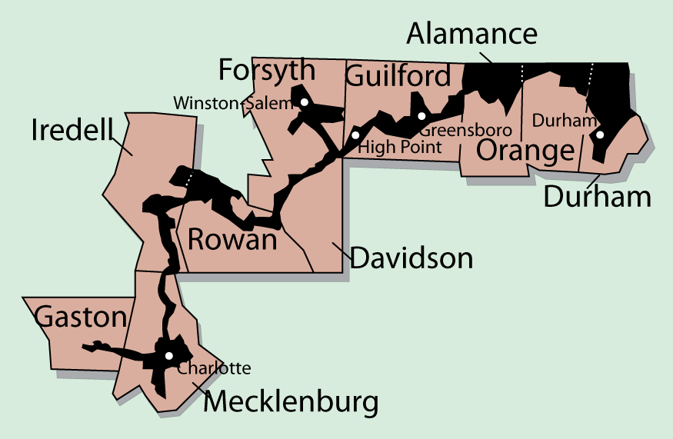
Gerrymandering
Packing Lumping opposition voters in one area
Cracking Splitting up groups of voters so they do not constitute a majority in any district

Slide 6
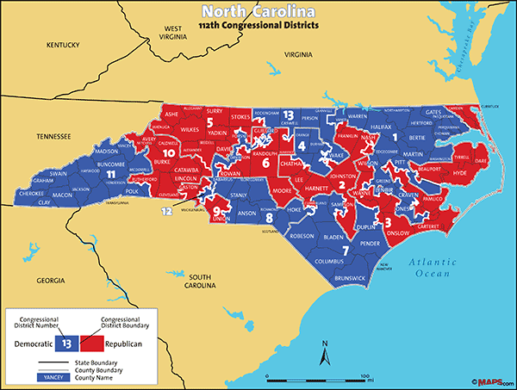
NC Congressional District Map

Slide 7
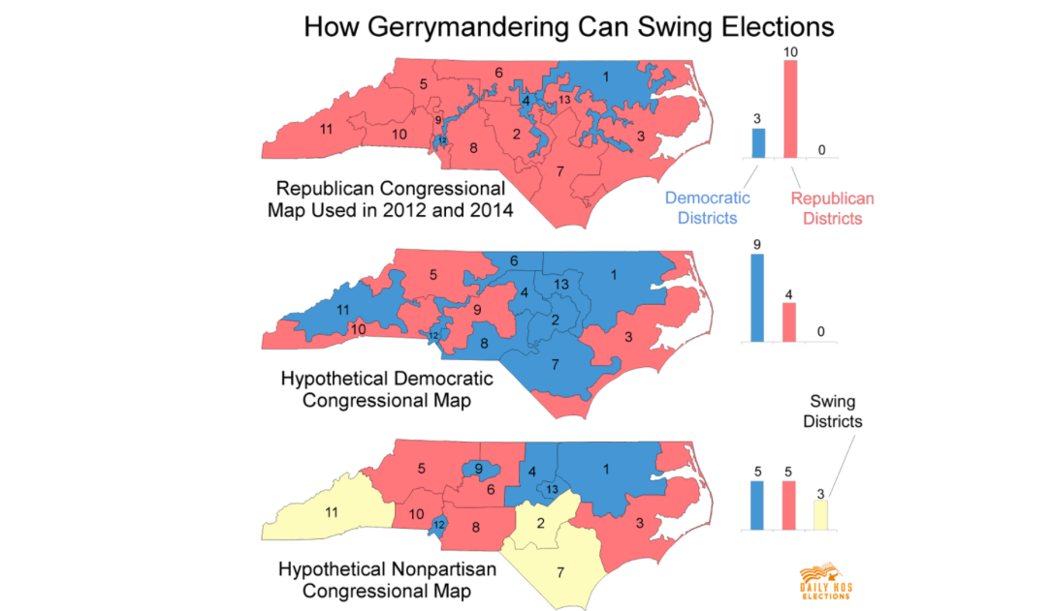

Slide 8
The US Senate
100 members; must be 30 and a 9 year US citizen. Each senator serves a six year term.
Each state has 2 senators who represent the entire state.
1/3 of senators are up for re-election every two years, so there is more consistency in the Senate.

Slide 9
Congressional Leaders
Each house of Congress has a majority party (>50%) and a minority party (<50%).
The majority party in the House of Representatives elects the Speaker of the House. This is the most powerful single person in the Congress.
Powers of the Speaker:
1. Choose which bills to address
2. Choose who will speak
3. Choose when to vote
Nancy Pelosi– Speaker of the House

Slide 10
More Leaders
The Vice President is the official leader of the Senate. He is rarely there and only gets to vote to break a tie. The day to day leader of the Senate is called the President Pro Tempore.
Each house has party leaders called the majority or minority leader. They direct members of their party to act on certain bills. The Senate Majority Leader is the person with the actual power in the Senate.
Each party also has officials called “Party Whips” who make sure members of the party are doing what has been asked of them.
Chuck Grassley
President Pro Tempore
Mitch McConnell
Senate Majority Leader

Slide 11
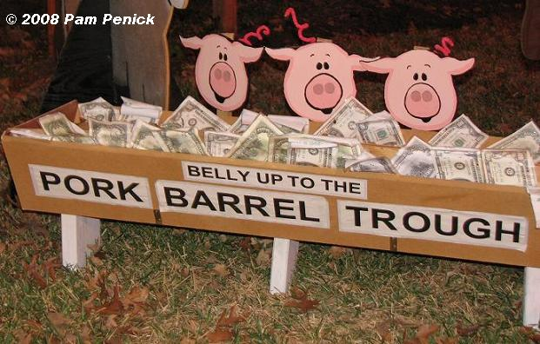
The Three Jobs of Congress Members
1. Lawmaking
2. Casework: help constituents deal with the Federal government
3. Helping the district/state: get Federal money for projects at home. These are called “pork-barrel” projects.

Slide 12
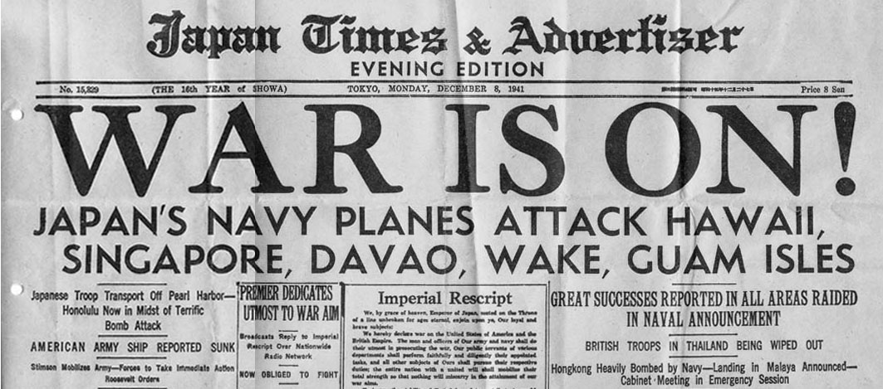
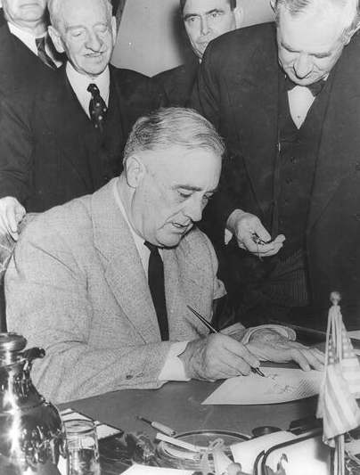
Powers of Congress
Expressed/Enumerated Powers (from Article 1)
Implied Powers (Elastic Clause)
Legislative Powers:
1. Taxing and Spending: only the Congress can pass laws about raising and spending money
2. Regulating Commerce: only the Congress can regulate interstate and international trade
3. Foreign relations: Only Congress can declare war, maintain the military, and approve treaties with other nations.

Slide 13
Other Congressional Powers
Non-legislative powers:
1. Propose constitutional amendments
2. Check other branches: approve Federal judges and secretaries of executive agencies; impeach the President and VP
3. Oversight and Investigation: Congress investigates the effectiveness of their laws and programs

Slide 14
Powers of House vs. Senate
House of Representative
Introduces appropriations bills ($$$)
Elects President if no majority in Electoral College
Impeaches officials
Senate
Ratifies treaties
Elects VP if no majority in Electoral College
Impeachment trials
Approves Presidential appointments (cabinet members, Supreme Court justices)

Slide 15
Limits on Congressional Power
First Amendment freedoms (Congress cannot pass a law that interferes with the legal rights of individuals)
Cannot interfere with powers reserved to the states
Cannot suspend the Writ of Habeas Corpus: cannot put people in jail without a charge
Cannot pass a Bill of Attainder: cannot put someone in prison unless convicted in a trial
No Ex Post Facto Laws: cannot charge someone with a crime if they committed the act before it was a crime

Slide 16
Congressional Punishments
Expulsion- Can be forced to leave due to a 2/3 vote by either house
Censure- Wrongdoings are made public (which can be very embarrassing)

Slide 17
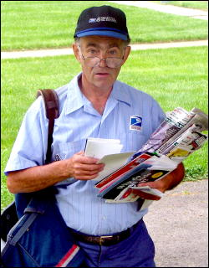
Benefits of Congress
$174,000+ annual salary
Free trips to home state
Franking Privilege: send work related US mail for free
Each member of Congress has a large staff who assist in many ways. They gather information on new bills, deal with lobbyists and the press, and deal with letters/email from constituents.

Slide 18
How Congress is Organized to Make Policy
Congressional Staff
Personal staff: They work for the member, mainly providing constituent service, but help with legislation too.
Committee staff: organize hearings, research and write legislation, target of lobbyists
Staff Agencies: CRS, GAO, CBO provide specific information to Congress
CRS- Congressional Research Service
CBO- Congressional Budget Office
GAO-General Accounting Office

Slide 19
Congressional Committees
Most real work of the Congress happens in committees.
Discuss, research, and revise bills
Members of Congress want to get on a committee that will give them a high profile or work in an area that can help out their constituents (to help them get reelected)

Slide 20
How Congress is Organized to Make Policy
The Committees and Subcommittees
The Committees at Work: Legislation and Oversight
Legislation
Committees work on the 11,000 bills every session
Some hold hearings and “mark up” meetings
Legislative oversight
Monitoring of the bureaucracy and its administration of policy through committee hearings
Special interest groups, private citizens, parts of the bureaucracy all sent representatives to Committee hearings

Slide 21
How Congress is Organized to Make Policy
The Committees and Subcommittees
Getting Ahead on the Committee: Chairs and the Seniority System
Committee chair: the most important influencer of congressional agenda (member of the majority party)
Dominant role in scheduling hearings, hiring staff, appointing subcommittees, and managing committee bills when they are brought before the full house
Most chairs selected according to seniority system:
Members who have served on the committee the longest and whose party controlled Congress become chair

Slide 22
Standing Committee
Permanent committees specializing in a certain area
Divided into subcommittees
House of Reps Examples
Appropriations ($), Ways and Means, Judiciary, Armed Services
Senate Examples
Same as house except no Ways and Means and Appropriations has much less power

Slide 23
Committees cont…
Select Committees
Joint Committees
Temporary committees formed to complete a task
The committee stops existing when the task is completed
Examples
9/11 Investigation
Members of both houses meet together in a committee
Not very powerful or influential (only 4 of them)
Examples
Library

Slide 24
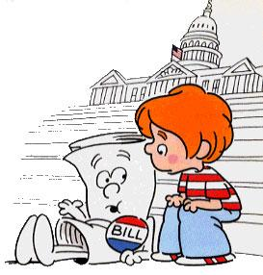
Conference Committees
Members of both houses work together to compromise a bill that has passed through both houses of Congress
An important step in the bill making process as both houses must agree on the same version of the bill before it can go to the President
Speaking of which…

Slide 25
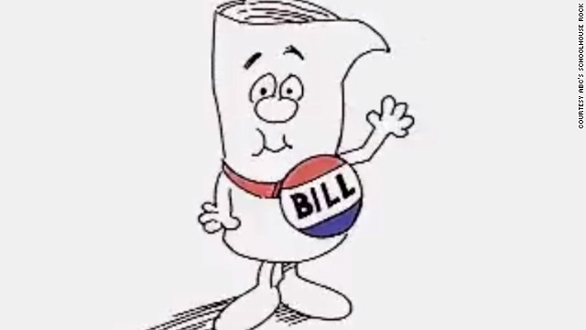
How a Bill Becomes a Law
1. A bill starts out as an idea (anyone can have this idea).
2. The idea is then proposed in either house of Congress (only by a member of Congress)
3. The bill is moved to a committee depending on its topic.
4. The committee can do one of four things:
a. Research and approve
b. Pigeonhole it (set it aside)
c. Reject it
d. Change it

Slide 26
Bill to Law Continued
5. Once approved in committee, it goes to either the House or Senate for debate.
a. The House limits how long someone can debate the bill
Senators may conduct a filibuster (talk it to death)
Cloture must be passed to limit how long a Senator may talk (3/5 vote)
6. Once passed with a simple majority in one house (half plus one), it moves to the other house.
7. Bill goes to a conference committee if necessary to finalize it.
8. Once it’s passed with a simple majority in both houses, it goes to the President.

Slide 27
9) Presidential Action
Sign the bill and it becomes law
Veto the bill (reject it)
If this happens the bill gets sent back to Congress
Congress can override a Presidential veto with a 2/3 vote in both houses (happens in less than 10% of all vetoes)
Pocket Veto- take no action for ten days
If Congress is in session after 10 days, the bill becomes a law
If Congress is not in session after 10 days, the bill is rejected

Slide 28
The Executive Branch
National, State and Local

Slide 29
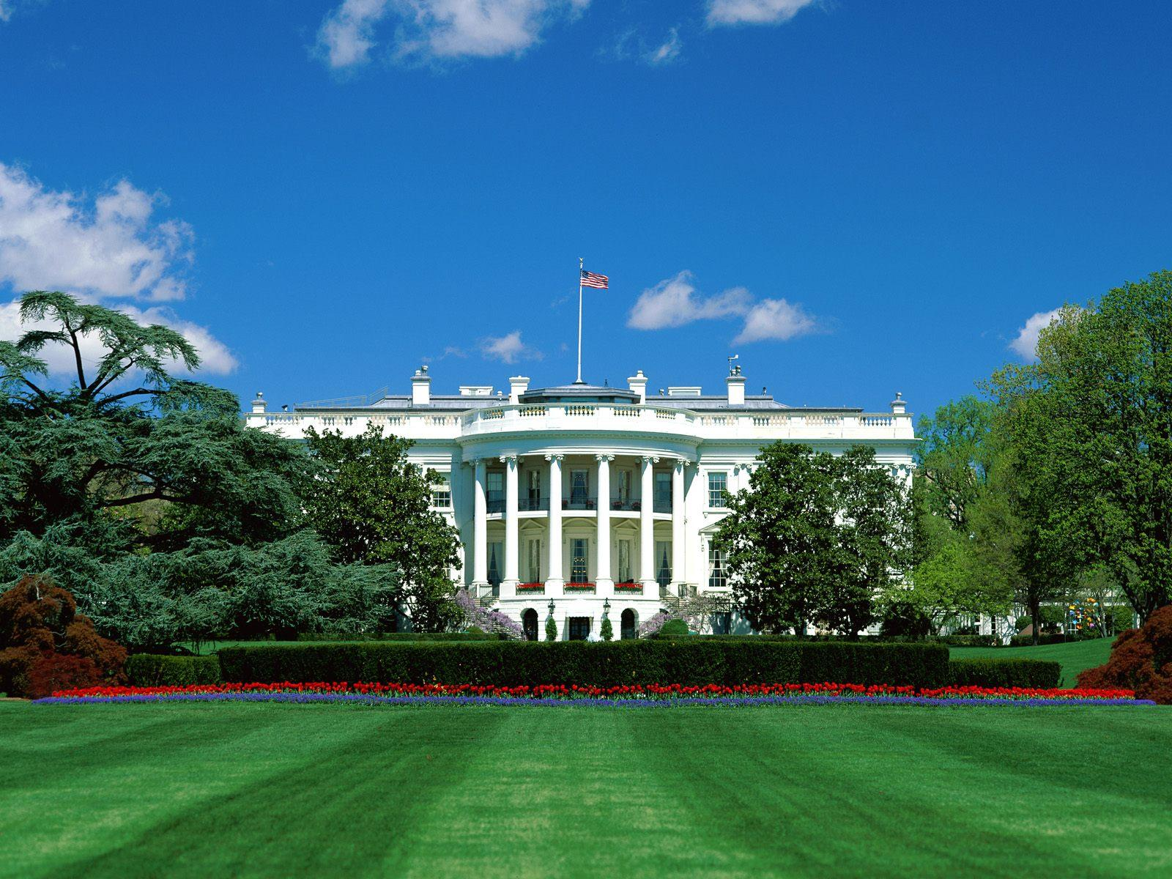

Slide 30
US Executive Branch
Led by the President of the United States.
All presidents have been white males, except for Barack Obama. All but one has been Protestant.
Cabinet: Group of advisors to the president.

Slide 31
Qualifications
Literally only three qualifications listed to be President in the US Constitution (Article II)
1. Must be a native-born US citizen.
2. Must be 35 years old.
3. Must have lived in the United States for 14 years.
The president is elected every four years by the Electoral College.

Slide 32
Presidential Amendments
22nd Amendment
President can serve a max of two terms, or ten years.
Amendment was put in place when FDR served FOUR terms.
25th amendment
VP takes over if the president can not fulfill his duties for any reason.
The presidential line of succession provides a lay out of who would be president in many cases.

Slide 33
Presidential Perks
Salary
$400,000/year plus money for expenses and travel
White House
Private movie theater, small gym, heated pool, bowling alley, large staff
Camp David, Air Force One

Slide 34
Presidential Elections
Occurs every 4 years through the Electoral College
Constitution does not provide for the direct election of the President, instead we have this indirect method
Each state gets as many electoral votes as their total of Congressmen (HoR + Senators)
Winner take all system per state (Except for Nebraska and Maine)
Electoral College has 538 electors
You need at least 270 to win

Slide 35
The Vice President
Vice President
Same qualifications as the President.
Leader of the Senate, votes only in case of a tie.
Becomes President if the President dies.
William Henry Harrison was the first President to die in office, and his VP, John Tyler finished out his term.
“My country has in its wisdom contrived for me the most insignificant office that ever the invention of man contrived or his imagination conceived.” –John Adams (1st VP)

Slide 36
The Vice President Joseph Biden
Speaker of the House John Boehner
President pro tempore of the Senate¹ Patrick Leahy
Secretary of State John Kerry
Secretary of the Treasury Jacob Lew
Secretary of Defense Ashton B. Carter
Attorney General Loretta Lynch
Secretary of the Interior Sally Jewel
Secretary of Agriculture Tom Vilsack
Secretary of Commerce Penny Pritzker
Secretary of Labor Thomas E. Perez
Secretary of Health and Human Services Sylvia Mathews Burwell
Secretary of Housing and Urban Development Julián Castro
Secretary of Transportation Anthony Foxx
Secretary of Energy Ernest Moniz
Secretary of Education Arne Duncan
Secretary of Veterans Affairs Robert McDonald
Secretary of Homeland Security Jeh Johnson
-Order determined by when the office was established (Homeland Security established in 2002 is last in line)
-One of these people must be absent from the President’s State of the Union address

Slide 37
Foreign v. Domestic Policy
The President carries out laws passed by Congress and his own beliefs through foreign and domestic policy.
Foreign policy is a nation’s plan for dealing with other nations
Domestic policy includes policies and programs that deal with issues within the country.

Slide 38
Presidential Roles
1) Chief Executive
The president can issue executive orders, a command that has the force of law.
The president appoints many officials which must be approved by the Senate.
Can issue a pardon - forgiveness and freedom from a punishment.
Can issue amnesty - a pardon for a group of people.
Can issue a reprieve - delay of punishment.

Slide 39
Presidential Roles
2) Chief Diplomat
Appoints ambassadors and makes treaties.
Ambassador: Official representative to a country.
Treaty: Agreement between two or more countries. Must be approved by the Senate by a 2/3 majority.
Executive Agreement: Agreement between the president and the leader of another country. Does not require Senate approval.

Slide 40
Presidential Roles
3) Commander in Chief
Congress is given the power to maintain an army and declare war. Only the President can order troops into battle.
War Powers Act (1973): The president must inform Congress when troops are sent into battle. Troops must be brought home after 60 days unless Congress grants an extension.
The president can order troops to stop disturbances in the United States during peace time.

Slide 41
Presidential Roles
4) Legislative leader
Presidents should have the support of Congress.
The president can write a bill, but someone from Congress must introduce the legislation.
The President tries to make deals with Congress.
The President tries to gain support from the American people through the use of the mass media.

Slide 42
Presidential Roles
5) Party Leader
The president helps other party members get elected (coattail effect).
Appoints people with his views.
6) Economic Leader
Deals with problems of the economy like unemployment, rising prices, high taxes.
Plans the federal government’s budget.
7) Chief of State
The president represents the entire nation.
Acts as the symbolic leader of the United States.
People are very interested in the president and his family.

Slide 43
Executive Office of the President (EOP)
Executive Office of the President: the Presidents administration who carry out a wide range of jobs
White House Office (President’s closest advisors, the most important is the chief of staff)
Office of Management and Budget (OMB, prepares budget and monitors federal spending)
National Security Council (NSC, helps President with military issues and foreign policy, supervises the CIA)
Office of Administration (administrative services);
Council of Economic Advisors (CEA, gives President information on the economy)

Slide 44
Federal Bureaucracy
Federal Bureaucracy
The network of agencies and departments of the government.
Lots of “red tape”: Inefficiency caused by rules and regulations.
Each person has a designed function and must operate within a chain of command.
People must be well-trained and managed.

Slide 45
Executive Departments
There are currently 15 depts.
The most recent of which is the Dept. of Homeland Security
The head of each is led by a Secretary, appointed by the Pres and approved by the Senate
These 15 secretaries make up part of the President’s cabinet.
The cabinet is there to advise the President
To Know for Quiz:
Education, Justice, Labor, State, Interior, Treasury

Slide 46
Independent Agencies
The President appoints the heads of these agencies with Senate approval
Executive Agencies – deal with specialized areas
IRS, FBI, FEMA
Government Corporations
US Postal Service
Regulatory Boards/Commissions - protect the public by making rules for certain groups or industries
FTC, FDA, FCC, EPA
To Know for Quiz:
EPA, FCC, SEC, CDC, DEA, FDA, IRS, CIA

Slide 47
Government Workers
Top jobs like Cabinet Secretaries are appointed by the President with Senate approval and leave their office when a new President is elected;
Other jobs are hired through the civil service system which is based on exams, experience or merit and their job is permanent, or until they quit.
Before the Civil Service Reform Act of 1883 federal jobs were given as a reward to those who had given political support to the elected President which was also called the spoils system.

