Slide 1
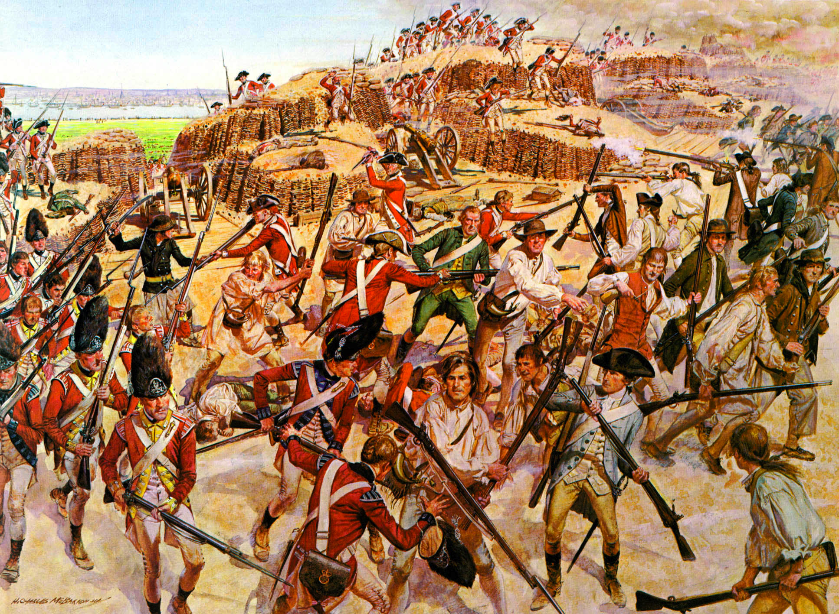
American Revolution

Slide 2
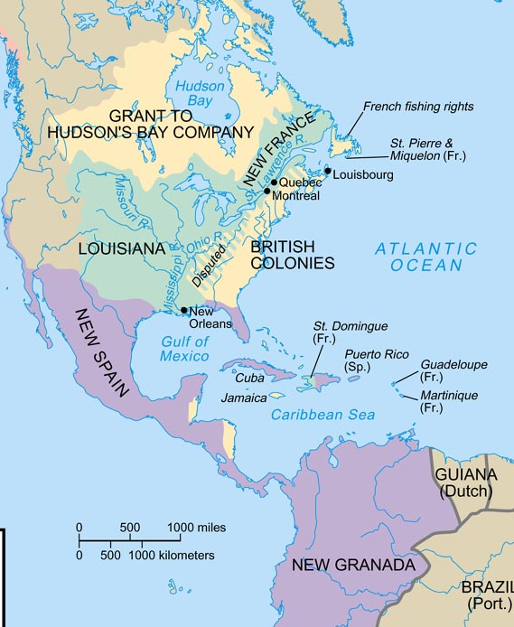

Slide 3
Precursor to revolution
By 1750, Britain & France had become serious rivals because:
Both nations used mercantilism to expand their colonial claims in order to increase their wealth
Britain & France went to war 3 times in Europe from 1690-1750
These wars in Europe meant that their colonists would fight too

Slide 4
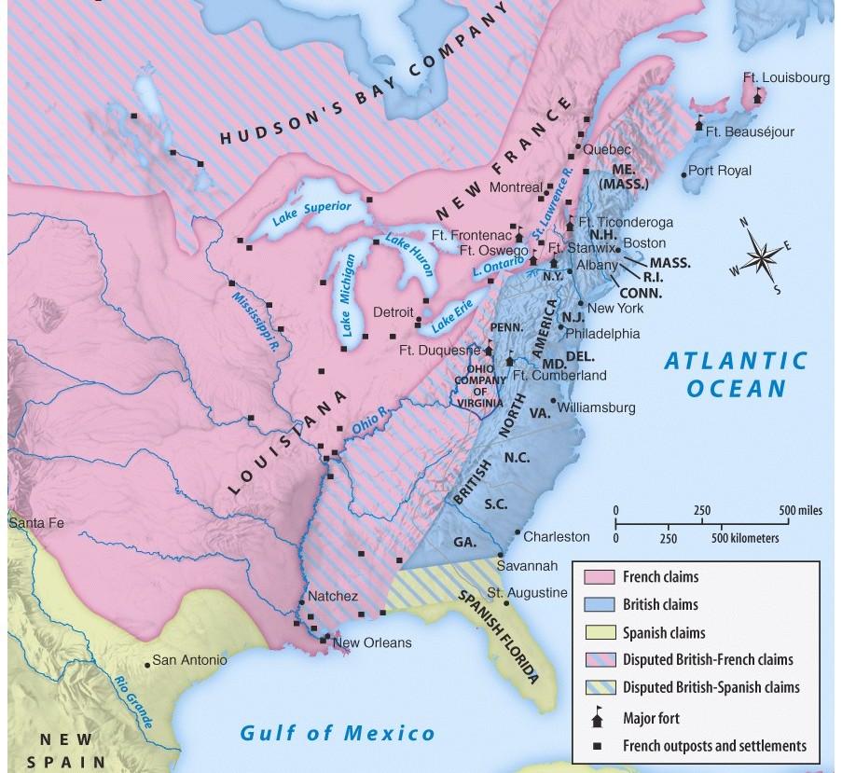
Land disputes along the Ohio River Valley led to the French & Indian War

Slide 5
The French and Indian War
Britain & their North American colonists
France, their colonists, & Indian allies
The war started in North America (1754-1763), but became part of a larger, “world” war called the Seven Years War (1756-1763) due to competition among empires

Slide 6
Effects of the War
France kicked out of North America
Colonists were excited about the possibility of new land in the west now that the French were gone
Parliament expected colonists to help pay off these debts

Slide 7
England is struggling

Slide 8
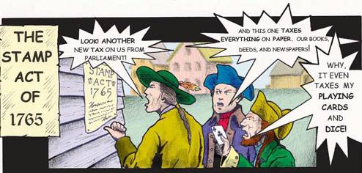

Slide 9
Notes:
Dumped 342 crates of tea into boston then congress passes the intolerable acts

Slide 10
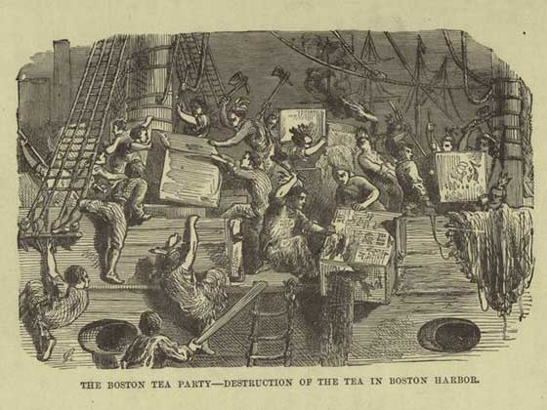

Slide 11
Lexington & Concord
Lexington
70 Massachusetts Minutemen waited for the British, which numbered in 750
A shot was fired and the colonists dispersed
18 American casualties 1 British casualty
Concord
Colonists began firing at the British
250 British casualties 100 American casualties
We lost at Lexington and conquered in Concord
Notes:
First battles of the american revo

Slide 12
2nd Continental Congress
Colonial leaders meet again in Philadelphia
This time we want out
Representatives this time were talking about independence
This was treason and punishable by death
Not everyone agreed
Thomas Paine wrote Common Sense
This pamphlet urged colonists to seek independence from the tyrannical government of England

Slide 13
Colonists divided
By 1776, American colonists were divided into 3 groups:
Patriots (40%) supported separation from Britain (independence)
Loyalists (40%) wanted to remain British colonies
Neutrals (20%) were undecided about which side to choose

Slide 14
Declaration of Independence
July 4th, 1776 – The Colonies declare Independence
Thomas Jefferson is the main author of the document
John Locke
Natural Rights theory
Jean-Jacques Rousseau
All men are created equal– everyone’s voice should count the same
George Washington is chosen as the leader of the Continental Army

Slide 15
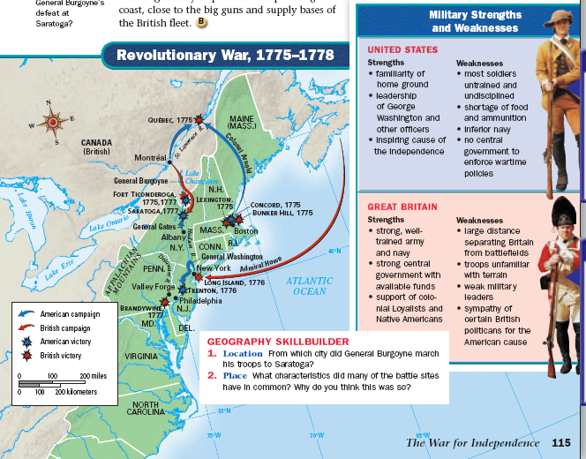
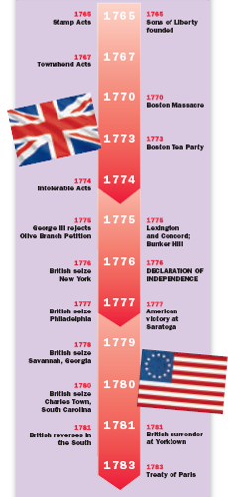
British victories from 1776-1777 made an American victory look impossible

Slide 16
On Christmas Eve 1776, Washington gave Americans hope by crossing the Delaware River & surprising British troops in Trenton, NJ

Slide 17
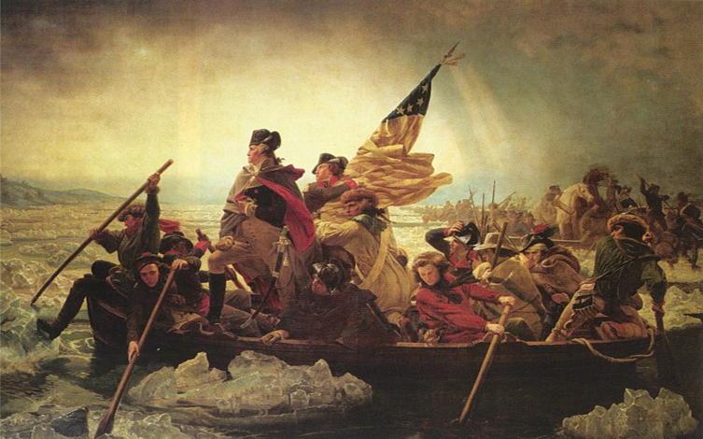
Crossing the Delaware in route to a surprise attack at Trenton & Princeton, 1776

Slide 18
Key Battles of the War
Saratoga
Turning point of the war
In October of 1777 the Continental Army defeats the British at Saratoga
This victory convinces the French to help us out
We needed the French for their navy

Slide 19
Key Battles of the War cont….
Yorktown
On October 17, 1781 the Continental army engaged in battle with the British once again at Yorktown
We were helped by about 7000 French soldiers
As victory was eminent General Cornwallis surrenders to the Continental Army
Notes:
Final battle of the revolution

Slide 20
American Independence
1783 the Treaty of Paris was signed which put an end to the American Revolution. With this document the British crown officially recognized the sovereign power of the colonies.
Notes:
Gave fishing rights, set boundaries, debts to be paid, land given to proper owners

Slide 21
Government After Independence
Articles of Confederation
First governing document of the U.S.A
Created weak national government
Government had no power to tax, could not negotiate with foreign nations
Articles produced government too weak to govern effectively
The said States hereby severally enter into a firm league of friendship with each other
Notes:
----- Meeting Notes (3/25/13 13:37) -----
JOhn Hanson

Slide 22
Constitutional Convention
Delegates met at Constitutional Convention, 1787, to revise Articles
Instead wrote new Constitution
George Washington presided over convention
James Madison negotiated main points
Known as “the father of the constitution”
Wrote the Federalist papers

Slide 23
The Constitution
Created a federal republic
Power separated between the national government and the states
Created separation of powers and checks and balances (ideas from Montesquieu)
Bill of Rights
First ten Amendments
Enlightenment ideas in action (freedom of speech, freedom of religion, rights for all citizens)

