Slide 1
The Greeks

Slide 3
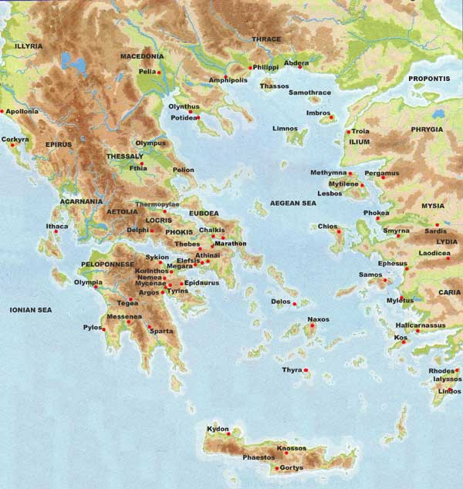

Slide 4
Foundations of Greece
Minoan
  Developed in Crete as early as 3000 BC
  Excavations show buildings with multiple rooms, plumbing, and artwork
  Their writing cannot be read
Mycenaean
  Considered the first Greeks
  Fought a lot with each other
  Relied heavily on trade
  Constant quest for glory

Slide 5
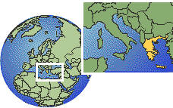
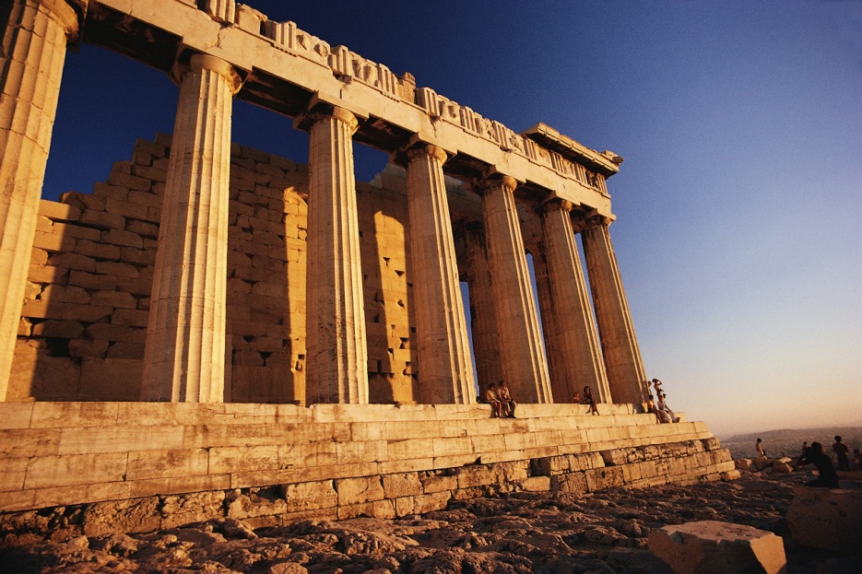
Part I: Greek Wars

Slide 6
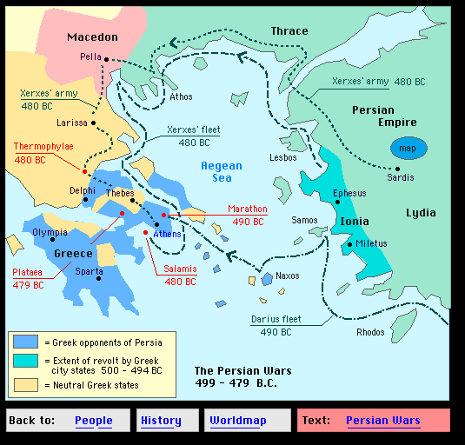
A Revolt leads to War!
Persia wants all of Greece in their possession.
  Certain Greek city-states in Ionia have come under Persian rule. Growing tensions erupt into a revolt. The revolt leads to a war of epic proportions between Greece and Persia.

Slide 7
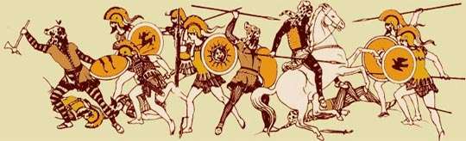
The Beginnings of the Persian War (490 – 479 BC)
The cause of the Persian Wars started with the Ionian Revolt in 499 BC. Athens sent troops to support the cause!
The Persian put down the revolt easily, but the actions of Athens angered King Darius.
  It took several years to get the full Persian army gathered, but he sent them to Greece in the year of 490 BC.

Slide 8
The Major Battles of the Persian War
The First Invasion
  Battle of Marathon (490 BC)– Persians landed on the shores at Marathon, and the Greeks heard of this and rushed to meet the Persians.
    Greeks used the military tactic, the phalanx.
    Victory for Greeks!
  Significance of Marathon
    Greeks fight off a clearly more powerful enemy, and after this Greece becomes a dominant power in the ancient world.
Notes:
Historical Origins of a Sport: Ask students what is a marathon? 26.2 mile run…why? Phiddipides ran from Marathon to Athens to report the battle results, and in the myth upon reporting a victory he died from exhaustion.

Slide 9
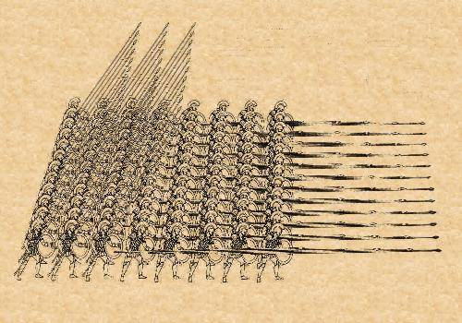
Why does the phalanx work so well?
Notes:
Herodotus states, of the Greeks at the Battle of Marathon, that "They were the first Greeks we know of to charge their enemy at a run". Many historians believe that this innovation was precipitated by their desire to minimize their losses from Persian archery. Also the Greeks had two other side flanks putting pressure on the sides of the Persian formation.

Slide 10
The Major Battles of the Persian War cont…
The Second Invasion- In 486 BC Darius died but in 480 BC, Xerxes (Darius’ son) sent more powerful force by land.
  Battle of Thermopylae (480 BC) – Victory for Persians
    Delayed by Spartans
    Athens captured & burned
  Battle of Salamis
    Themistocles tricks Xerxes into leading his ships into the narrow straight of Salamis. Persian ships are too big and are slow to maneuver.
    Persians defeated by Athenian navy
  Battle of Plataea (479 BC) Persian army defeated at Plataea

Slide 11
Aftermath of the Persian War
Persia wasn’t as much of a threat to the Greeks, but the Delian League was created just as a safe-guard.
  Delian League was a band of city-states that sought to maintain defense against Persia.
    Treasury was on the Island of Delos
  Athens starts growing more powerful because it was the lead city-state in the league.
    Athens begins to conquer neighboring city-states
    Treasury money used to rebuild Athens, at the other city-states displeasure.
  30 years peace, agreement made by all Greek city-states. (This doesn’t last long!)
Notes:
Makings of the Peloponnesian War start here with the Delian League, and as Athens grows more powerful there are fewer city-states to challenge them.

Slide 12
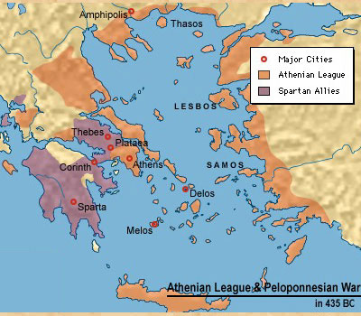
Makings of a Greek Civil War!
As Athens overstepped its bounds on numerous occasions.
  Built Long Walls
  Used treasury money to rebuild city
  Forced Delian League membership
Sparta headed the Peloponnesian League, and tension mounted once again. Only this time the Greeks were battling each other.
Notes:
Athens building of “long walls” walls that wrapped completely around the city-state and the harbor city

Slide 13
The Peloponnesian War (431- 404 BC)
First Phase
  Athenian advantage: Large Athenian Naval Fleet
    Sea Battle Advantage
  Spartan advantage: Honed warrior society
    Land Battle Advantage

Slide 14
The Plague Emerges in Athens
Pericles, a skilled politician came up with the idea to retreat within the city walls of Athens
  Unfortunately, sanitation problems grew in the city and many people started showing signs of illness.
    Pericles dies from this mysterious illness
  Athens is crippled, and a truce was formed in 421 BC.
Notes:
Historians have long tried to identify the disease behind the Plague of Athens. The disease has traditionally been considered an outbreak of the bubonic plague in its many forms, but re-considerations of the reported symptoms and epidemiology have led scholars to advance alternative explanations. These include typhus, smallpox, measles, and toxic shock syndrome Others have suggested anthrax, tramped up from the soil by the thousands of stressed refugees or concentrated livestock held within the walls.
"Epidemic typhus fever is the best explanation," said Dr. David Durack
http://en.wikipedia.org/wiki/Plague_of_Athens

Slide 15
The End of the Peloponnesian War
Second Phase: Athens strengthens and fights Sparta at the naval Battle of Aegospotami.
  Athens losses 90% of ships
  Sparta cuts trade lines and Athens can’t recover from this deadly blow
Significance of the War
  Athens never regains former glory of the Golden Age.
  Sparta too weak to effectively rule Greece
  Eventually conquered by Macedonian King

Slide 16
Warm Up- Wed. 9/13
What is a theocracy?
What are examples from an ancient civilization and one modern example of a theocracy?
What were the causes/effects of the Peloponnesian War?
Write down as many characteristics as you can think of for a good leader
Write down characteristics of a bad leader

Slide 17
Rise of Macedonia
After the Peloponnesian war Macedonia rose to power
Other Greeks thought they were backwards
Phillip II reorganized the military and conquered all Greece city-states except for Sparta
Phillip II was assassinated and the power and his plans fell to his son Alexander
Notes:
Northern part of greece
Their greek wasn’t the same
Larger spears used phalanx, more archers and cavalry

Slide 18
Alexander the Great
Was only 20 years old when he took power
Raised to know how to rule the country from birth—taught by Aristotle
Had to reestablish his dominance
Notes:
Thebes rebellion – crushed the army, sold the people into slavery and burned the city to the ground

Slide 19
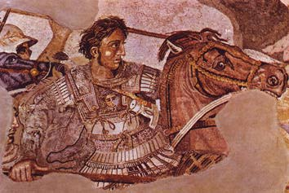
Alexander the Great

Slide 20
New Conquests
Lead his army into Asia to take on the Persians
Within a year he had won a major victory in Asia Minor
After this he lead his troops into Egypt where he wins again and they name him their new Pharaoh
Marched into Persia (Iraq) and destroyed the Persian army and caused Darius III to flee
Notes:
There was a lot more persians but they were unorganized and untrained
Darius II flees gives him the persian empire
Marched to persepolis a capital and burned it to the ground
He wanted to keep going but his military was exhausted

Slide 21
Alexander the Great Legacy
Built the largest empire the world had ever seen
The empire did not last very long (about 13 years)
He died when he was 33 in the city of Babylon
He left no heir and fighting started

Slide 22
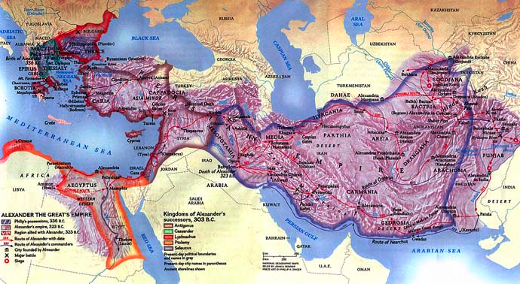

Slide 23
Legacy cont…
This gave us Hellenistic culture
  Actively promoted the blending of the cultures
  Centers of culture and learning
Decline of city-states and the rise of kingdoms
Women saw more rights
Notes:
Greek, Persian, and Egyptian Culture

Slide 24
Part II:
Greek Achievements

Slide 25
Characteristics of the city-states
In Greece we see a rise in the polis
  Polis = Greek city-state
  These became the basic political unit in Greece
  Each polis developed independently of each other
    This resulted in different governments (Athens, Sparta Corinth)
Usually built around an acropolis
  Settlement built on on area of elevated ground
  Frequently a hill with steep sides for defense purposes
  The center of large cities

Slide 26
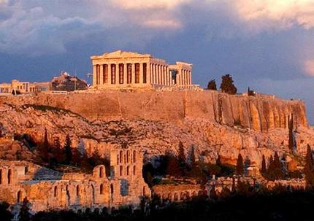

Slide 27
The Gods
The pantheon of Greek Gods is filled with Gods that fill many different roles in the culture
Each polis held one God as their protector (Athens is the best example)
The Gods played a role in every aspect of Greek life
Delphi and Olympus
Notes:
Cronos overthrew his father and ruled till he was overthrown by zeus ate each one after they were born
Zeus raised by a goat husband story
Hephaestus – married to aphrodite cuz he was so ugly
Ares wounded by diomedes with a spear driven home by athena
Prometheus

Slide 28
Nature of Athenian Democracy
Three main bodies:
  Assembly- all citizens eligible to take part in government
  The Council of 500- wrote the laws that would be voted on by the Assembly
  Complex Court Systems- 6,000 people from the Assembly would hear trials and sentence criminals.
The Archon- served as chief of state (9 elected)
  Head of both the Council of 500 and Assembly, elected for one year term

Slide 29
Definition of Athenian Citizen
Only free men over the age of 30 who completed military training.
  Only about 10% of population could participate in government affairs.
    Vote in all elections
    Serve in office if elected
    Serve on juries
    Serve in military during war

Slide 30
Overview of Athenian Democracy
Important Aristocrats (Noblemen)
  Draco- reformed laws
    He believed that harsh punishment would solve unrest. Rich/Poor gap grew!
  Solon- revised Draco’s laws
    Overturn harshest laws:
      Debt Slavery abolished
      Allowed ALL men to participate in the Assembly, not all can hold office.
  Peisistratus
    Tyrant- seized power by force
  Cleisthenes- created the Council of 500 to break up aristocratic family power
Notes:
“Early in its history, Athens was ruled by several kings.” page 135 It’s first King was the mythical Theseus (from the Minotaur Tale), or his father Agesus. “Later the kings were replaced by aristocrats who had both money and power.” page 135
Peisistratus was an interesting guy. Attempts to power> (1) Claimed Aristocracy beat him up (Failed), (2) Marriage alliance (Failed), (3) Mercenaries hired (Success)>>> He ruled for 20 years and died of natural causes. Policies: Economy improves, Patron of the Arts: Iliad and Odyssey written during his reign.
Sons: Hippias and Hipparchus

Slide 31
This is SPARTAAAAA!!!!!
One of the strongest city-states in Greece
Lead by two kings who were military commanders
Conquered the areas around them
  Turned the Messenians into helots
Great emphasis on training for war
Spartans need to be tough from birth
  Lycurgus created schools to make boys tough
At age 20 boys became hoplites where they served 10 years
Notes:
Child washed with wine to make sure it was strong raised till 7 then given to state

Slide 32
Spartan Women
Women were not left out
  They had important roles in society
Trained in gymnastics
Had to be physically fit to bear strong Spartan boys
They could own land

Slide 33
Warm Up- Thurs. 9/14
What are three major differences between Sparta and Athens?
Define the following types of government: theocracy, democracy, oligarchy
The blending of Greek, Persian, and Egyptian cultures after Alexander the Great is known as what?
Name and describe two of the eight features of a civilization.

Slide 34
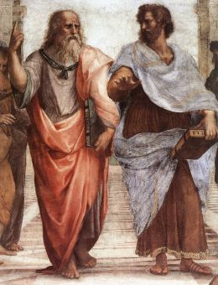
Greek Philosophy

Slide 35
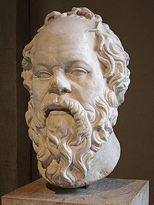
Socrates
What we know about him comes from Plato
Taught about truth, justice, and virtue
Believed we learn best by asking questions (Socratic method)
Put to death by the government for corrupting the youth

Slide 36
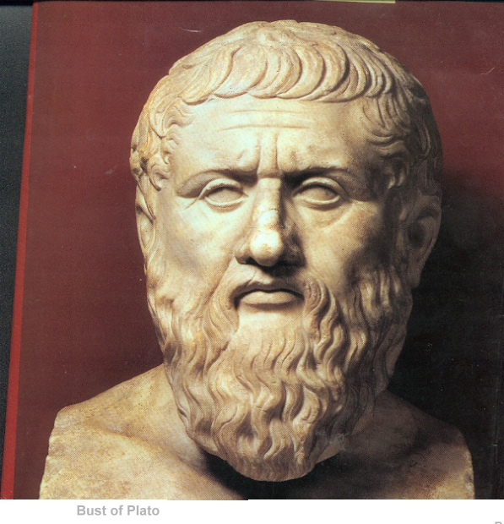
Plato
Student of Socrates
Taught of government and what was the best form
Philosophers were the most qualified people to make good decisions—and should head the government
Notes:
Wanted philosophers to be leaders

Slide 37
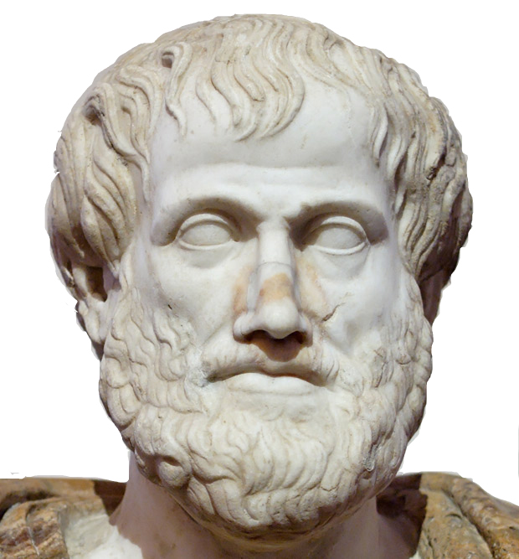
Aristotle
Student of Plato
Taught Alexander the Great
Wanted to know about nature and the world
Reason should help us learn
Use of logic and deductive reasoning

Slide 38
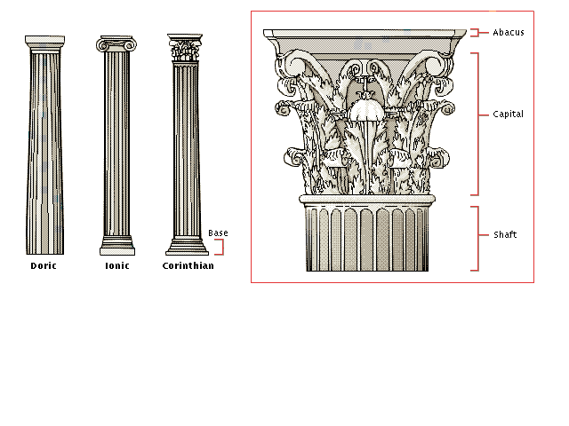
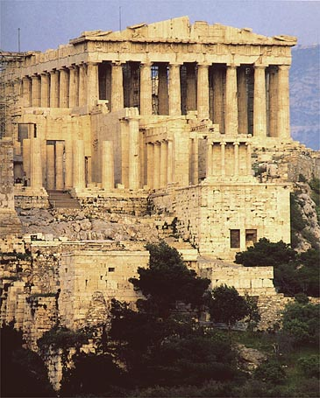
Greek Architecture
Parthanon
  Dedicated to Goddess Athena
Columns
  Doric
  Ionic
  Corinthian

Slide 39
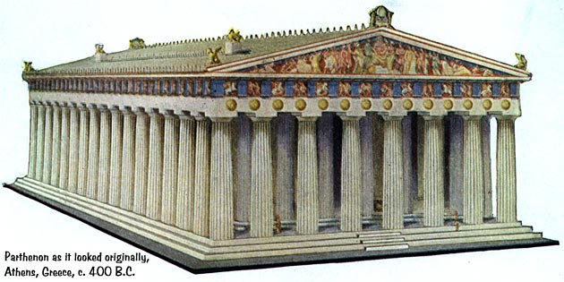
Architecture

Slide 40
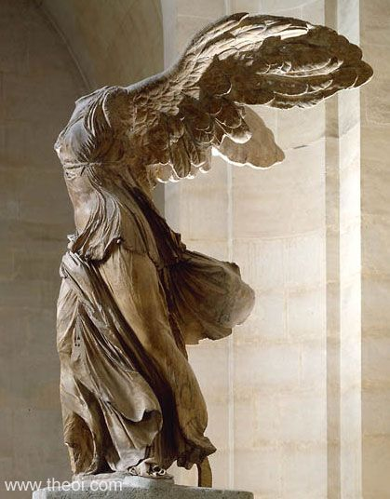
Sculptures

Slide 41
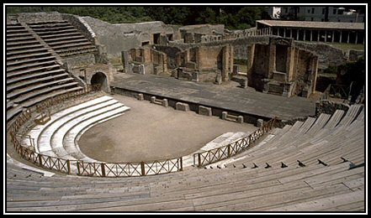
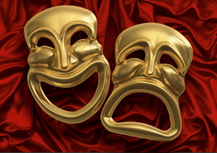
Greek Drama
Tragedies, plays that told stories of human suffering that usually ended in disaster.
  Aeschylus, Sophocles, and Euripides
Comedies, humorous plays that mocked people or customs.
  Aristophanes

Slide 42
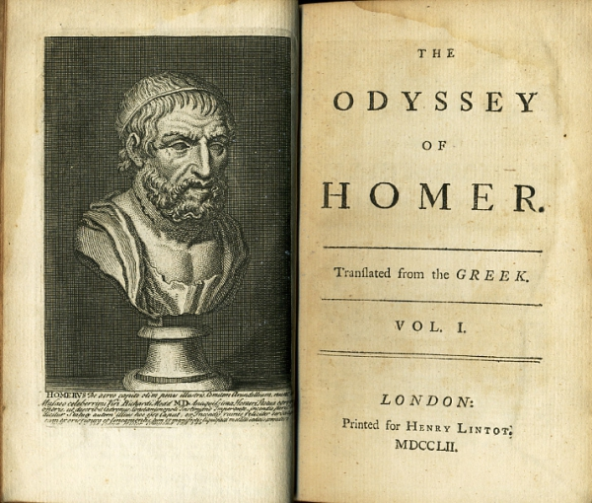
Literature
Epic poems
  The Iliad
  The Odyssey

Slide 43
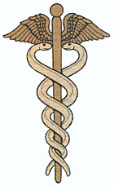
History & Science
History
  Herodotus “first historian” or “father of history”
  Thucydides showed the need to avoid bias.
Medicine
  Hippocrates & the Hippocratic Oath – all patients must be treated regardless of class

