Slide 1
Byzantine Empire
Remnants of the Eastern half of the Roman Empire
Capital in Constantinople, an important trading center coveted by many outside groups

Slide 2
Byzantine Empire
Two institutions central to Byzantine culture—the emperor and Christianity
Emperor: Priest-king who was considered the deputy of Jesus on Earth.
Controlled both civil and religious law
United civil and religions spheres
Christianity- Crisis emerged over used of icons/idols
Pope: Head of Roman-Catholic church

Slide 3
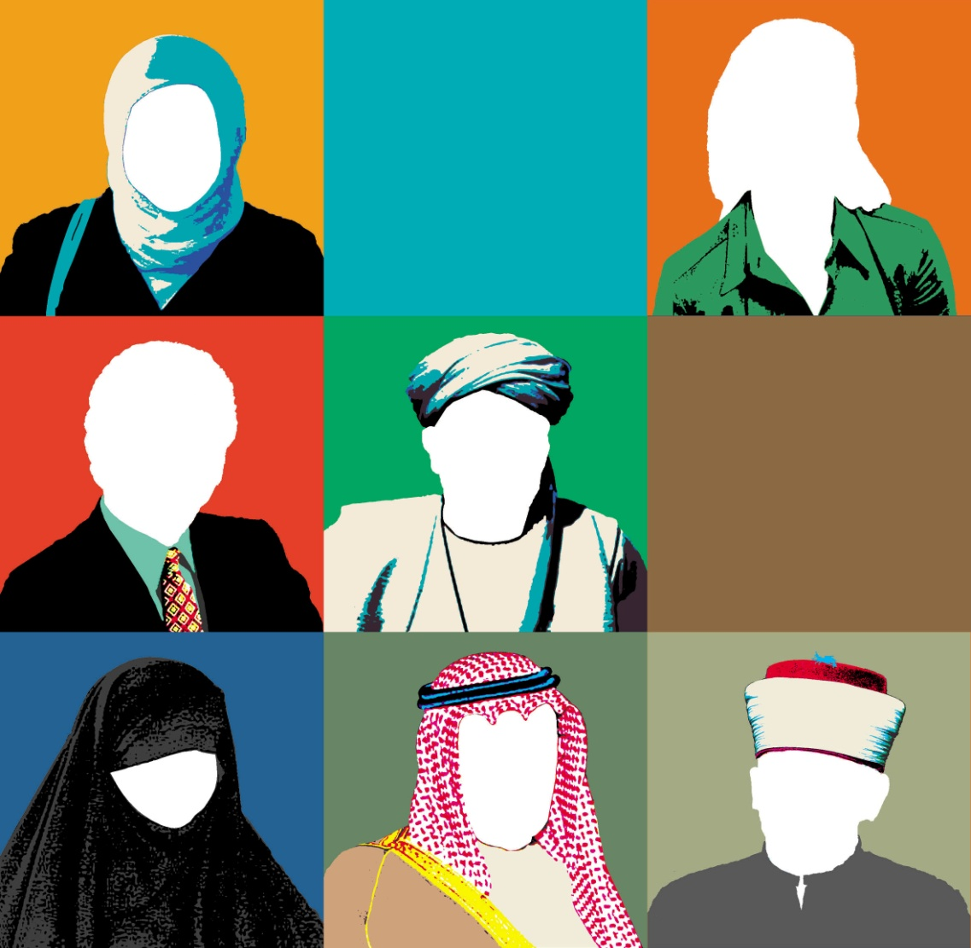
Muslim Civilization A religion that launched an empire
`

Slide 4
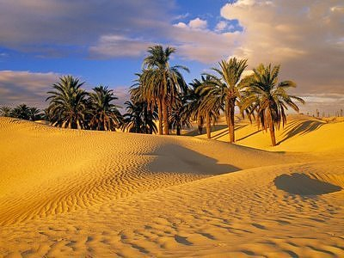
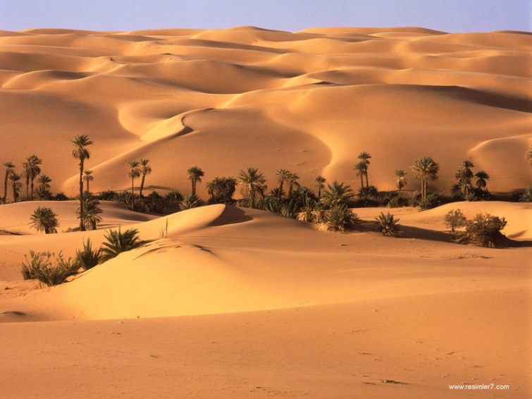
The Arabian Peninsula
The Arabian Peninsula is a harsh and with vast desert interior.
People lived as Bedouins, nomadic Arab peoples moved their herds between scattered oases.
Each tribe had a different polytheistic god or deity.
Islam means these tribes have to come together as one people.

Slide 5
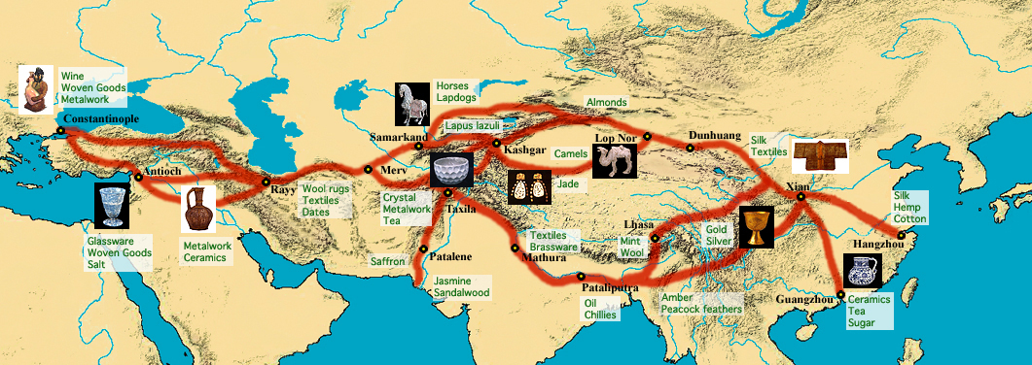
If people can’t farm they have to trade…
On the route of the Silk Road
Traded: Horses, Thoroughbred Camels, Ostriches, & Tanned Hides

Slide 6
Deserts, Towns, and Trade Routes
On the Arabian Peninsula, Bedouin (Arab Nomad) tribes organize into clans. Their Ideals of courage and loyalty to family would become part of culture.
By the 600’s trade routes connected Arabs to the major ocean and land trade routes. Trade was extended as far as the silk road would allow.

Slide 7
The Prophet Muhammad
Born into a powerful Meccan family.
He became an orphan by age four, and his uncle (the clan/tribe leader) raised him.
He married a wealthy merchant.
Around the age of 40, he believed that he received a call from the Angel Gabriel to proclaim him the messenger of Allah.

Slide 8
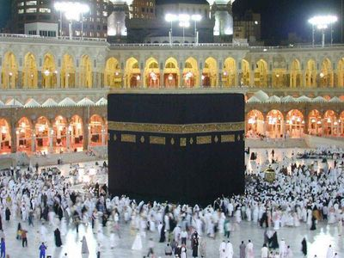
Basis of Islam
Islam originated in the Middle East around 622 AD with the Prophet, Muhammad.
Muhammad was born in Mecca and traveled to Medina in a journey called the hijra (hegira), that became the founding of Islam.
Muslim worshippers follow scriptures called the Qur'an, or Koran. The collection of Islamic laws is also known as the Sharia.

Slide 9
A religion emerges…Islam
Muhammad the Messenger
Prophet of Islam who Muslims-(those who surrender to God) recognize as Allah’s messenger to all humankind. His teachings form the basis of Islam.
Muhammad’s Revelations
“Allah was the one and only true and all-powerful God.”
(Guidelines) How people should live.
Muhammad’s teachings get him in trouble with local leaders so he moved to Medina.

Slide 10
The Hijrah
After some of his followers were attacked, Muhammad leaves Mecca for a city called Yathrib, 200 miles north. He attracts many followers, the city is renamed Medina. The conservative Meccan authority believed that Muhammad’s radical ideals would changed their way of life.

Slide 11
Return to Mecca
630 – Muhammad returns to Mecca with an army of 10,000 men.
Mecca surrenders, Muhammad destroys the idols in the Ka’aba.
Muhammad dies at the age of 62.

Slide 12
Five Pillars of Islam Not in notes, we have already covered this.
Faith in one God “Allah” – Monotheism
Five times daily prayer towards Mecca
Help the poor (giving alms)
Fasting during the holy month of Ramadan
Pilgrimage to the holy city of Mecca (hajj)

Slide 13
Islamic Guidelines
Forbidden to eat pork
No alcoholic beverages
Must wash themselves before prayer (must be pure before praying to God)
Prohibition of murder, lying, and stealing
Jihad- struggle for the faith
Islam views Christianity has taken the wrong path because they worship Jesus.

Slide 14
Sunna and Sharia (Legal & Ethical Systems)
Sharia
Legal system that reflects the various rules by which all Muslims should live.
Sunna
“means tradition”
Includes hundreds of individual lessons or reports on Muhammad's actions.

Slide 15
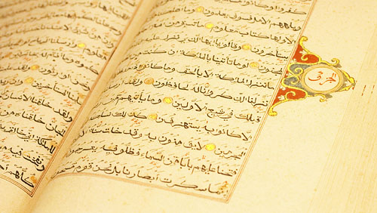
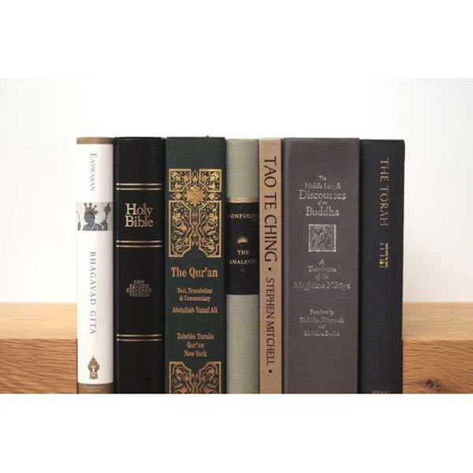
People of the Book
Christianity, Judaism, & Islam are all monotheistic.
“The Qur’an teaches that Allah is the same as God in the Jewish and Christian traditions.

Slide 16
Spread of Islam
Muhammad dies in 632 and many question who should follow him.
Abu Bakr- chosen as Muhammad’s successor or “caliph”- chief Muslim civil and religious ruler
Caliphate- area ruled by a caliph

Slide 17
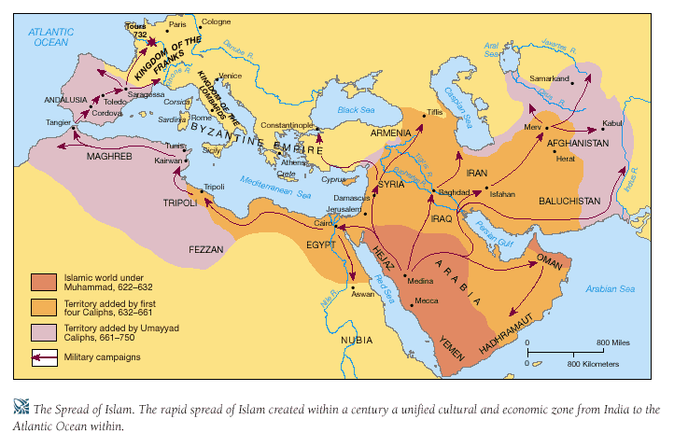
Spread of Islam

Slide 18
Islamic Schism
Islamic faith splits as a result of Umayyad rule.
The majority accepted them (Sunni, followers of Muhammad’s example)
The group that resisted was called the Shi’a who believed that the Caliph (ruler) needed to be descended from Muhammad.
Sufis is a third group *very small*
Seek a mystical, personal connection with God.
Breath Control & Meditation

Slide 19
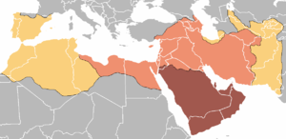
Expansion of Territory
Red – Expansion under Muhammad (622- 632)
Orange – Rashidun Caliphate (632- 661)
Gold - Umayyad Caliphate (661- 750)

Slide 20
Muslim Society
Man is head of the family
He could have several wives, but he had to treat all equally. (Can’t favor a certain wife although it did happen.)
Women had equal status regarding the laws.
Could inherit property and seek divorce.
Women eventually lost status
Covered faces
Secluded to a harem

Slide 21
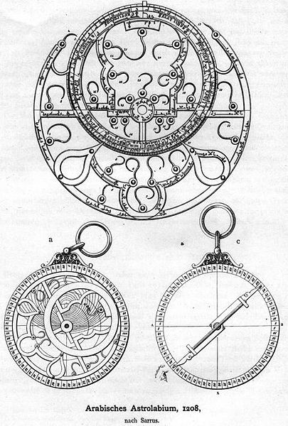
Muslim Achievements
Astronomy and Mathematics
Astrolabe- an instrument fore finding the positions and movements of stars and planets.
Calculated longitude and latitude any time of day.

Slide 22
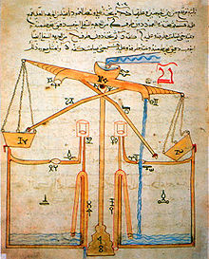
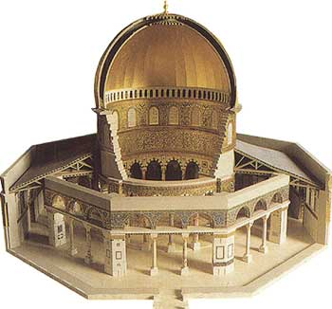
Achievements cont…
Medicine (Early eye surgery)
Islamic Art (Calligraphy- beautifully styled writing)
Architecture
(Dome of the Rock)
One of the most revered sites
Located in Jerusalem
Spot were Muhammad ascended to heaven

