Slide 1
1) What rights do you believe that all people deserve?
2) What rights should you as high school students have?
3) What should happen if your rights are taken away?

Slide 2
The Enlightenment

Slide 3
Effects of the Scientific Revolution
As a result, new ideas began in areas outside of science:
Especially criticizing absolute monarchy & think of new ideas about government

Slide 4
What is the Enlightenment?
The intellectuals of the Enlightenment (called Philosophes) believed:
The universe could be understood through reason
Everything in nature could be explained by natural laws—universal truths found through observation (Religion is not necessary to understand the world)

Slide 5
What is the Enlightenment?
The belief in progress—the world can be improved upon & perfected
People have natural rights—personal freedoms that allow people to enjoy liberty (no restrictions on speech, religion, or the economy)

Slide 7
Political Thinkers of the Enlightenment
Hobbes, Locke, Jefferson, Montesquieu, Rousseau, Voltaire

Slide 8
Thomas Hobbes
People cannot be trusted. Kings should rule!

Slide 9
… In a state of nature… where every man is Enemy to every man;…wherin men live without other security than their own strength….In such a condition there is no place for Industry; because the fruit therof is uncertain…no Culture of Earth; no Navigation…no Arts; no Letters; no Society; and which is worst of all continuall feare and danger of violent death; and the life of man; solitary, poore, nasty, brutish, and short.

Slide 10
Thomas Hobbes
Hobbes believed humans are naturally violent & disorderly; citizens need kings to protect them from themselves (like a father protects his children)
Hobbes believed that people form a social contract with the king & agree to give up their freedoms in exchange for the king’s protection

Slide 11
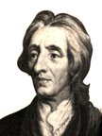
John Locke
People are good! They have rights & should overthrow the government when kings abuse their power

Slide 12
John Locke
Locke believed that all people have natural rights (rights to life, liberty, & ownership of property)
He added to Hobbes’ Social Contract Theory saying that people can break the “contract” when a king become corrupt
The best government has limited powers & listens to the people
Notes:
Greatly influences T Jeff

Slide 13
Whose ideas are right?
Locke
People are reasonable & able to make decisions
People should be able to rule themselves
Hobbes
People are selfish, self-serving, & brutal
Without government control, society would be chaotic

Slide 14
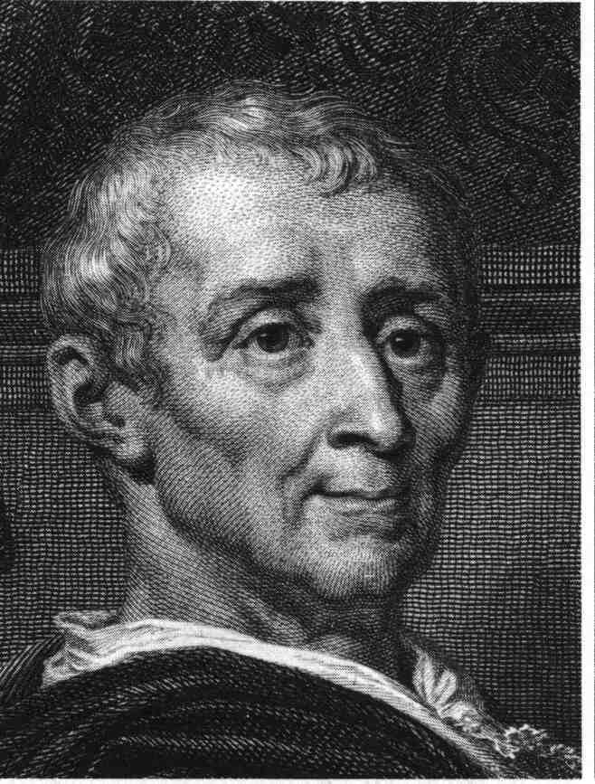
Baron de Montesquieu
Giving one person all the power is a bad idea.
Notes:
Charles-Louis de Secondat, Baron de La Brède et de Montesquieu

Slide 15
Baron de Montesquieu
Montesquieu wanted separation of powers & checks and balances to keep kings from gaining too much power in the government:
Legislative branch makes laws
Executive branch enforces laws
Judicial branch interprets laws
Like Parliament or Congress
Like a king or president
Like a court system

Slide 16
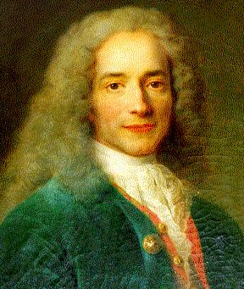
Voltaire
Don’t be a hater! People should be allowed to say anything they want, even if you don’t like it
Notes:
François-Marie Arouet

Slide 17
Voltaire
Voltaire demanded that kings offer their people freedoms of thought, speech, & religion
He fought against prejudice & pushed for the French king to be more tolerant
Taught that god no longer influenced the world.
Didn’t hold religion very high in his thoughts
Notes:
Born in Paris, Voltaire was the son of a lawyer. He received an excellent education but chose not to follow his father into law. Instead, he ended his schooling at age 16 and devoted himself to literary pursuits. He joined a group of irreverent young aristocrats and began to write witty political verses. As a young man, Voltaire got himself into a certain amount of trouble with his writing, but he also managed to meet like-minded people. Through acquaintances with philosophers, artists, and thinkers, and also through his won desire to learn and understand the world, Voltaire became a great thinker.

Slide 18
« La nôtre est sans contredit la plus ridicule, la plus absurde, et la plus sanguinaire qui ait jamais infecté le monde »
Ours [religion] is without a doubt the most ridiculous, the most absurd, and the most bloody to ever infect the world.

Slide 19
Questions for discussion:
Voltaire said:
“I may disapprove of what you say, but I will defend to the death your right to say it.”
What does this statement indicate about Voltaire’s views on free speech?

Slide 20
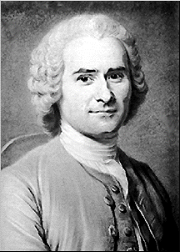
Jean-Jacques Rousseau
Let’s make a government that benefits the majority of people

Slide 21
Jean-Jacques Rousseau
Believed people are naturally good, but power corrupts them
The best form of government is a direct democracy that promotes the common good of the majority
People give up some of their individual rights to be ruled by the general will of the majority
What the majority wants, the majority gets
Like their choice if they disagree with the majority opinion

Slide 22
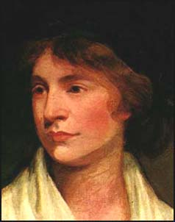
Mary Wollstonecraft
Women have been mistreated for too long. It is time to take our rights back

Slide 23
Mary Wollestonecraft
Wollstonecraft demanded equal rights for women
A Vindication of the Rights of Woman, equal education for women
She partially blamed women for being unequal with men
Believed that through education women can achieve equality
Notes:
Sensibilities were bad
do not fall prey their bodies and sexual desires
women who are controlled by their lust are controlled by men

Slide 24
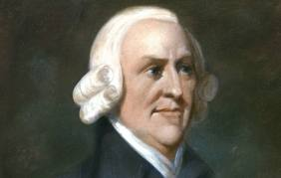
Adam Smith
Whatever happens, happens. Let the economy work itself out.

Slide 25
Adam Smith
Scottish economist, used reason to analyze economic systems
The Wealth of Nations advanced free market enterprise
Strong believer in laissez-faire economics, no government regulation
Believed economy would be stronger if market forces of supply and demand were allowed to work freely

Slide 26
Enlightened Despots
Some absolute monarchs (despots) throughout Europe were influenced by Enlightenment ideas & became known as Enlightened Despots
These monarchs ruled by trying to do what is best for citizens:
They favored religious tolerance, economic reforms, give more people legal rights

Slide 27
Frederick the Great of Prussia
Ruler of Prussia, granted many religious freedoms
Reduced censorship
Improved education & justice system
Abolished torture
Thought he was “the 1st servant of the state”
Notes:
Frederick the Great, king of Prussia (1740 – 1786), committed himself to reforming Prussia. Perhaps his most important contribution was is attitude toward being king. He called himself “the first servant of the state.” From the beginning of his reign he made it clear that his goal was to serve and strengthen his country. This attitude was clearly one that appealed to the philosophes.

Slide 28
Catherine the Great of Russia
Tried to modernize & reform Russia according to the writings of the philosophers
Tried to free serfs, stop torture & death penalty (she failed but tried!)
Notes:
Catherine was the daughter of a minor German prince. At age 15, she was summoned to the Russian court at St.Petersburg. She was to marry the Grand Duke Peter, heir to the Russian throne.
The marriage between Catherine and Peter was a disaster. Peter was mentally unstable and only months after her husband became Czar, Catherine had him arrested and confined. Soon afterward, Peter conveniently died.

Slide 29
How did Enlightenment writers and thinkers set the stage for revolutionary movements?
Philosophes encouraged people to judge for themselves what they thought was right or wrong
People began to rely on reason to solve their social problems
These ideas led to violent revolutions in America & France to overthrow “corrupt kings”
Notes:
John Locke – Natural rights – Reason solves all problems – Thomas Hobbes/ people are bad need king – Laissez Faire – Rousseau everyone vote -

