Slide 1
Warm Up
What is your moral code? What values do you think it is important to live by?

Slide 2
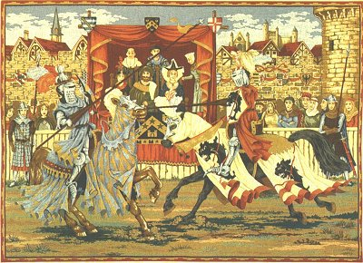
The Middle Ages aka the Dark Ages

Slide 3
Since we last spoke 1500 years passed Here’s what happened
By 500 A.D. Western Roman Empire fell to barbarian tribes:
  Visigoths controlled Spain
  Ostrogoths controlled Italy
  Franks controlled Gaul (France)
  Vandals controlled North Africa
  Angles, Saxons, Jutes battled for Britannia
  Celts ruled Ireland & Scotland

Slide 4
The Middle Ages
After the fall of Rome, Western Europe entered the Middle Ages from 500-1300 A.D.
Reasons for the rise of Middle Ages:
  No Roman emperor to make rules
  No Roman army to protect people
  No common language to unite them
  No longer citizens of a common empire; people now loyal to family members (clan) or feudalism
Notes:
Skip justinian stuff

Slide 5
Franks
After the decline of the Roman Empire, the territory of Gaul was ruled by the Franks:
  Charlemagne (Charles the Great) became the greatest king of the Middle Ages by doing something no other king was able to do
  He created an organized empire

Slide 6
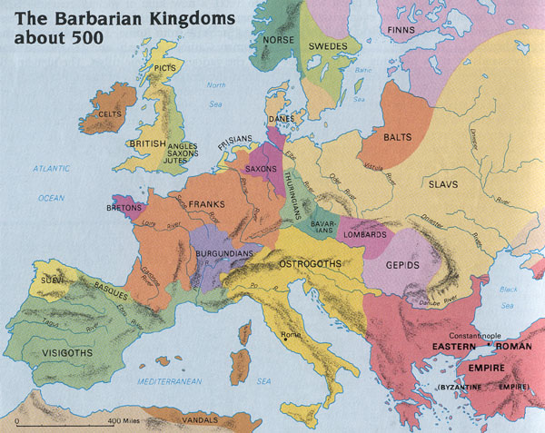

Slide 7
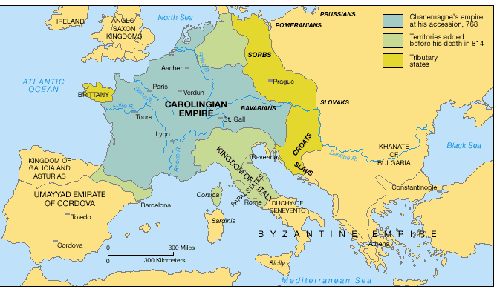
Look at this massive, well-organized empire! This is the EXCEPTION rather than the rule during the Middle Ages!!
One king controlled all this & had power over feudal lords

Slide 8
Charlemagne
Charlemagne was called the “strong hand of God”
Charlemagne’s accomplishments:
  Greatly expanded the Frankish empire
  Spread Christianity through missionaries & violence
  Divided this large empire into counties
  Began schools for church members

Slide 9
In 814 Charlemagne dies and we begin again
From 800 A.D. to 1000 A.D., Europe was constantly attacked by foreign armies:
  Muslims attacked Europe from the northern Africa
  Magyar warriors attacked Europe from the East
  Vikings attacked Europe from the Scandinavia in the north

Slide 10
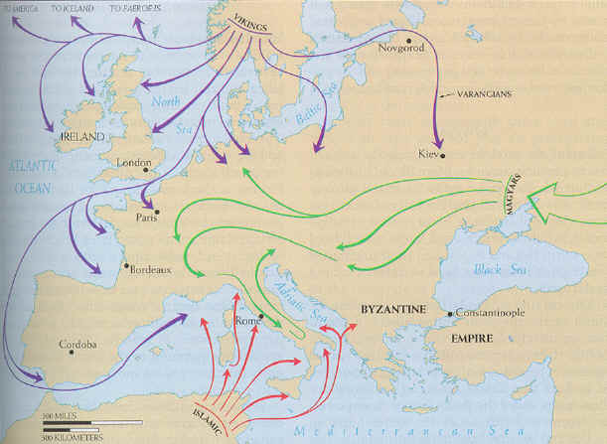
See how dangerous Europe was!!!
So, why was Feudalism necessary??

Slide 11
I am the King!! I have so much land!!

Slide 12
I think I’ll build myself a castle, but I have no power so maybe I should give fiefs to some lords

Slide 13
Thank you king for this fief. As your loyal lords we will oversee this land

Slide 14
We will fight for the king and provide him with food from our lands, but this territory to too large.

Slide 15
Let’s pick the best land to build our homes on, then let’s give fiefs to some vassals!!

Slide 17
Thank you lords for this fief. We promise loyalty, military service, & a portion of our food

Slide 18
Let’s pick the best land to build our homes on!!

Slide 19
Aren’t we going to need protection, too?

Slide 20
Oh yeah, let’s give fiefs to some knights also!

Slide 21
Let’s allow serfs to do all the work & provide us with food! We will gain their work & loyalty

Slide 22
Thank you vassals for allowing us to live on this land. We provide you loyalty, military service, & a portion of our food

Slide 23
According to the code of Chivalry, I will forever protect my lord & vassal, my God, and my sweetie-pie at home!

Slide 24
The Feudal System
King
Military Service
&
Labor
&
Loyalty
Lords
Lesser Lords (Vassals)
Land
&
Protection
Knights
Peasants (Serfs)

Slide 25
Feudalism
 of feudalism was the idea of vassalage (feudal contract)based on land ownership and loyalty.
Kings
Fief Loyalty, Military Support
Lords
Fief Loyalty, Military Support
Knights (Chivalry)
Protection Loyalty, Labor
Serfs (peasants)
Fief is the land granted to people

Slide 26
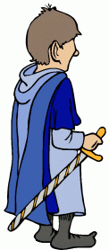
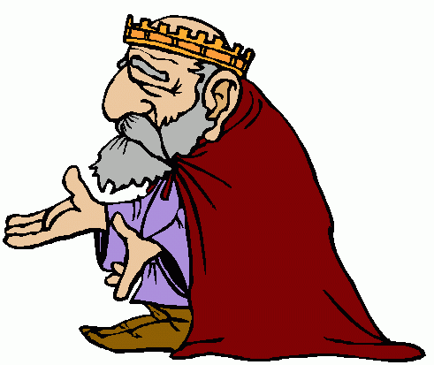
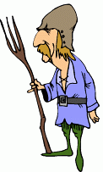
The Feudal System
The feudal system provided order and stability. Everyone knew their place and what they had to do.
The manorial system provided for an economy that was based on farming and being self-sufficient on the manor.

Slide 27
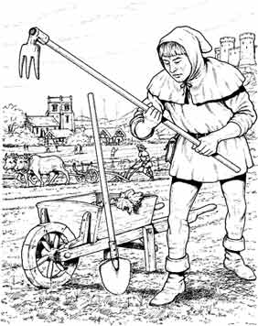
Manors: The Economic Side of Feudalism
The manor was the lord’s estate.
The manor system was an economic arrangement between a lord and his serfs.
The lord would provide serfs with housing, strips of farmland, and protection from bandits.
In return, the serfs tended the lord’s lands, cared for his animals, and performed other tasks to maintain the estate.
The manor was largely a self-sufficient community.

Slide 28
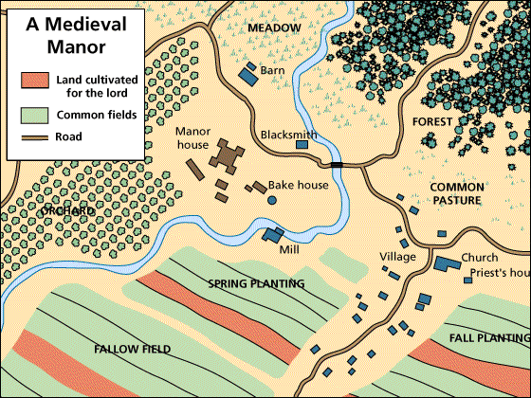
Manors: The Economic Side of Feudalism

Slide 29
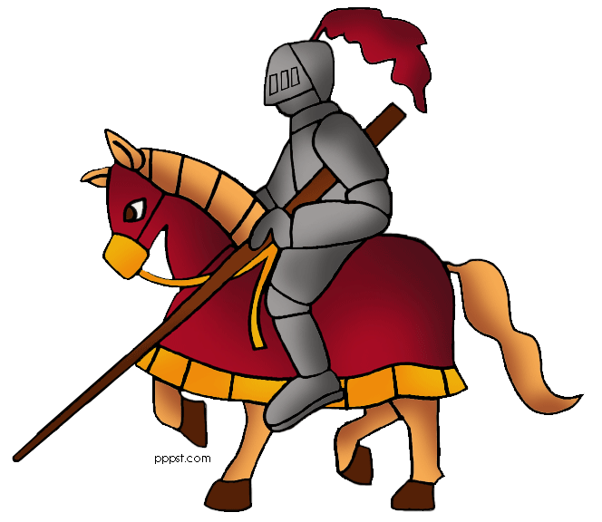
Knights

Slide 30
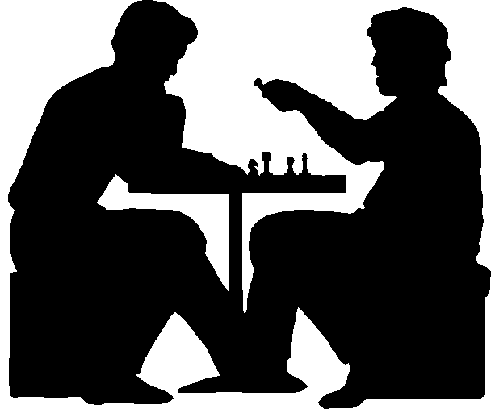
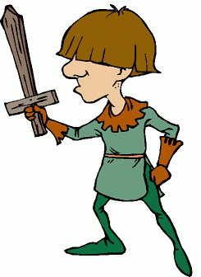
Education of a Knight
The education of a young noble began early (age 7).
He would be sent off to the castle of another lord. He waited on his hosts and learned courtly manners. He played chess and learned war strategies.
To develop fighting skills, he would practice sword fighting.

Slide 31
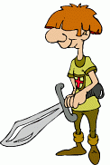
Education of a Knight
At around the age of 14, the boy would become a squire.
A squire would act as a servant to a knight.
The squire took care of the knight’s armor, weapons, and warhorse.
The squire would also escort the knight to battles.

Slide 32
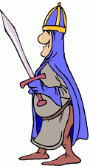
Education of a Knight
At around 21, a squire became a full-fledged knight.
Knights were to abide by a complex set of ideals, which became known as the code of chivalry.
Later in the Middle Ages battles were often for show.

Slide 33
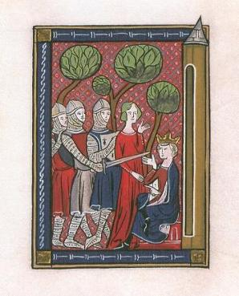
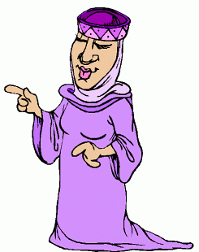
Knights Continued...
Knights were bound by a strict code of conduct called chivalry.
According to this code, knights were expected to be brave, loyal, true to their word and protective of women and those weaker than them.

Slide 34
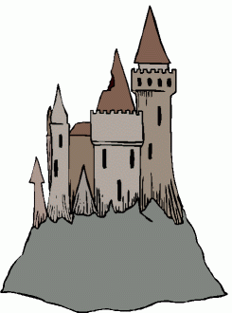
Castles
Medieval castles were designed in response to the weaponry they had to withstand. Wooden castles were easily destroyed by the burning missiles slung by siege weapons.
Castles began to be built with stone and their walls were built higher and thicker—exposed walls could be as thick as 33 feet.

Slide 35
Castles
Rectangular towers were rounded off to deflect missiles.
As protection against battering rams, castle doors were reinforced with one or more iron grilles and sometimes a second door.

Slide 36
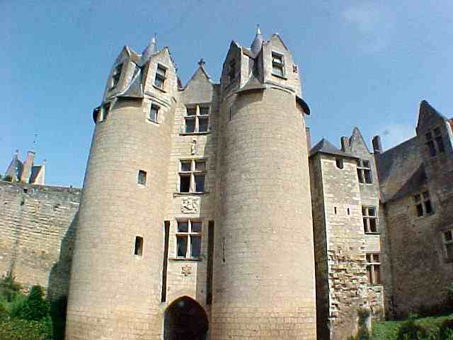

Slide 37
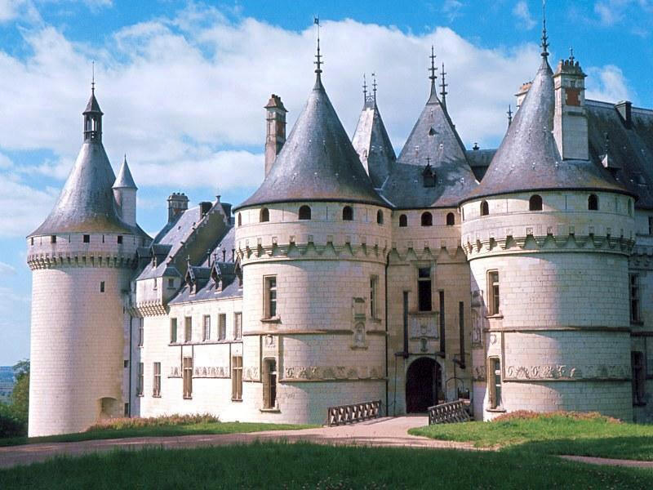

Slide 38
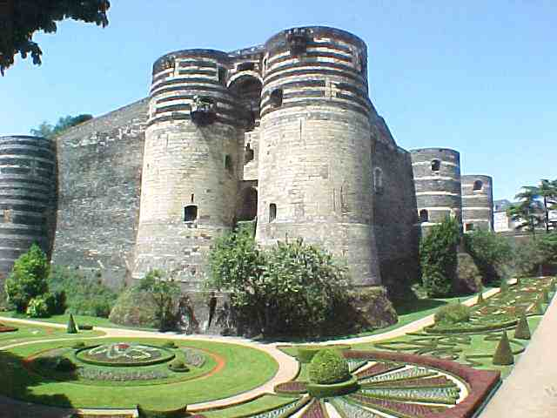

Slide 39
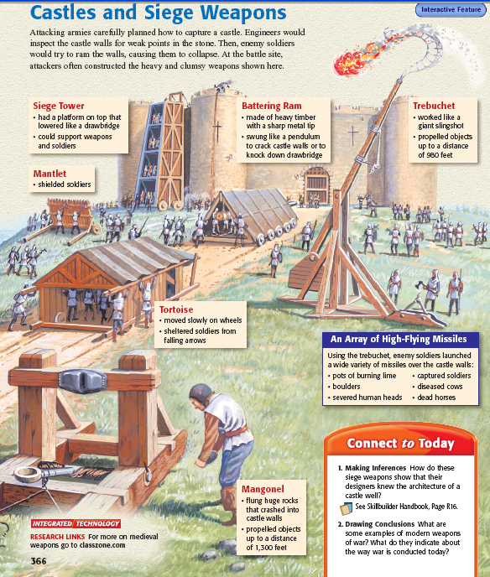
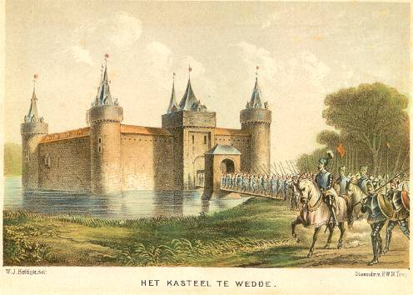
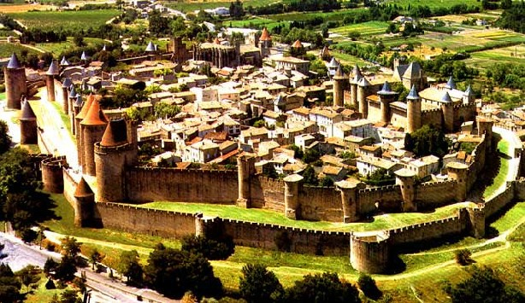
Medieval Castles

Slide 40
Medieval Nation-States
Except for Charlemagne, kings had very little power because their lands & power was transferred to the nobles
BUT, in 1100s European monarchs (kings) began to build strong nation-states
Nation-state is group of people under 1 government, with definite territorial borders, common culture & language

Slide 41
England & France were Europe’s 1st nation-states
The role of the monarchy (king) grew stronger in England & France in the 1300s
The growth of nations led to the beginning of Nationalism (loyalty to a nation-state rather than feudal lord)

Slide 42
English Kings
William the Conqueror
  Strong ruler took crown by force in Battle of Hastings
  Created new nobility
  Started taxing
Henry II
  Set up a system of common law
John
  Weak unpopular due to losing French holdings
  Raised Taxes
  Forced to sign Magna Carta (limited king powers)
  Created parliament
Edward I
  Formed English Parliament
Notes:
William was long relative of Alfred the great and claimed the crown but it was given to harold so he took it
King john of robin hood

Slide 43
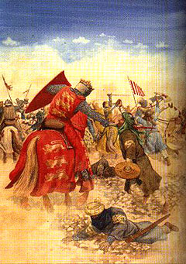
Crusades and High Middle Ages

Slide 44
Why Fight the Crusades?
Why did Christians fight the Crusades?
  The Pope wanted to unite Roman Catholic & Eastern Orthodox Christians & regain holy lands from Muslims
  Knights wanted to gain forgiveness for sins, gain riches, & support the Church
  Merchants wanted to trade

Slide 45
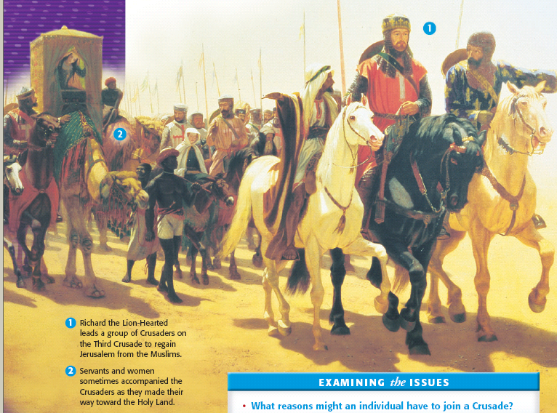
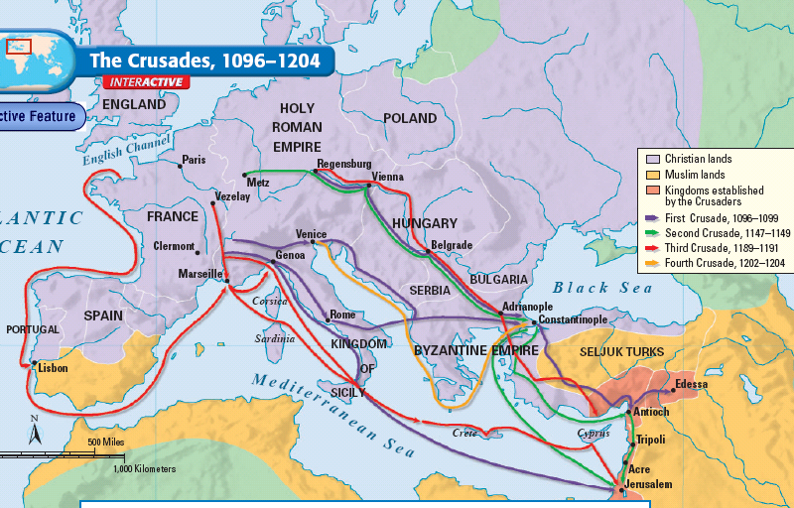
The Christian Crusades

Slide 46
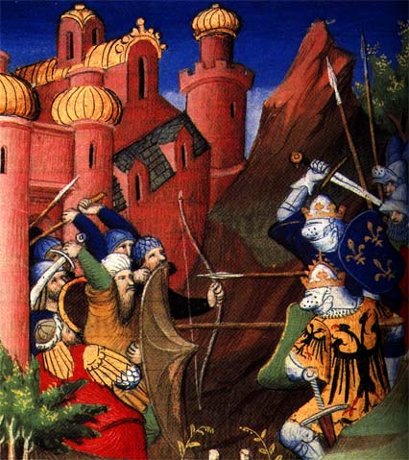

CHRISTIANS
MUSLIMS

Slide 47
Fighting the Crusades
Between 50,000-60,000 knights from all over Europe became Crusaders to defeat the Muslims:
  First Crusade—was only successful Crusade; Christians took back Jerusalem in 1099
  But after the Crusaders left, Muslims took back Jerusalem & kept it during the Second & Third Crusades
Notes:
; came from present-day, Italy, Germany, England, Scotland, Spain

Slide 48
The Christian Crusades

Slide 49
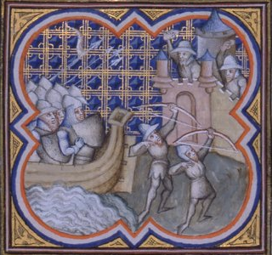
Fighting the Crusades
Fourth Crusade—crusaders never even made it to Jerusalem:
  Christians from Europe stopped in the Byzantine Empire & looted & burned Constantinople
  These actions divided Roman Catholic & Eastern Orthodox Christianity

Slide 50
Effects of the Crusades
Before the Crusades:
  Everyone lived on a manor
  Everything that was needed was made on the manor
  Nothing was purchased from the outside except resources like salt & iron through fairs
So, now that the Crusaders have seen new places, how is this going to change Europe?

Slide 51
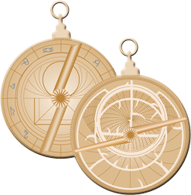
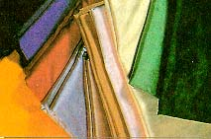
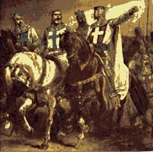
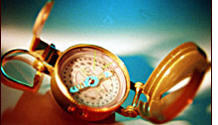
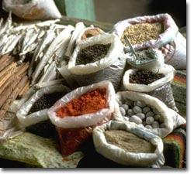

Slide 52
Effects of the Crusades
Cultural Diffusion—new products & ideas spread from the Middle East & Asia to Europe:
  Luxury Goods—ivory, pearls, silk, cotton, sugar, & spices
  Navigation—shipbuilding ideas, accurate maps, astrolabe, gunpowder & the compass
  Math—Arabic numbers, algebra
  Science—chemistry, astronomy, & the telescope

Slide 53
Effects of the Crusades
Trade increased:
  Europeans badly wanted these new products
  Led to a money-economy (using metal coins) & banking (giving loans & offering credit)
  Merchants & bankers formed a new middle class
  Cities began to form, especially in Italy (Florence & Venice)

Slide 54
The Crusades- where Christians sought to regain the Holy Land from Muslims http://player.discoveryeducation.com/index.cfm?guidAssetId=0FE0F4EC-B84A-48AE-8BEE-79867E3A6F6B&blnFromSearch=1&productcode=US
Muslims control of Palestine (the Holy Land) and threaten Constantinople
Byzantine Empire calls for help
Pope wants to reclaim Palestine
Pope appeals to Knights
Knights feel religious
Italians cities desire commercial power
Byzantine Empire weakened
Pope’s power declines
Power of Feudal Nobles weakens
King becomes stronger
Religious intolerance grows
Italian cities grow
Muslims distrust Christians
Trade grows b/w Europe and Middle East
European tech. improves
Causes…
Effects…

Slide 55
Effects of the Crusades
Feudal power changed:
  Pope lost power—failures of the Crusades led to loss of respect
  Noble lords lost power—some lords & knights sold pieces of their land to raise money to fight the Crusades & some serfs gained their freedom
  Kings gained power—raised taxes & created armies to fight

Slide 56
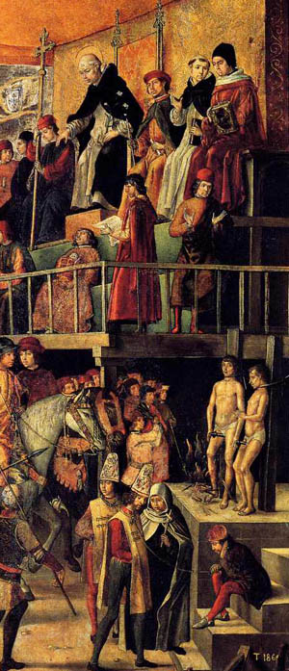
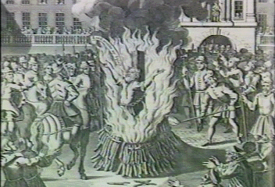
After the Crusades it gets bad
Church faces increasing heresy
Lead to inquisitions

Slide 57
Wars
Hundred Years War
  Fight for French throne
  French king dies
  English King (Edward III) stakes claim for crown
  The French aren’t having it
  English take most of France
  Joan of Arc starts to push back

Slide 58
Black Death (1347-1351)
The bubonic plague or Pneumonic plague
Started spreading due to rats infested with fleas that had the disease
Dark splotches on skin, high fever, vomiting, headaches. Death
25 million died 1/3 of the population

Slide 59
Effects of the Plague
Europe and China both lost one-third of their population
People blamed God for the plague, Anti-clericalism began to rise
Anti-Semitic beliefs increased in Europe
The Manor system collapsed as people left their manors

