Slide 1
Warm Up- Thursday Oct. 30th
1) What were the official starts of the American and French Revolutions?
2) Compare and contrast the American and French Revolutions with at least two similarities and two differences
3) Which event during the French Revolution was the most important and impactful? Why?

Slide 2
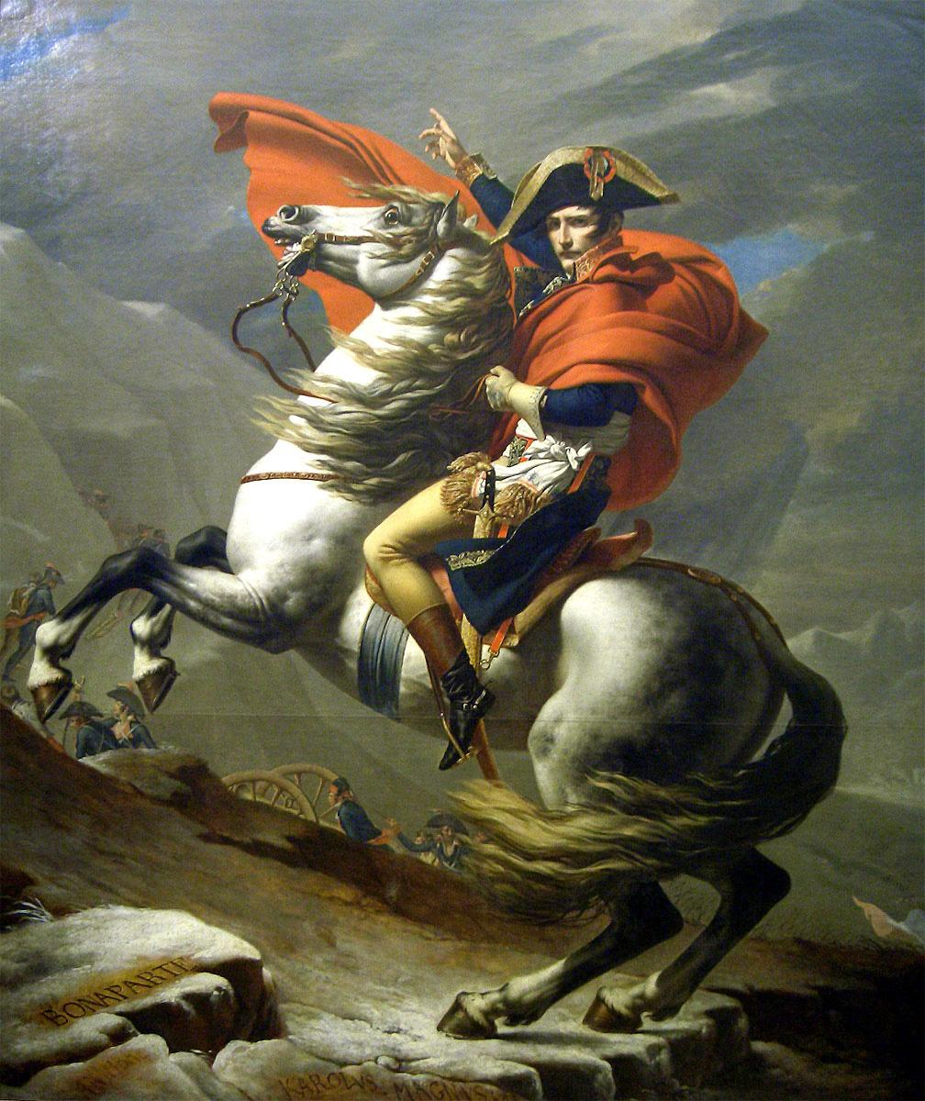
Napoleon

Slide 3
Fear of Revolutionary Ideas
When Louis XVI was executed during the French Revolution, other European kings were afraid that these ideas would lead to revolutions in their countries
Prussia, Spain, England, Sweden, Austria formed the First Coalition & went to war with France to bring the Bourbon Dynasty back & end the French Revolution

Slide 4
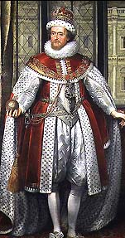
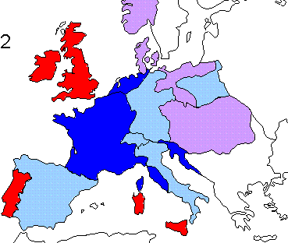

Let’s team up to put out this fire before it spreads!!

Slide 5
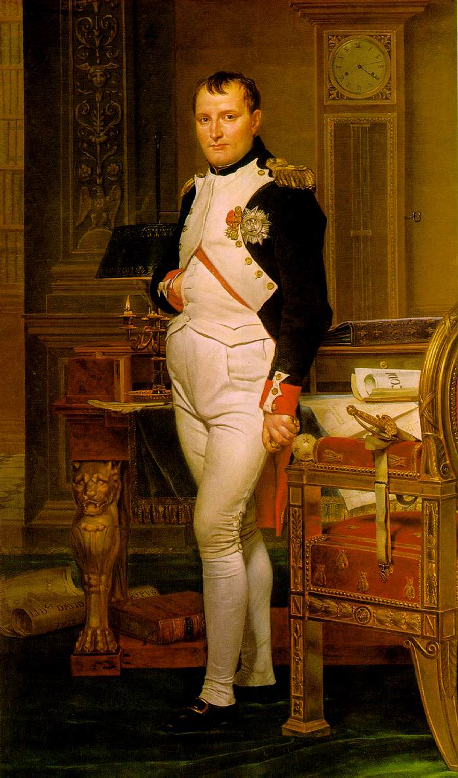
Napoleon Bonaparte
Napoleon Bonaparte was a popular soldier in the French military who supported the republic
In 1796, the leaders of the French republic gave Napoleon command of the army to defend France from this European coalition

Slide 6
Napoleon’s Control of France
Napoleon showed his great military skills & defeated the First Coalition
By 1799, Napoleon believed
that he could do a better
job running the French government than the leaders of the republic

Slide 7
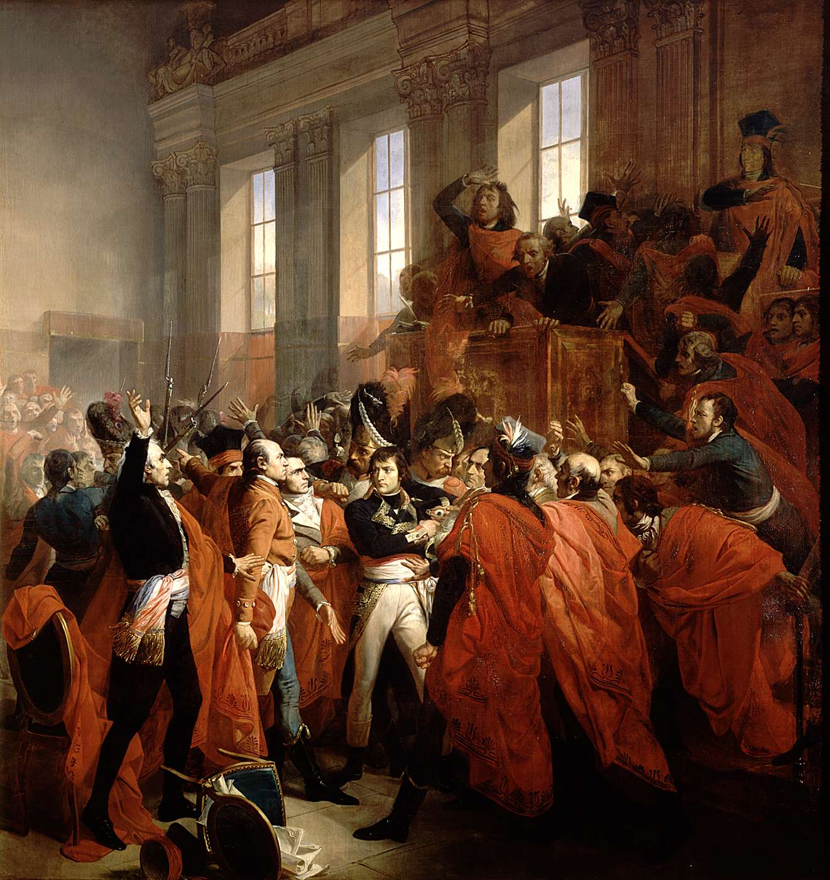
In 1799, Napoleon staged a coup d’etat (overthrow) of the republic & had himself named dictator
Napoleon’s control of France was supposed to be a short-term fix to restore order, BUT…

Slide 8
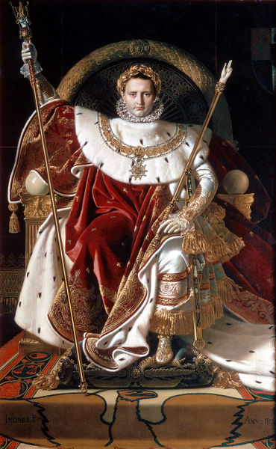
Napoleon Controlled France
Desperate for strong leadership, French citizens allowed Napoleon to have as much power as he wanted, so he made
himself emperor in
1804
The philosophes of the Enlightenment were outraged (this is absolutism!); but the people supported Napoleon

Slide 9
Napoleon’s Changes in France
Good Changes
Improved education
Created a Bank of France & made everyone pay taxes
Created the Napoleonic Code to make French laws more equal & clear
Increased the size of the French empire
Bad Changes
Used the military to run the country
Limited freedom of speech & executed or jailed his critics
Forced men to join the French army
Continued fighting European wars

Slide 10
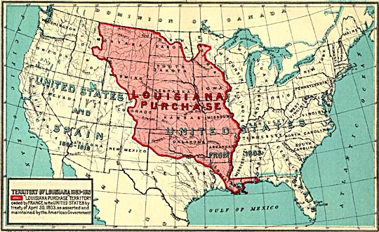
Napoleon sold Louisiana territory to USA president Thomas Jefferson in 1803 for $15 million ($0.03 per acre)
Notes:
About $230 million in today .42 per acre

Slide 11
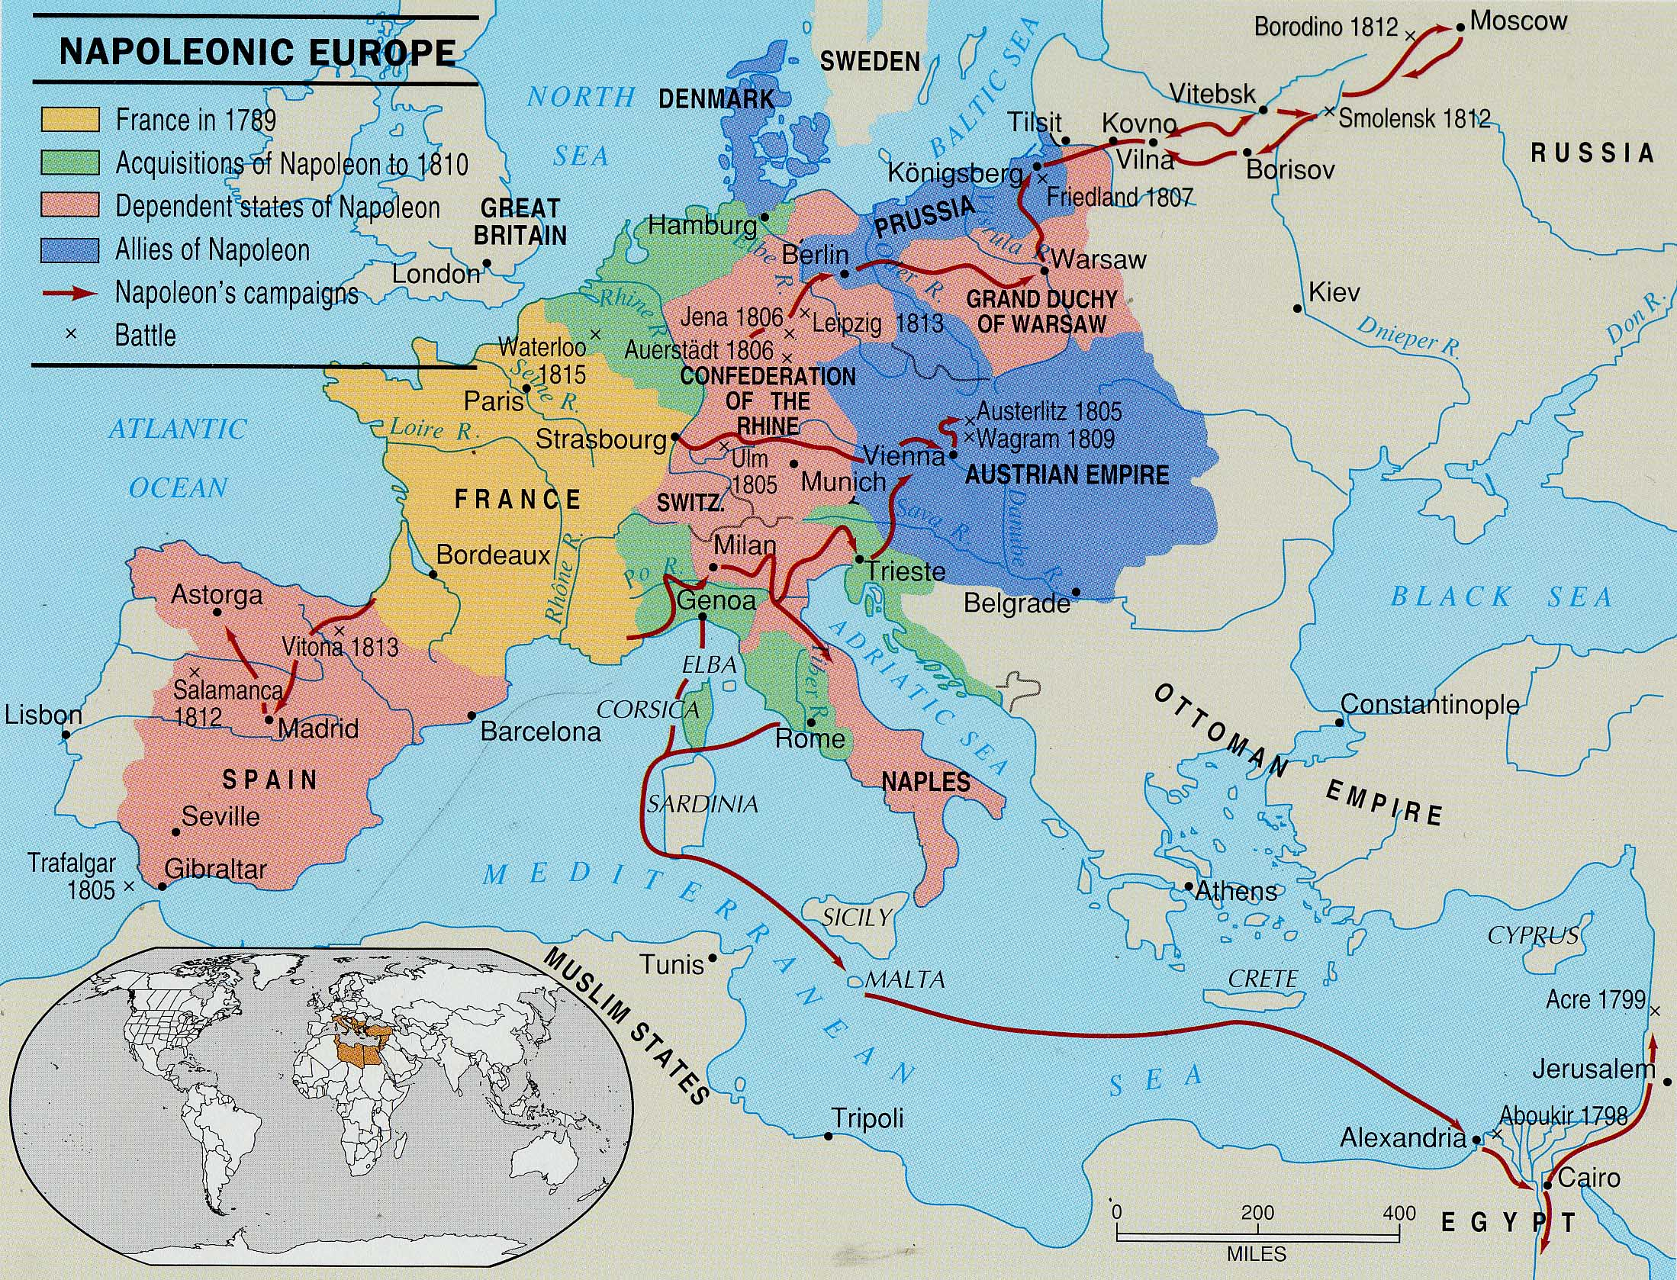
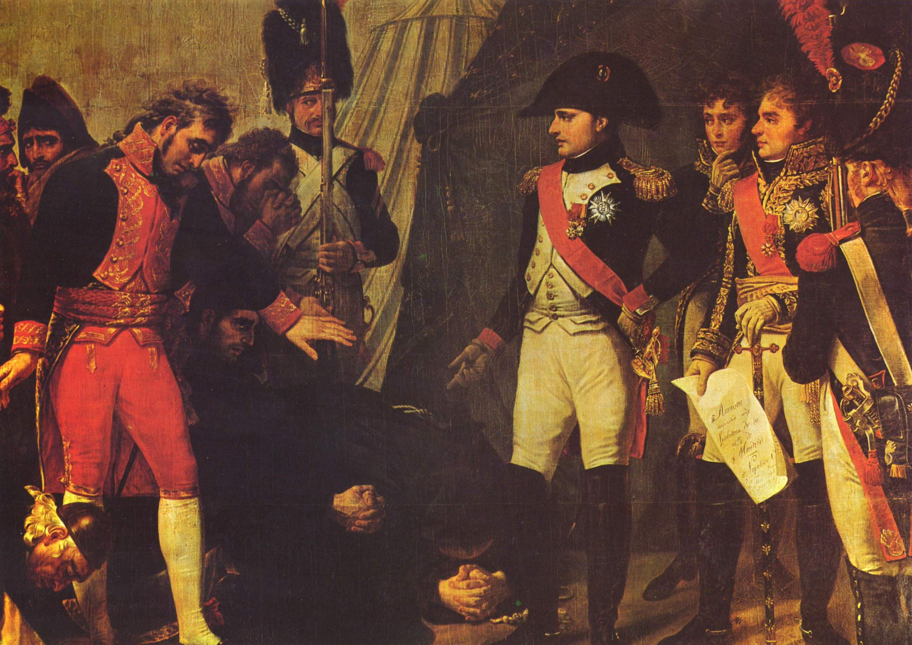
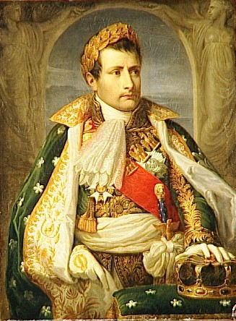
After Napoleon defeated the First Coalition in 1796, he continued his fight against his European enemies
Napoleon defeated Austria & Italy in a war against the Third Coalition in 1805
Napoleon defeated Prussia in a war against the Fourth Coalition in 1806
Napoleon defeated Spain in 1809
Notes:
At the peninsular war – initially were going to fight portugal together

Slide 12
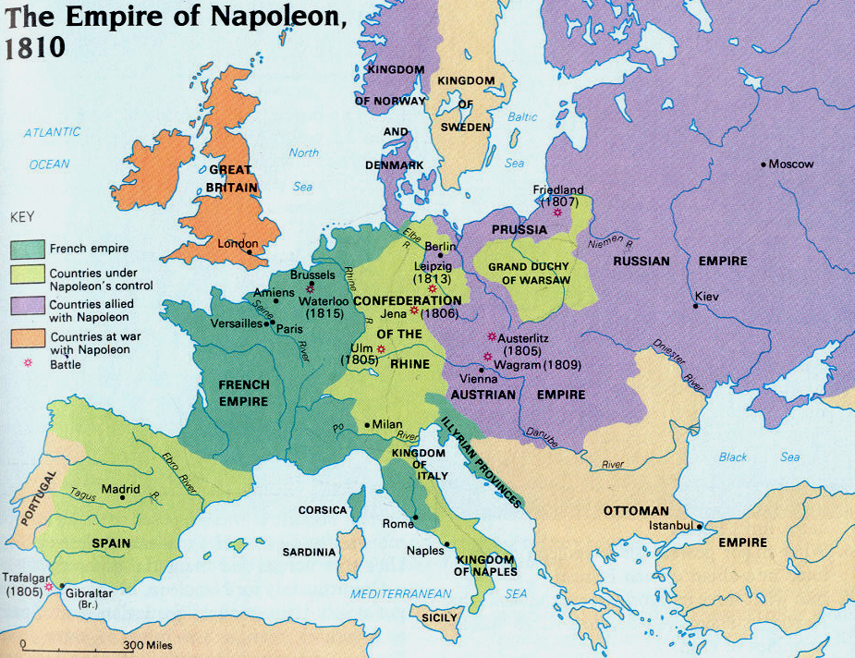
By 1810, Napoleon had created the largest European empire since the Romans!

Slide 13
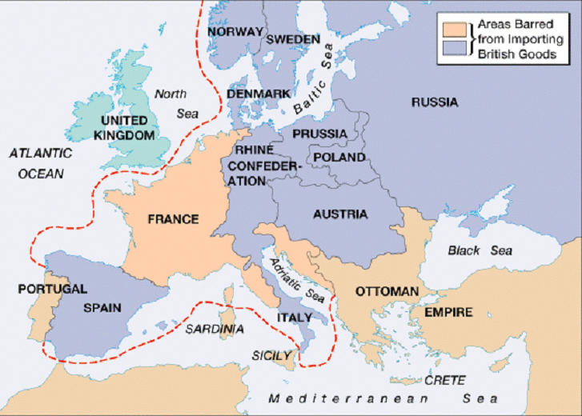
Napoleon’s Empire
Napoleon forced Europe to:
  Obey the Napoleonic Code
  Obey the Continental System—a strict blockade of all British goods & a
  heavy tax on any
  non-french product

Slide 14
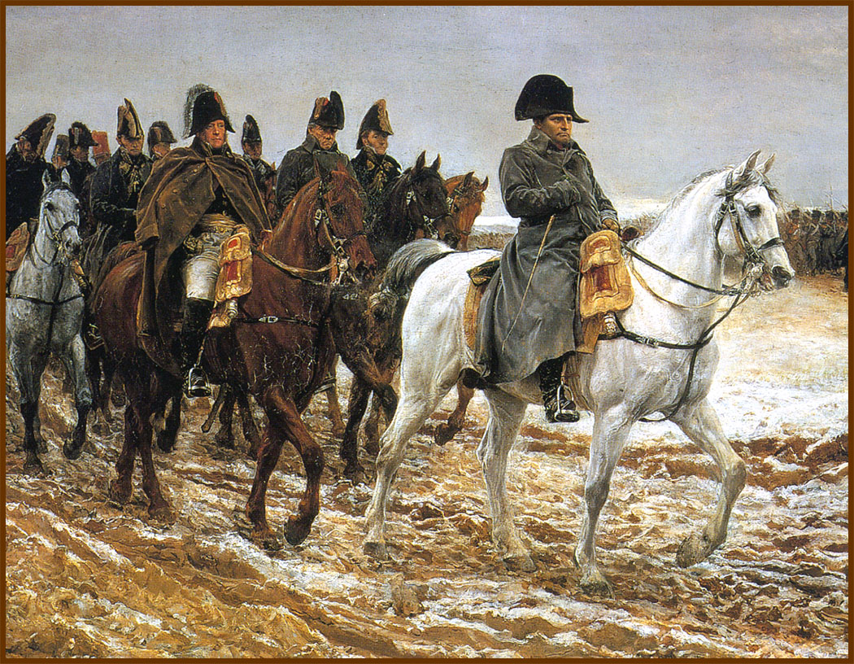
End of Napoleon’s Empire
By 1812, the only countries Napoleon
did not control were England, Sweden & Russia
When Russia violated the Continental System & bought grain from England, Napoleon attacked

Slide 15
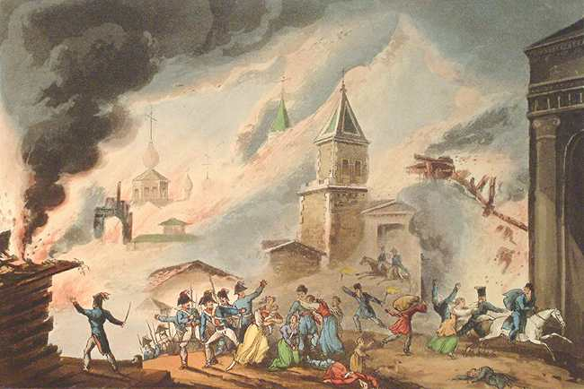

End of Napoleon’s Empire
Napoleon advanced towards Russia with a superior army, but…
The Russians used a Scorched-Earth policy—attack the French, then retreat while burning everything so Napoleon’s army can’t use them for food or shelter
This tactic & a harsh winter devastated Napoleon’s army; Napoleon lost to Russia in 1812

Slide 16
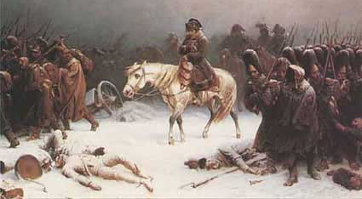
Napoleon’s Retreat from Russia
Napoleon arrived in Russia with 614,000 French troops but returned with only 40,000
Notes:
Napoleon’s retreat from Russia after defeat. Burr…cold!

Slide 17
End of Napoleon’s Empire
Napoleon was exiled to Elba (an island near Italy); France brought back the Bourbon king Louis XVIII
But…Napoleon returned & created a new army to lead France; BUT…
Notes:
After the exile he met troops that were sent to stop the uprising
Here I am. Kill your Emperor, if you wish."^{[131]}
The soldiers responded with, "Vive L'Empereur!"

Slide 18
End of Napoleon’s Empire
The Sixth Coalition of European powers defeated him at Waterloo in 1815 & ended Napoleon’s reign
Napoleon was exiled to the South Atlantic where he died in 1821 (of stomach cancer or poison?)

Slide 19
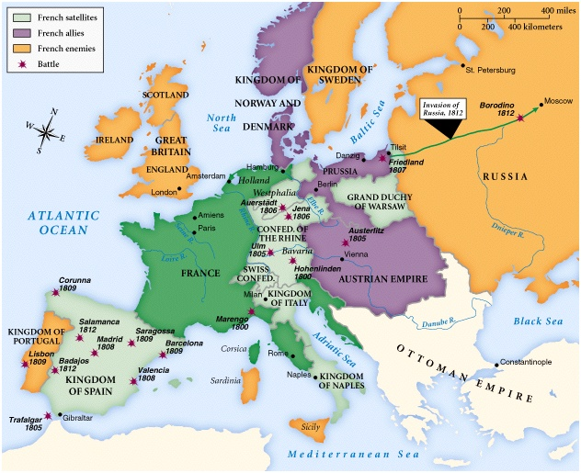
Europe in 1812 (at the height of Napoleon)
…and Norway & Denmark
In 1812, Napoleon was the emperor of France
…and Prussia
…and Warsaw
…and Spain
…and the Rhine
…and Switzerland
…and had defeated Austria
…and he had conquered Italy

Slide 20
Now that Napoleon has been defeated, what should be done to keep this from happing again?
From Sept 1814 to June 1815, an international conference called the Congress of Vienna was held in Austria
The main goal of the conference was to create a balance of power & keep peace in Europe

Slide 21
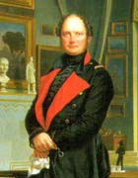
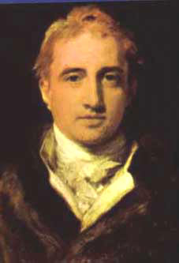
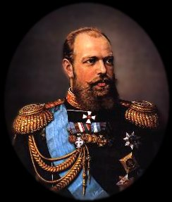
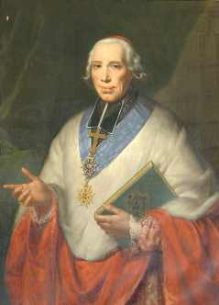
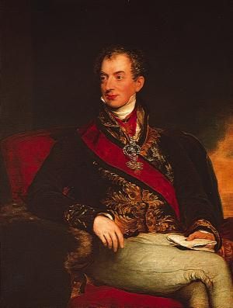
The decisions of the Congress of Vienna were made by representatives of the 5 “great powers”
King Frederick William III of Prussia
Czar Alexander I of Russia
Foreign Minister,
Castlereagh of England
The “host”
Prince Klemens von Metternich of Austria
Foreign Minister, Tallyrand of France

Slide 22
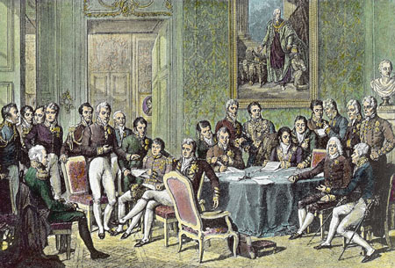
Let’s go back to the way things were
Revolutions are terrible!

Slide 23
Congress of Vienna
Austrian Prince Metternich & the other delegates disliked democracy & feared the new ideas of the French Revolution
They wanted to put Europe back “the way it was before” the French Revolution & Napoleon

Slide 24
Congress of Vienna
The 5 major powers of Europe made 3 big decisions:
Redrew the map of Europe to prevent further aggression—
  Took away all lands France gained under Napoleon
  Made the weaker countries around France stronger to keep France from attacking again

Slide 25
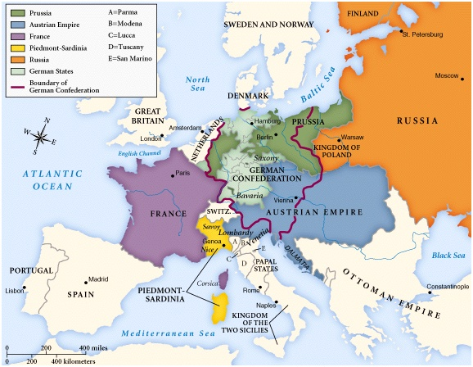
The Kingdom of the Netherlands was created
39 states joined to form the German Confederation
Switzerland became a new nation
Sardinia merged with Genoa
This created a “buffer zone” between France & the major European powers

Slide 26
Congress of Vienna
Reestablished royal monarchies:
  Representatives at the Congress of Vienna believed kings were more stable than democracies
  They brought back strong kings in France, Spain, Portugal, & many Italian & German states

Slide 28
Congress of Vienna
Reestablished a balance of power in Europe:
  England, Austria, Prussia, Russia formed a Quadruple Alliance to maintain security in Europe
  This helped keep peace in Europe for almost 40 years

