Slide 1
The Legislative Branch
How does the most powerful branch of government work to represent citizens at each level of government?

Slide 2
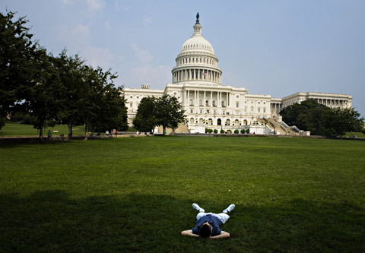
Terms of Congress
Every two years, new representatives join the Congress. They meet in sessions each year from January to November.
Usually, the two houses of Congress meet separately, but they occasionally meet together in a Joint Session.

Slide 3
The House of Representatives
435 members; must be 25 and a 7 year US citizen. Each representative serves for two years
Representation is based on population. The number of representatives of each state changes every ten years based on the census. This process is called apportionment.

Slide 4
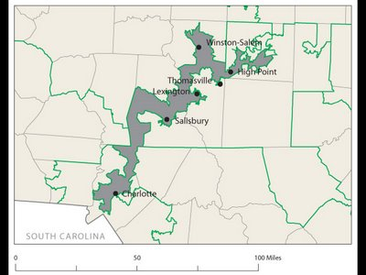
Congressional Districts
Each state is divided in parts of approximately equal population called districts. There is one representative per district. The people living in each district are called constituents.
Gerrymandering: drawing a district to favor one group over another. This is illegal.
Representatives focus on the concerns of their district rather than the whole state.

Slide 5
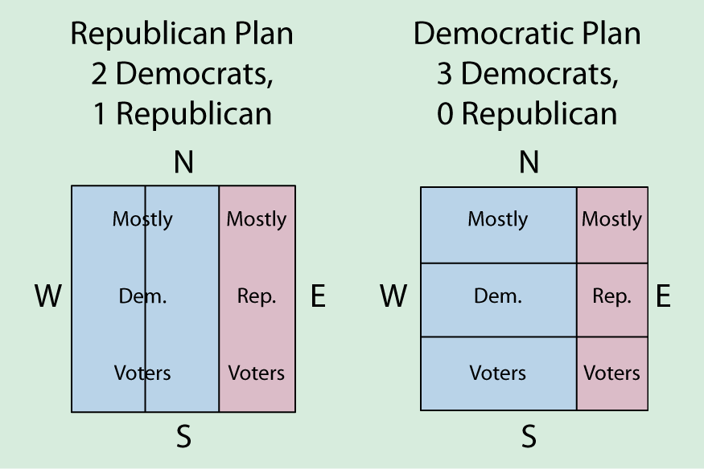
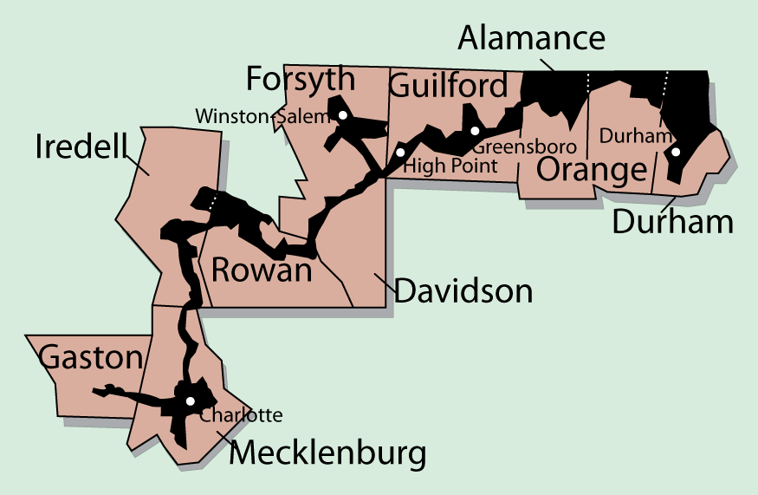
Gerrymandering
Packing Lumping opposition voters in one area
Cracking Splitting up groups of voters so they do not constitute a majority in any district

Slide 6
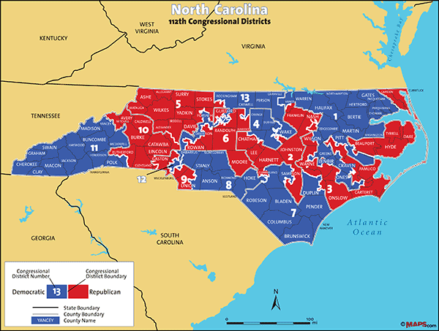
NC Congressional District Map

Slide 7
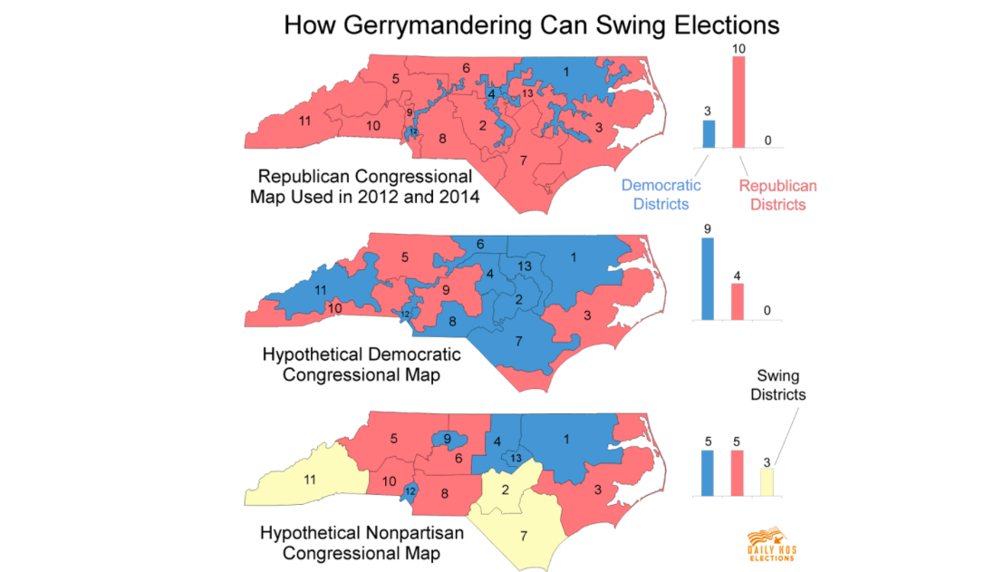

Slide 8
The US Senate
100 members; must be 30 and a 9 year US citizen. Each senator serves a six year term.
Each state has 2 senators who represent the entire state.
1/3 of senators are up for re-election every two years, so there is more consistency in the Senate.

Slide 9
Congressional Leaders
Each house of Congress has a majority party (>50%) and a minority party (<50%).
The majority party in the House of Representatives elects the Speaker of the House. This is the most powerful single person in the Congress.
Powers of the Speaker:
1. Choose which bills to address
2. Choose who will speak
3. Choose when to vote
Nancy Pelosi– Speaker of the House

Slide 10
More Leaders
The Vice President is the official leader of the Senate. He is rarely there and only gets to vote to break a tie. The day to day leader of the Senate is called the President Pro Tempore.
Each house has party leaders called the majority or minority leader. They direct members of their party to act on certain bills. The Senate Majority Leader is the person with the actual power in the Senate.
Each party also has officials called “Party Whips” who make sure members of the party are doing what has been asked of them.
Chuck Grassley
President Pro Tempore
Mitch McConnell
Senate Majority Leader

Slide 11
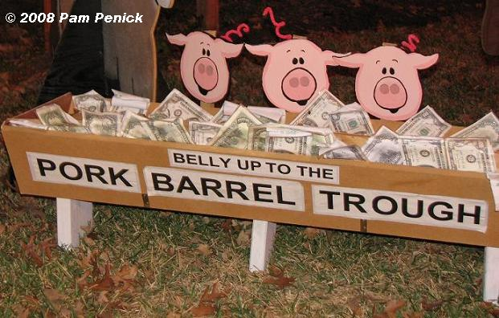
The Three Jobs of Congress Members
1. Lawmaking
2. Casework: help constituents deal with the Federal government
3. Helping the district/state: get Federal money for projects at home. These are called “pork-barrel” projects.

Slide 12
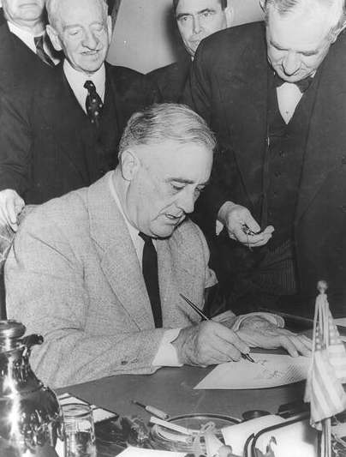
Powers of Congress
Expressed/Enumerated Powers (from Article 1)
Implied Powers
Legislative Powers:
1. Taxing and Spending: only the Congress can pass laws about raising and spending money
2. Regulating Commerce: only the Congress can regulate interstate and international trade
3. Foreign relations: Only Congress can declare war, maintain the military, and approve treaties with other nations.

Slide 13
Other Congressional Powers
Non-legislative powers:
1. Propose constitutional amendments
2. Check other branches: approve Federal judges and secretaries of executive agencies; impeach the President and VP
3. Oversight and Investigation: Congress investigates the effectiveness of their laws and programs

Slide 14
Powers of House vs. Senate
House of Representative
Introduces appropriations bills ($$$)
Elects President if no majority in Electoral College
Impeaches officials
Senate
Ratifies treaties
Elects VP if no majority in Electoral College
Impeachment trials
Approves Presidential appointments (cabinet members, Supreme Court justices)

Slide 15
Limits on Congressional Power
First Amendment freedoms (Congress cannot pass a law that interferes with the legal rights of individuals)
Cannot interfere with powers reserved to the states
Cannot suspend the Writ of Habeas Corpus: cannot put people in jail without a charge
Cannot pass a Bill of Attainder: cannot put someone in prison unless convicted in a trial
No Ex Post Facto Laws: cannot charge someone with a crime if they committed the act before it was a crime

Slide 16
Congressional Punishments
Expulsion- Can be forced to leave due to a 2/3 vote by either house
Censure- Wrongdoings are made public (which can be very embarrassing)

Slide 17
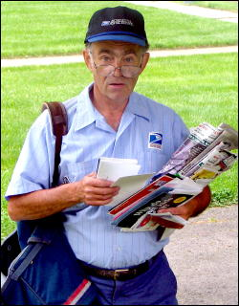
Benefits of Congress
$174,000+ annual salary
Free trips to home state
Franking Privilege: send work related US mail for free
Each member of Congress has a large staff who assist in many ways. They gather information on new bills, deal with lobbyists and the press, and deal with letters/email from constituents.

Slide 18
How Congress is Organized to Make Policy
Congressional Staff
Personal staff: They work for the member, mainly providing constituent service, but help with legislation too.
Committee staff: organize hearings, research and write legislation, target of lobbyists
Staff Agencies: CRS, GAO, CBO provide specific information to Congress
CRS- Congressional Research Service
CBO- Congressional Budget Office
GAO-General Accounting Office

Slide 19
Congressional Committees
Most real work of the Congress happens in committees.
Discuss, research, and revise bills
Members of Congress want to get on a committee that will give them a high profile or work in an area that can help out their constituents (to help them get reelected)

Slide 20
How Congress is Organized to Make Policy
The Committees and Subcommittees
The Committees at Work: Legislation and Oversight
Legislation
Committees work on the 11,000 bills every session
Some hold hearings and “mark up” meetings
Legislative oversight
Monitoring of the bureaucracy and its administration of policy through committee hearings
Special interest groups, private citizens, parts of the bureaucracy all sent representatives to Committee hearings

Slide 21
How Congress is Organized to Make Policy
The Committees and Subcommittees
Getting Ahead on the Committee: Chairs and the Seniority System
Committee chair: the most important influencer of congressional agenda (member of the majority party)
Dominant role in scheduling hearings, hiring staff, appointing subcommittees, and managing committee bills when they are brought before the full house
Most chairs selected according to seniority system:
Members who have served on the committee the longest and whose party controlled Congress become chair

Slide 22
Standing Committee
Permanent committees specializing in a certain area
Divided into subcommittees
House of Reps Examples
Appropriations ($), Ways and Means, Judiciary, Armed Services
Senate Examples
Same as house except no Ways and Means and Appropriations has much less power

Slide 23
Committees cont…
Select Committees
Joint Committees
Temporary committees formed to complete a task
The committee stops existing when the task is completed
Examples
9/11 Investigation
Members of both houses meet together in a committee
Not very powerful or influential (only 4 of them)
Examples
Library

Slide 24
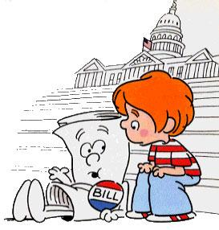
Conference Committees
Members of both houses work together to compromise a bill that has passed through both houses of Congress
An important step in the bill making process as both houses must agree on the same version of the bill before it can go to the President
Speaking of which…

Slide 25
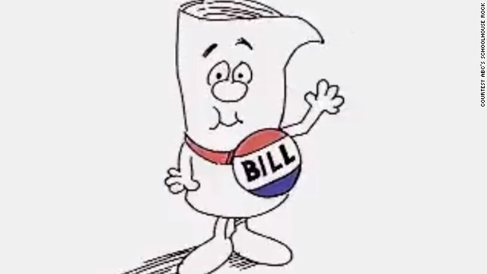
How a Bill Becomes a Law
1. A bill starts out as an idea (anyone can have this idea).
2. The idea is then proposed in either house of Congress (only by a member of Congress)
3. The bill is moved to a committee depending on its topic.
4. The committee can do one of four things:
a. Research and approve
b. Pigeonhole it (set it aside)
c. Reject it
d. Change it

Slide 26
Bill to Law Continued
5. Once approved in committee, it goes to either the House or Senate for debate.
a. The House limits how long someone can debate the bill
Senators may conduct a filibuster (talk it to death)
Cloture must be passed to limit how long a Senator may talk (3/5 vote)
6. Once passed with a simple majority in one house (half plus one), it moves to the other house.
7. Bill goes to a conference committee if necessary to finalize it.
8. Once it’s passed with a simple majority in both houses, it goes to the President.

Slide 27
9) Presidential Action
Sign the bill and it becomes law
Veto the bill (reject it)
If this happens the bill gets sent back to Congress
Congress can override a Presidential veto with a 2/3 vote in both houses (happens in less than 10% of all vetoes)
Pocket Veto- take no action for ten days
If Congress is in session after 10 days, the bill becomes a law
If Congress is not in session after 10 days, the bill is rejected

Slide 28
NC General Assembly
Passes laws (called statutes) for the state. Also performs oversight, and can impeach elected officials.
NC Senate: 50 members
- Must be 25 and 2 year citizen of NC
NC House of Representatives: 120 members
- Must be 21 and 1 year NC resident
The state is divided into 120 House districts and 50 Senate districts.
Sessions: when legislators are working in Raleigh
- “Long Session”: in odd years, members meet from Jan-July
- “Short Session”: in even years, members meet from May-Aug

Slide 29
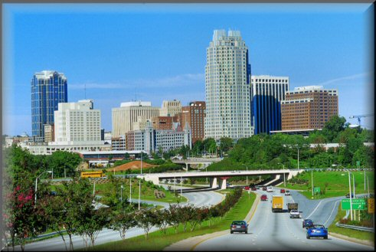
Municipalities
Municipalities: cities, towns, and villages
Provide services that are necessary for people living close together. Ex: street lights, water and sewer service, trash pick up.
Incorporated by the General Assembly: the General Assembly approves the geographic boundaries and charter of the city. A charter is a written document outlining the government of a municipality. It is like a city’s constitution.

Slide 30
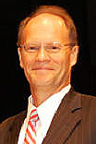
Municipalities continued…
Government in Municipalities:
- Municipalities are governed by an elected council called either the city/town council, board of commissioners, or board of aldermen.
- This council makes laws for the municipality. These laws are called ordinances.
- The council is led by a mayor who may be appointed by the council itself or elected by the citizens.
- The board hires a city manager to run the day to day activities of the municipality and enforce the ordinances. The city manager is the Chief Executive of the municipality

Slide 31
NC Counties
There are exactly 100 counties in NC.
Counties carry out the statutes passed by the General Assembly.
They also provide services like public libraries.
Government in counties:
- Run by an elected board of county commissioners. They oversee elections, alcohol distribution, and schools in the county.
- Each county has a Local Education Authority (LEA), aka School Board. The school board operates the public schools in a county.
- The citizens of the county also elect a sheriff who is in charge of law enforcement in the county.

