Slide 1
The Executive Branch
National, State and Local

Slide 2
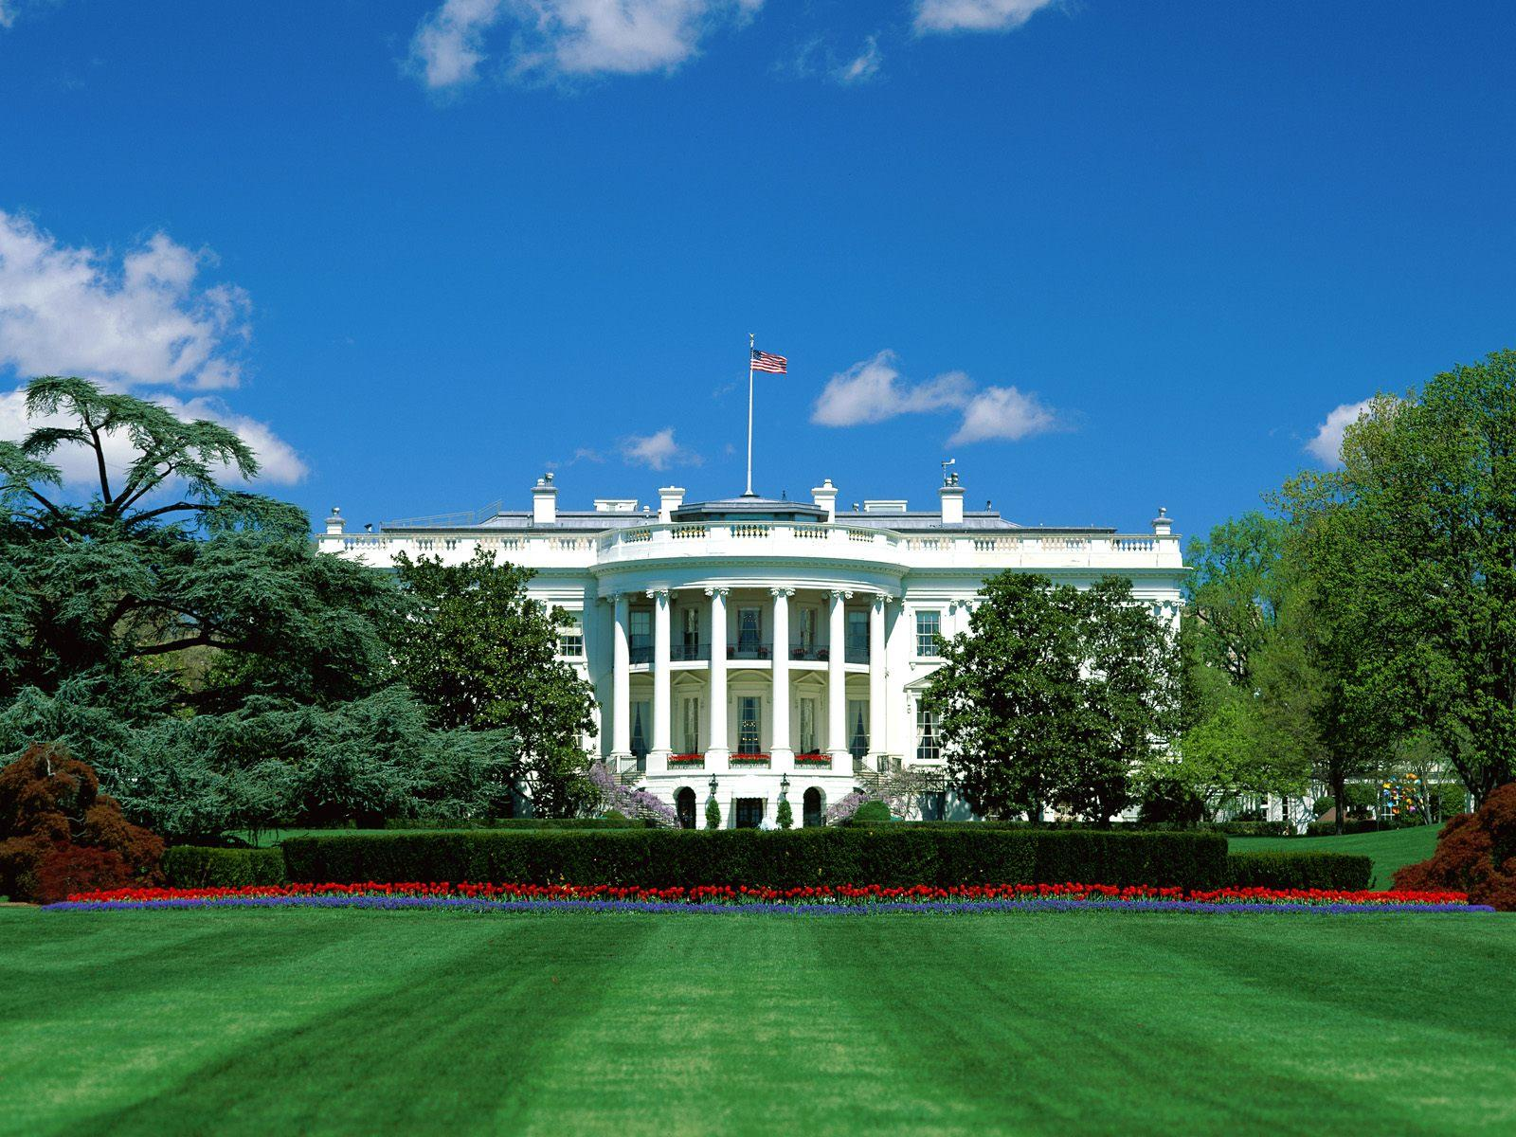

Slide 3
US Executive Branch
Led by the President of the United States.
All presidents have been white males, except for Barack Obama. All but one has been Protestant.
Cabinet: Group of advisors to the president.

Slide 4
Qualifications
Literally only three qualifications listed to be President in the US Constitution (Article II)
1. Must be a native-born US citizen.
2. Must be 35 years old.
3. Must have lived in the United States for 14 years.
The president is elected every four years by the Electoral College.

Slide 5
Presidential Amendments
22nd Amendment
President can serve a max of two terms, or ten years.
Amendment was put in place when FDR served FOUR terms.
25th amendment
VP takes over if the president can not fulfill his duties for any reason.
The presidential line of succession provides a lay out of who would be president in many cases.

Slide 6
Presidential Perks
Salary
$400,000/year plus money for expenses and travel
White House
Private movie theater, small gym, heated pool, bowling alley, large staff
Camp David, Air Force One

Slide 7
Presidential Elections
Occurs every 4 years through the Electoral College
Constitution does not provide for the direct election of the President, instead we have this indirect method
Each state gets as many electoral votes as their total of Congressmen (HoR + Senators)
Winner take all system per state (Except for Nebraska and Maine)
Electoral College has 538 electors
You need at least 270 to win

Slide 8
The Vice President
Vice President
Same qualifications as the President.
Leader of the Senate, votes only in case of a tie.
Becomes President if the President dies.
William Henry Harrison was the first President to die in office, and his VP, John Tyler finished out his term.
“My country has in its wisdom contrived for me the most insignificant office that ever the invention of man contrived or his imagination conceived.” –John Adams (1st VP)

Slide 9
The Vice President Joseph Biden
Speaker of the House John Boehner
President pro tempore of the Senate¹ Patrick Leahy
Secretary of State John Kerry
Secretary of the Treasury Jacob Lew
Secretary of Defense Ashton B. Carter
Attorney General Loretta Lynch
Secretary of the Interior Sally Jewel
Secretary of Agriculture Tom Vilsack
Secretary of Commerce Penny Pritzker
Secretary of Labor Thomas E. Perez
Secretary of Health and Human Services Sylvia Mathews Burwell
Secretary of Housing and Urban Development Julián Castro
Secretary of Transportation Anthony Foxx
Secretary of Energy Ernest Moniz
Secretary of Education Arne Duncan
Secretary of Veterans Affairs Robert McDonald
Secretary of Homeland Security Jeh Johnson
-Order determined by when the office was established (Homeland Security established in 2002 is last in line)
-One of these people must be absent from the President’s State of the Union address

Slide 10
Foreign v. Domestic Policy
The President carries out laws passed by Congress and his own beliefs through foreign and domestic policy.
Foreign policy is a nation’s plan for dealing with other nations
Domestic policy includes policies and programs that deal with issues within the country.

Slide 11
Presidential Roles
1) Chief Executive
The president can issue executive orders, a command that has the force of law.
The president appoints many officials which must be approved by the Senate.
Can issue a pardon - forgiveness and freedom from a punishment.
Can issue amnesty - a pardon for a group of people.
Can issue a reprieve - delay of punishment.

Slide 12
Presidential Roles
2) Chief Diplomat
Appoints ambassadors and makes treaties.
Ambassador: Official representative to a country.
Treaty: Agreement between two or more countries. Must be approved by the Senate by a 2/3 majority.
Executive Agreement: Agreement between the president and the leader of another country. Does not require Senate approval.

Slide 13
Presidential Roles
3) Commander in Chief
Congress is given the power to maintain an army and declare war. Only the President can order troops into battle.
War Powers Act (1973): The president must inform Congress when troops are sent into battle. Troops must be brought home after 60 days unless Congress grants an extension.
The president can order troops to stop disturbances in the United States during peace time.

Slide 14
Presidential Roles
4) Legislative leader
Presidents should have the support of Congress.
The president can write a bill, but someone from Congress must introduce the legislation.
The President tries to make deals with Congress.
The President tries to gain support from the American people through the use of the mass media.

Slide 15
Presidential Roles
5) Party Leader
The president helps other party members get elected (coattail effect).
Appoints people with his views.
6) Economic Leader
Deals with problems of the economy like unemployment, rising prices, high taxes.
Plans the federal government’s budget.
7) Chief of State
The president represents the entire nation.
Acts as the symbolic leader of the United States.
People are very interested in the president and his family.

Slide 16
Executive Office of the President (EOP)
Executive Office of the President: the Presidents administration who carry out a wide range of jobs
White House Office (President’s closest advisors, the most important is the chief of staff)
Office of Management and Budget (OMB, prepares budget and monitors federal spending)
National Security Council (NSC, helps President with military issues and foreign policy, supervises the CIA)
Office of Administration (administrative services);
Council of Economic Advisors (CEA, gives President information on the economy)

Slide 17
Federal Bureaucracy
Federal Bureaucracy
The network of agencies and departments of the government.
Lots of “red tape”: Inefficiency caused by rules and regulations.
Each person has a designed function and must operate within a chain of command.
People must be well-trained and managed.

Slide 18
Executive Departments
There are currently 15 depts.
The most recent of which is the Dept. of Homeland Security
The head of each is led by a Secretary, appointed by the Pres and approved by the Senate
These 15 secretaries make up part of the President’s cabinet.
The cabinet is there to advise the President

Slide 19
Independent Agencies
The President appoints the heads of these agencies with Senate approval
Executive Agencies – deal with specialized areas
IRS, FBI, FEMA
Government Corporations
US Postal Service
Regulatory Boards/Commissions - protect the public by making rules for certain groups or industries
FTC, FDA, FCC, EPA

Slide 20
Government Workers
Top jobs like Cabinet Secretaries are appointed by the President with Senate approval and leave their office when a new President is elected;
Other jobs are hired through the civil service system which is based on exams, experience or merit and their job is permanent, or until they quit.
Before the Civil Service Reform Act of 1883 federal jobs were given as a reward to those who had given political support to the elected President which was also called the spoils system.

Slide 21
NC Executive Branch
Led by a governor. Our current governor is Roy Cooper.
In most states a person must be 30 years old, a US citizen, and a resident of the state for five years.
Serve a four year term.
Recall: An election where voters can remove state officials (ex. Scott Walker in Wisconsin).
Lieutenant Governor: Takes over for the governor and is head of the state senate. (Is like the Vice Pres. of the state)

Slide 22
Powers of the Governor
Chief Executive, Chief Legislator, Judicial Leader, Commander in Chief, Party Leader, Ceremonial Leader.
As judicial leader a governor can:
Commute: Reduce a sentence.
Parole: Early release from prison.
Extradition: Governor orders a suspect to be returned to the state where the crime was committed.
Can offer pardons and reprieves.
Calls in the National Guard if problems occur in the state.

Slide 23
NC Executive Officials
Most officials are elected by voters.
There is a Council of State, which are elected heads of state agencies in North Carolina that are independent of the governor.
There is also a NC cabinet, where leaders are appointed by the Governor.

Slide 24
Local Executive Government
Mayor-Council government
Separate legislative (city council) and executive (mayor) branches.
There are strong and weak mayor plans. Use common sense -- Strong mayor has more power than weak.
Council-Manager
Voters elect a city council.
City manager runs the city. Appointed by the city council.
If the manager does not do a good job, he can fired by the council.
Commission government
Separate departments led by a commissioner. The commission has executive and legislative powers.

Slide 25
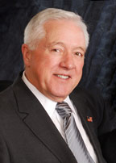
Holly Springs
Holly Springs has a council-manager form of gov’t
5 board members on the city council, plus the mayor, plus a city manager that runs the day-to-day operations.
Responsible for passing town ordinances (local laws); Holly Springs has a code of ordinances.
Dick Sears is the Mayor

