Slide 1
The United States Court System
Essential Questions: What are the similarities and differences between the US and NC courts in terms of structure, power, and organization? What relationship exists between citizens and the government? What relationship exists between the federal, state, and local governments?

Slide 2
US Courts
Most directly influenced by English common law.
Common law is a system of of unwritten rules or laws based on customs and traditions.
Many decisions are based on precedents.
Precedents are decisions made from a previous ruling.
Courts use the idea of judicial review
Reviewing decisions or actions made by the other 2 branches

Slide 3
Marbury v. Madison
Midnight judges: John Adams appointed several judges on his last night as President.
James Madison became Jefferson’s Secretary of State and was instructed to withhold the commissions.
William Marbury took the case to the Supreme Court as a provision of the Judiciary Act of 1789.

Slide 4
Marbury v. Madison Principles
1. Constitution is the Supreme law of the land.
2. In cases of conflict between the Constitution and any other document, the Constitution must be followed.
3. Judicial branch must uphold the Constitution and nullify all unconstitutional laws.
4. This case established judicial review.

Slide 5
US Court hierarchy
The lowest court in the Unites States District Court.
Above the District Courts are the US Court of Appeals
The highest court in the United States is the US Supreme Court.
US Supreme Court
US Court of Appeals
US District Court

Slide 6
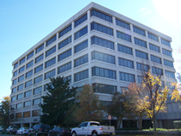
US District Courts
There are 94 US District Courts across the US.
Each District Court hears cases from that happen in their district.
DCs have Original Jurisdiction in most cases – meaning, most cases start here.
Only US court where actual “trials” are held.
Created by the Judiciary Act of 1789.

Slide 7
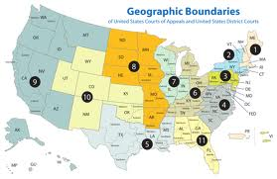
US Court of Appeals
If a case is appealed – or if one of the parties ask for the case to be reviewed, it will be heard at the US Court of Appeals.
This is called Appellate Jurisdiction.
There are 12 US Court of Appeals around the United States known as circuits.
Created by the Judiciary Act of 1789.

Slide 8
Us court of appeals
Each appeals court has from 6-27 judges. They earn $167,600 a year.
A panel of at least three judges will hear each case.
The court may:
1. Uphold the earlier ruling.
2. Overturn the decision.
3. Remand the case to a lower court for a new ruling.
Some cases will be appealed to the Supreme Court.

Slide 9
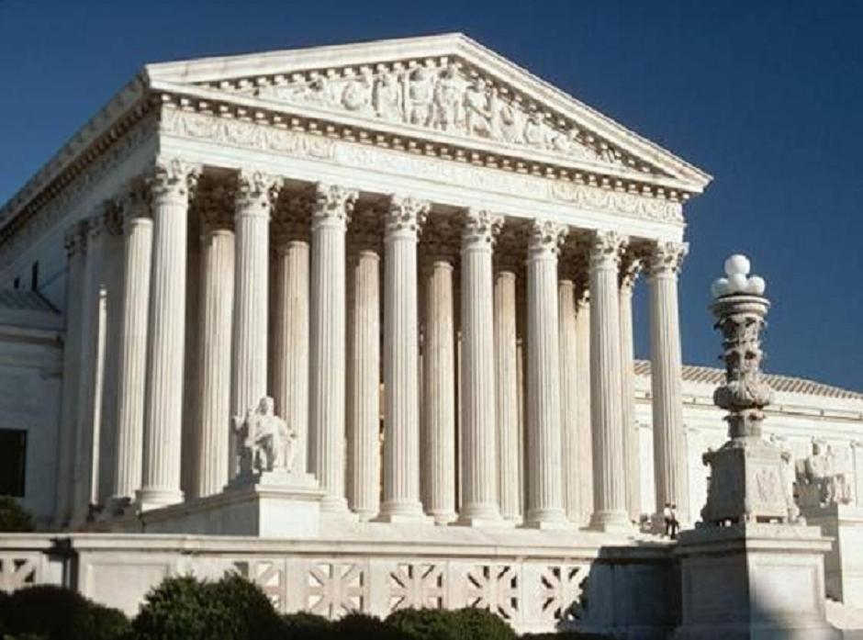
US Supreme Court
The highest court in the United States
Established by Article 3 of the US Constitution.
Any case appealed from the US Court of Appeals is heard here (Appellate Jurisdiction).
Exclusive Jurisdiction in: cases where one state sues another state, cases involving foreign diplomats
Located in Washington, D.C.

Slide 10
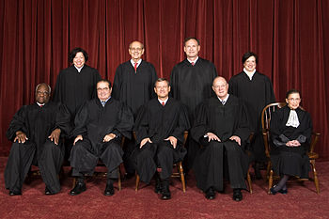
US Supreme Court
Structure of the SC
There are 9 SC Justices – 1 Chief Justice and 8 Associate Justices
Judges are appointed by the President and approved by the Senate
No listed qualifications for judges
Appointed for life – only way to “quit” is to be impeached, die, or resign
Should not be “partisan”

Slide 11
Supreme Court Schedule
First two weeks of the month, they hear arguments, discuss cases, and vote. They have a two week recess where they decide what cases to hear and write opinions on other cases. They read briefs, or arguments written by attorneys.
Four out of nine justices must vote to hear a case. It is then placed on the docket, calendar.
The case must have two adversaries, opposing sides.

Slide 12
When making a decision…
When the US Supreme Court rules in a case, we call it the court’s “opinion”.
The “winning” decision comes from the “majority” of justices agreeing, so it is called the majority opinion.
If a justice does NOT agree with the majority of the court, then they would write a different opinion called a dissenting opinion.
If a justice agrees with the majority, but for different reasons, they would write a concurring opinion explaining their reasoning.
If all of the justices agree – it’s called a “unanimous” decision.

Slide 13
Types of jurisdiction
Jurisdiction - the ability to hear a case
Original jurisdiction – the first court to hear a case
Appellate jurisdiction – the court can review a case heard at a lower court to check for errors
Concurring jurisdiction – when more than one court has the authority to hear a case
Exclusive jurisdiction – when only one court can hear a case

Slide 14
The nc court system

Slide 15
Nc court hierarchy
The lowest court in NC is the NC District Court.
NC has a second trial court called the NC Superior Court.
Appeals cases from the trial courts are heard at the NC Court of Appeals.
The highest court in the state is the NC Supreme Court.
NC Supreme Court
NC Court of Appeals
NC Superior Court
NC District Court

Slide 16
Nc district court
NC’s District Court has original jurisdiction in cases involving misdemeanors, juveniles, and civil cases dealing with less than $10,000.
Cases appealed from the NC District Court go to the NC Court of Appeals.
All judges in NC are elected by the people to 8 year terms.

Slide 17
NC superior court
NC’s Superior Court has original jurisdiction in felony cases and civil cases dealing with more than $10,000.
Cases appealed from the NC District Court go to the NC Court of Appeals, except for First Degree Murder cases resulting in the Death Penalty – they go straight to the NC Supreme Court.

Slide 18
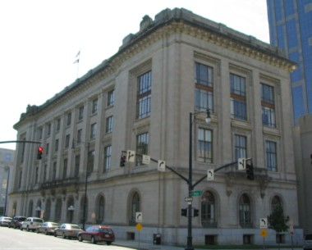
NC court of Appeals
NC’s Court of Appeals hears all reviews of cases from the District and Superior Courts. (Appellate jurisdiction)
Made up of a panel of 15 judges state wide.
Only 3 judges sit in on each case.

Slide 19
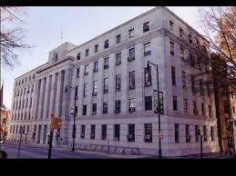
NC supreme Court
Highest court in the state
Made up of 7 SC Justices
Hear all cases appealed from the lower courts in NC

Slide 20
Warm Up #14
What are you thankful for?
What is your favorite Thanksgiving food?
What are three differences between the US and NC Supreme Courts?
What are the two specific types of cases that go directly to the US Supreme Court?
What is the difference between NC District and Superior Courts?
What is the importance of Marbury v. Madison?
What is the written version of the “winning” decision in a Supreme Court case called?

Slide 21
NC Executive Branch
Led by a governor. Our current governor is Roy Cooper.
In most states a person must be 30 years old, a US citizen, and a resident of the state for five years.
Serve a four year term.
Recall: An election where voters can remove state officials (ex. Scott Walker in Wisconsin).
Lieutenant Governor: Takes over for the governor and is head of the state senate. (Is like the Vice Pres. of the state)

Slide 22
Powers of the Governor
Chief Executive, Chief Legislator, Judicial Leader, Commander in Chief, Party Leader, Ceremonial Leader.
As judicial leader a governor can:
Commute: Reduce a sentence.
Parole: Early release from prison.
Extradition: Governor orders a suspect to be returned to the state where the crime was committed.
Can offer pardons and reprieves.
Calls in the National Guard if problems occur in the state.

Slide 23
NC Executive Officials
Most officials are elected by voters.
There is a Council of State, which are elected heads of state agencies in North Carolina that are independent of the governor.
There is also a NC cabinet, where leaders are appointed by the Governor.

Slide 24
Local Executive Government
Mayor-Council government
Separate legislative (city council) and executive (mayor) branches.
There are strong and weak mayor plans. Use common sense -- Strong mayor has more power than weak.
Council-Manager
Voters elect a city council.
City manager runs the city. Appointed by the city council.
If the manager does not do a good job, he can fired by the council.
Commission government
Separate departments led by a commissioner. The commission has executive and legislative powers.

Slide 25
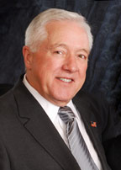
Holly Springs
Holly Springs has a council-manager form of gov’t
5 board members on the city council, plus the mayor, plus a city manager that runs the day-to-day operations.
Responsible for passing town ordinances (local laws); Holly Springs has a code of ordinances.
Dick Sears is the Mayor

Slide 26
NC General Assembly
Passes laws (called statutes) for the state. Also performs oversight, and can impeach elected officials.
NC Senate: 50 members
- Must be 25 and 2 year citizen of NC
NC House of Representatives: 120 members
- Must be 21 and 1 year NC resident
The state is divided into 120 House districts and 50 Senate districts.
Sessions: when legislators are working in Raleigh
- “Long Session”: in odd years, members meet from Jan-July
- “Short Session”: in even years, members meet from May-Aug

Slide 27
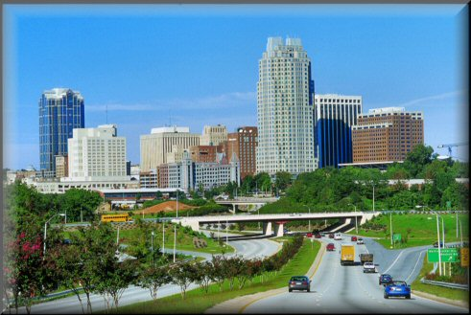
Municipalities
Municipalities: cities, towns, and villages
Provide services that are necessary for people living close together. Ex: street lights, water and sewer service, trash pick up.
Incorporated by the General Assembly: the General Assembly approves the geographic boundaries and charter of the city. A charter is a written document outlining the government of a municipality. It is like a city’s constitution.

Slide 28
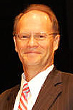
Municipalities continued…
Government in Municipalities:
- Municipalities are governed by an elected council called either the city/town council, board of commissioners, or board of aldermen.
- This council makes laws for the municipality. These laws are called ordinances.
- The council is led by a mayor who may be appointed by the council itself or elected by the citizens.
- The board hires a city manager to run the day to day activities of the municipality and enforce the ordinances. The city manager is the Chief Executive of the municipality

Slide 29
NC Counties
There are exactly 100 counties in NC.
Counties carry out the statutes passed by the General Assembly.
They also provide services like public libraries.
Government in counties:
- Run by an elected board of county commissioners. They oversee elections, alcohol distribution, and schools in the county.
- Each county has a Local Education Authority (LEA), aka School Board. The school board operates the public schools in a county.
- The citizens of the county also elect a sheriff who is in charge of law enforcement in the county.

