Slide 1
The Beginnings of Civilizations
Prehistory→ 1000BC

Slide 2
Beginnings of Civilizations…
How do we tell what happened Prehistory?
Archeologists- look for clues (digs)
Anthropologists- study the culture
Paleontologists- Study fossils
Earliest known human remains come from Africa

Slide 3
Earliest known human remains→ Africa
Invention of tools, mastery of fire and the development of language improved human life
Homo sapiens is the scientific name for modern man
Early humans were nomads – people who wander from place to place with no permanent settlements
They were hunters and gatherers for their food
Made tools to help increase their food supply
Made cultural advances with necklaces, cave paintings, rock paintings and carving

Slide 4
NEOLITHIC REVOLUTION
10,000 years ago, agricultural revolution, shifted to food producing instead of finding
Domesticated animals
Leads to settlements and villages
Took place in many places around the world, especially around fertile river valleys

Slide 5
CHANGES LEAD TO CITIES
Irrigation systems for surplus of crops, freed villagers to
do other jobs
Leads to craftsmen and trade with the invention of the wheel and the sail
Social classes emerge – need leaders
Established religions
Trade leads to cultural diffusion – spread of ideas,
beliefs, customs, skills or technology

Slide 6
EARLY RIVER CIVILIZATIONS…

Slide 7
Early Civilizations
Sprang up around the Fertile Crescent in the Middle East
Rich fertile farmland between the Tigris and Euphrates Rivers
It was known as Mesopotamia or the land between 2 rivers

Slide 8
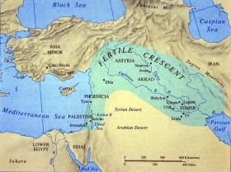

Slide 9
SUMERIANS
Had a city-state→ City with the surrounding land that the government controlled
Had a temple with a ziggurat or a pyramid shaped structure
Religion that was polytheistic--many gods
First city-states worshipped female gods of nature, however as warriors gained power male gods replaced them and women became dependent on men
Developed Cuneiform, the world’s first form of writing
Used to record harvests, myths, laws, contracts, etc…

Slide 10
Empires that were established in Mesopotamia

Slide 11
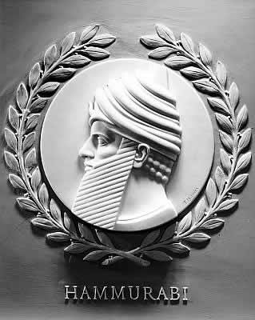
Babylonians
Lead by King Hammurabi who came up with the first written law code called Hammurabi’s Code – harsh punishments – eye for an eye

Slide 12
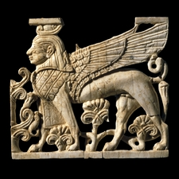
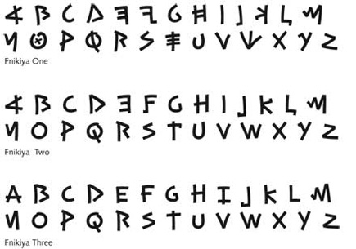
Phoenicians
trading empire (present day Lebanon)
First alphabet – modern English alphabet based on it

Slide 13
Persians
Present day Iran, at height the Empire extended from India to Turkey
Lasting legacy in communication and art/architecture
Greatest Rulers
Cyrus the Great- Defeated the Medes and united Persia
Darius I
Established a permanent army (the 10,000 immortals), tried to conquer Greece but failed
Responsible for building new roads and introducing standard weights and measures
Religion called Zoroastrianism – belief in dualism – struggle of good and evil

Slide 14
Warm Up- Friday, September 1
List 2-3 aspects the early civilizations and empires had in common
Name 1 unique aspect of each of the following civilizations: Sumerians, Babylonians, Phoenicians, Persians

Slide 15
Nile River Civilizations

Slide 16
EGYPT
Civilizations that live around the Nile River (flows north), biggest cities arose along the delta
Nile floods every year, giving Egyptians great crops
From June-October it overflows, depositing a layer of rich silt to create a narrow strip of fertile land for farming
Pyramids built by pharaohs or god-kings as burial tombs
Buried with possessions and servants for afterlife
Mummification – process of preserving body in cloth strips &
Minerals
Theocracy – where the government is run by religious leaders

Slide 17
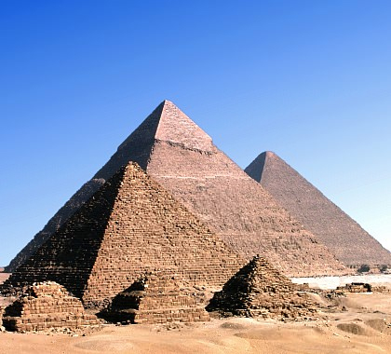
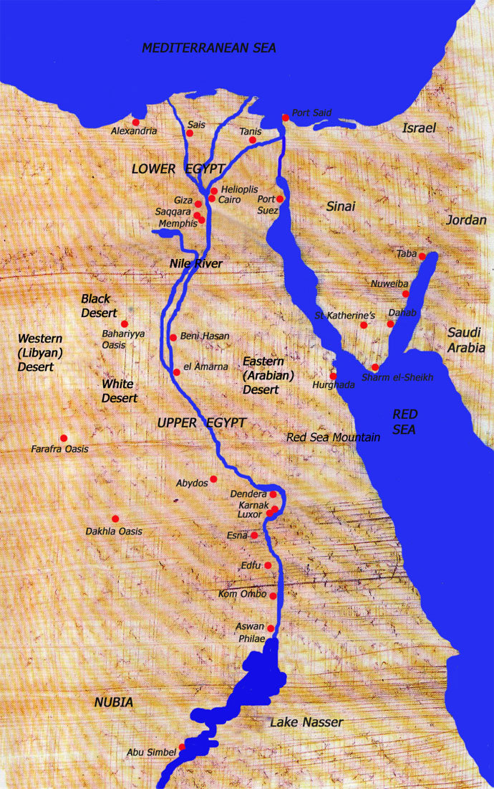
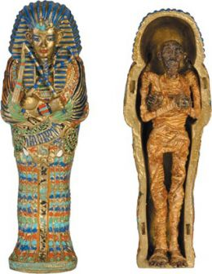

Slide 18
Egyptian culture
Society was very divided by social status
Women had many rights in their society
Egypt was surrounded by deserts, mountains, and seas so they were never invaded
Writing
Hieroglyphs
Invented writing on Papyrus paper
Notes:
Makeup bugs and coal

Slide 19
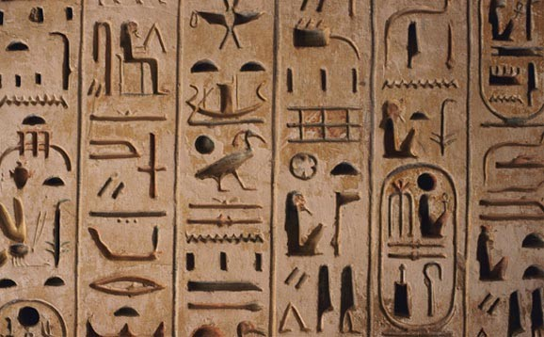
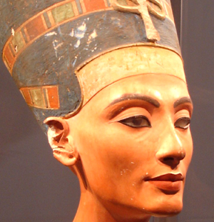
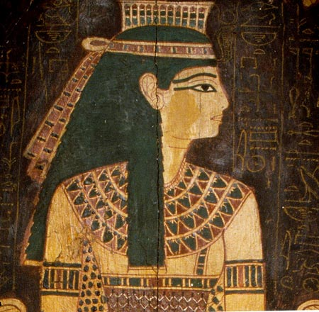

Slide 20
The Rosetta Stone
Discovered in 1799 near the town of Rasheed (Rosetta)
Lead us to understand Egyptian hieroglyphs through a translation in Greek

Slide 21
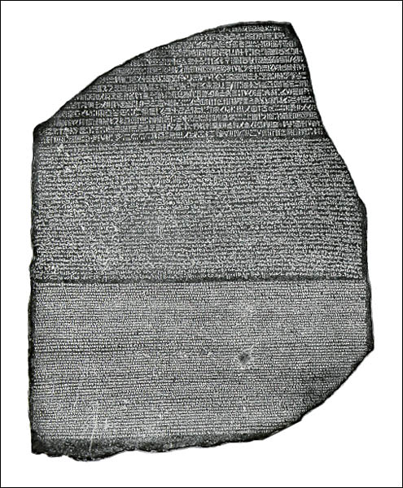
Notes:
7ft x 2 x 1
Hieroglyphs – Demotic - Greek

Slide 22
Indus River Valley

Slide 23
Early people lived in the Indus River Valley
People of Indus River developed well-planned cities with brick homes, streets, wells, sewers, markets

Slide 24
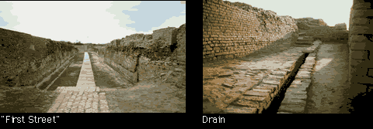

Slide 25
Early Indus Valley settlers
Like the Nile, the Indus flooded predictably & provided rich soil for farming
Aryans entered Indus River Valley in 1500 B.C.
Spoke early form of Sanskrit (language that is still around today in India)
Passed on traditions through Vedas—thousands of oral scriptures & poems that tell of the history & religion of Aryans
Major religion = Hinduism
Buddhism later breaks off of Hinduism

Slide 26
Social Structure
Caste System—complicated set of divisions of people within Indian society; higher castes were “purer” than lower castes
Did not marry outside of caste; did not share food with lower caste
Each group had own occupation & dharma (duty within caste)
“Better to do one’s own duty badly than do another’s duty well”

Slide 27
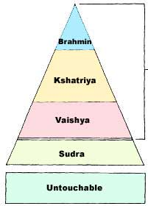
Priests
Warriors, Rulers
Common People
Unskilled Laborers
Slaves (Untouchables)
Notes:
KUH SHAT REE YUHZ, VEEZ YUHZ
Cannot enter other houses, no common paths, lived in slums, working with leather

Slide 28
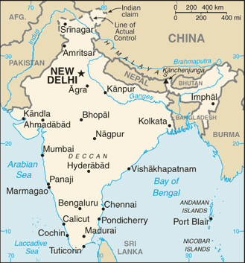
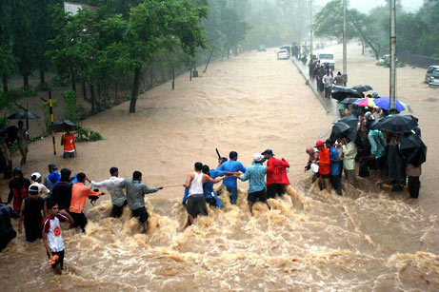
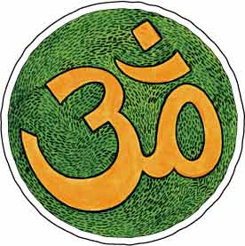
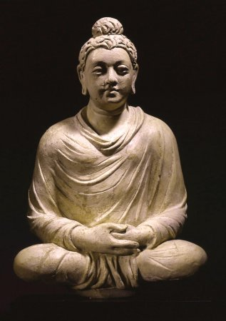

Slide 29
CHINA
Started around Yangzi and Yellow Rivers
Isolated by rivers and mountains as barriers
Believed in ancestor worship – had to honor ancestors with actions
Dynasties – periods of rulers from the same family
Philosophies of :
Confucianism – people should show love and respect to each other using traditional manners
Daoism – people should follow the laws of nature – balance of ying and yang

Slide 30
China’s first Dynasties
Began at least 1,000 years later than other 3 river valleys, but is only one to survive today
Chinese referred to themselves as “Middle Kingdom”—believed everything outside China was barbarian

Slide 31
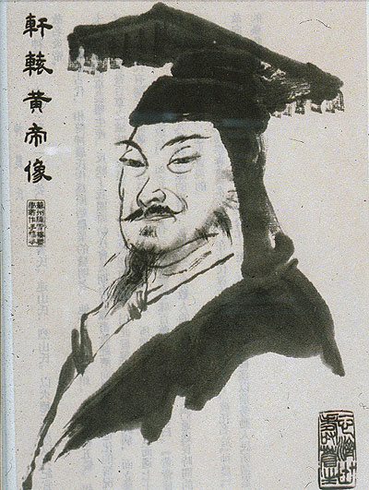
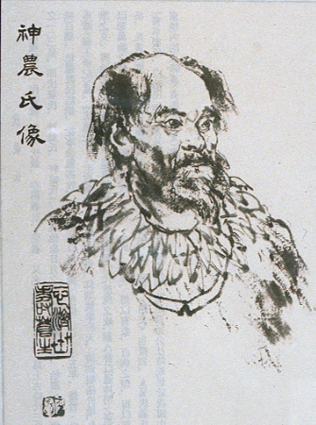
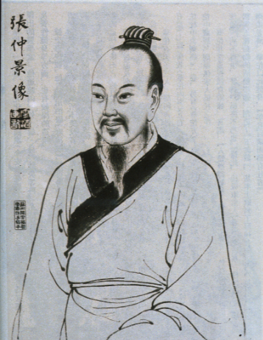
Dynastic Cycles
Mandate of Heaven—rulers of China got approval to rule from God & ruled as families called dynasties

Slide 32
Mandate of Heaven
Heaven = a power that controlled human destiny.
As long as the king governed his people well, Heaven gave him the right to rule.
Heaven would send signs of displeasure (earthquakes, floods)
When the king lost the support of heaven, others had the right to overthrow him.

Slide 34
Ch’in Dynasty (221-202 BCE)
Ch’in Shih Huangdi challenged the Chou (lost mandate of heaven); won & began the Ch’in Dynasty & became the 1st “emperor” (greater than king)
After years of chaos, Ch’in Shih Huangdi used abusive political style to maintain order (executed opponents, book burnings)

Slide 35
Ch’in Dynasty cont…
BUT…left a legacy:
Built Great Wall to keep out barbarians; created network of roads & canals
Set up civil service exams to determine who could work in government
Common writing, weights, measures
Expanded China into an empire

Slide 36
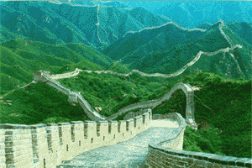

Slide 37
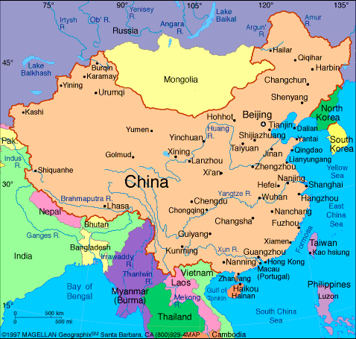
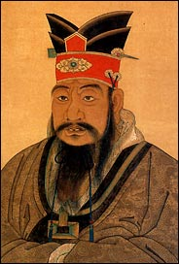

Slide 38
Convince me to visit your favorite early river valley
You have been asked by the ruler of an early river civilization to create a travel brochure for that civilization.
Create a pamphlet that highlights the best of the area you choose
Include what advancements they have made and parts of their culture (5 good and 2 bad)
Draw images of what these civilizations would look like.

