Slide 1
Unit 6: n.c. state and local government

Slide 2
NC General Assembly
Passes laws (called statutes) for the state. Also performs oversight, and can impeach elected officials.
NC Senate: 50 members
- Must be 25 and 2 year citizen of NC
NC House of Representatives: 120 members
- Must be 21 and 1 year NC resident
The state is divided into 120 House districts and 50 Senate districts.
Sessions: when legislators are working in Raleigh
- “Long Session”: in odd years, members meet from Jan-July
- “Short Session”: in even years, members meet from May-Aug

Slide 3
NC Executive Branch
Led by a governor. Our current governor is Roy Cooper.
In most states a person must be 30 years old, a US citizen, and a resident of the state for five years.
Serve a four year term.
Recall: An election where voters can remove state officials (ex. Scott Walker in Wisconsin).
Lieutenant Governor: Takes over for the governor and is head of the state senate. (Is like the Vice Pres. of the state)

Slide 4
Powers of the Governor
Chief Executive, Chief Legislator, Judicial Leader, Commander in Chief, Party Leader, Ceremonial Leader.
As judicial leader a governor can:
Commute: Reduce a sentence.
Parole: Early release from prison.
Extradition: Governor orders a suspect to be returned to the state where the crime was committed.
Can offer pardons and reprieves.
Calls in the National Guard if problems occur in the state.

Slide 5
NC Executive Officials
Most officials are elected by voters.
There is a Council of State, which are elected heads of state agencies in North Carolina that are independent of the governor.
There is also a NC cabinet, where leaders are appointed by the Governor.

Slide 6
Local Executive Government
Mayor-Council government
Separate legislative (city council) and executive (mayor) branches.
There are strong and weak mayor plans. Use common sense -- Strong mayor has more power than weak.
Council-Manager
Voters elect a city council.
City manager runs the city. Appointed by the city council.
If the manager does not do a good job, he can fired by the council.
Commission government
Separate departments led by a commissioner. The commission has executive and legislative powers.

Slide 7
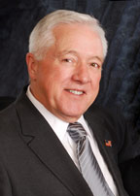
Holly Springs
Holly Springs has a council-manager form of gov’t
5 board members on the city council, plus the mayor, plus a city manager that runs the day-to-day operations.
Responsible for passing town ordinances (local laws); Holly Springs has a code of ordinances.
Dick Sears is the Mayor

Slide 8
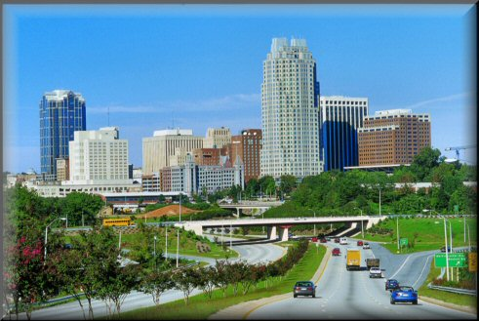
Municipalities
Municipalities: cities, towns, and villages
Provide services that are necessary for people living close together. Ex: street lights, water and sewer service, trash pick up.
Incorporated by the General Assembly: the General Assembly approves the geographic boundaries and charter of the city. A charter is a written document outlining the government of a municipality. It is like a city’s constitution.

Slide 9
Municipalities continued…
Government in Municipalities:
- Municipalities are governed by an elected council called either the city/town council, board of commissioners, or board of aldermen.
- This council makes laws for the municipality. These laws are called ordinances.
- The council is led by a mayor who may be appointed by the council itself or elected by the citizens.
- The board hires a city manager to run the day to day activities of the municipality and enforce the ordinances. The city manager is the Chief Executive of the municipality

Slide 10
NC Counties
There are exactly 100 counties in NC.
Counties carry out the statutes passed by the General Assembly.
They also provide services like public libraries.
Government in counties:
- Run by an elected board of county commissioners. They oversee elections, alcohol distribution, and schools in the county.
- Each county has a Local Education Authority (LEA), aka School Board. The school board operates the public schools in a county.
- The citizens of the county also elect a sheriff who is in charge of law enforcement in the county.

